Slide 1
The NDC Action Project
Climate Finance Training Kit
Background and purpose of the webinars
Supported by:
based on a decision of the German Bundestag

Slide 2
Scope
Concept notes
Concept notes
Agenda
Background: NDC Action project
Supports 10 partner countries to translate their NDCs into concrete strategies and actions ready for financing and implementation
Aims to enable and/or help secure public and private investment in sector specific NDCs
Focuses its support on two priority sectors , to be selected by each partner country
NDC ACTION PROJECT | Facilitating the implementation of climate-resilient and low-carbon development aligned with national and global goals

Slide 3
Team
Scope
Concept notes
Concept notes
Agenda
Background: NDC Action project
Duration: 4 years (2020 - 2024)
Funded by the IKI programme of the German Federal Ministry for the Environment (BMU)
UNEP implementating agency, technical support from UNEP-CCC
Builds on three core principles:
Country ownership
Balanced focus on adaptation and mitigation
Integration of national development and climate change priorities
NDC ACTION PROJECT | Facilitating the implementation of climate-resilient and low-carbon development aligned with national and global goals

Slide 4
OVERVIEW
Outcome & outputs
Partner countries
Partnerships & SYNERGIES
Contact
Background: NDC Action project
Outcome: Partner countries are applying a systematic approach to using policies and economic instruments that drives public and private investment in NDC implementation.
Outputs:
Expected outcome and outputs
1
2
3
4
Partner institutions are leading NDC implementation and driving more ambitious NDCs with the engagement and support of relevant national stakeholders.
Relevant actors have the knowledge on policies and programmes needed to drive NDC implementation in the priority mitigation and/or adaptation sectors.
Financial institutions are engaged in the development of climate-friendly investment plans and proposals led by governments
Experiences and lessons learned are shared among partner countries and beyond, creating a foundation for enhanced ambition.
NDC ACTION PROJECT | Facilitating the implementation of climate-resilient and low-carbon development aligned with national and global goals

Slide 5
OVERVIEW
Outcome & outputs
Partner countries
Partnerships & SYNERGIES
Contact
Background: NDC Action project
Outcome: Partner countries are applying a systematic approach to using policies and economic instruments that drives public and private investment in NDC implementation.
Outputs:
Expected outcome and outputs
1
2
3
4
Partner institutions are leading NDC implementation and driving more ambitious NDCs with the engagement and support of relevant national stakeholders.
Relevant actors have the knowledge on policies and programmes needed to drive NDC implementation in the priority mitigation and/or adaptation sectors.
Financial institutions are engaged in the development of climate-friendly investment plans and proposals led by governments
Experiences and lessons learned are shared among partner countries and beyond, creating a foundation for enhanced ambition.
NDC ACTION PROJECT | Facilitating the implementation of climate-resilient and low-carbon development aligned with national and global goals

Slide 6
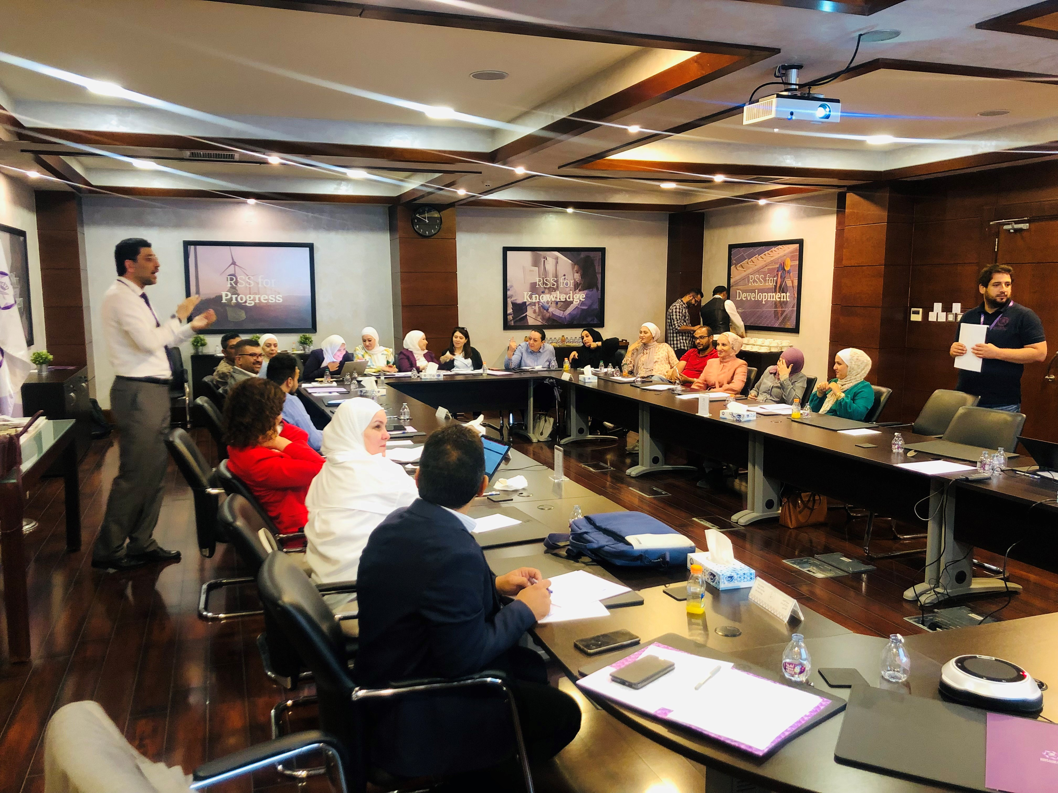
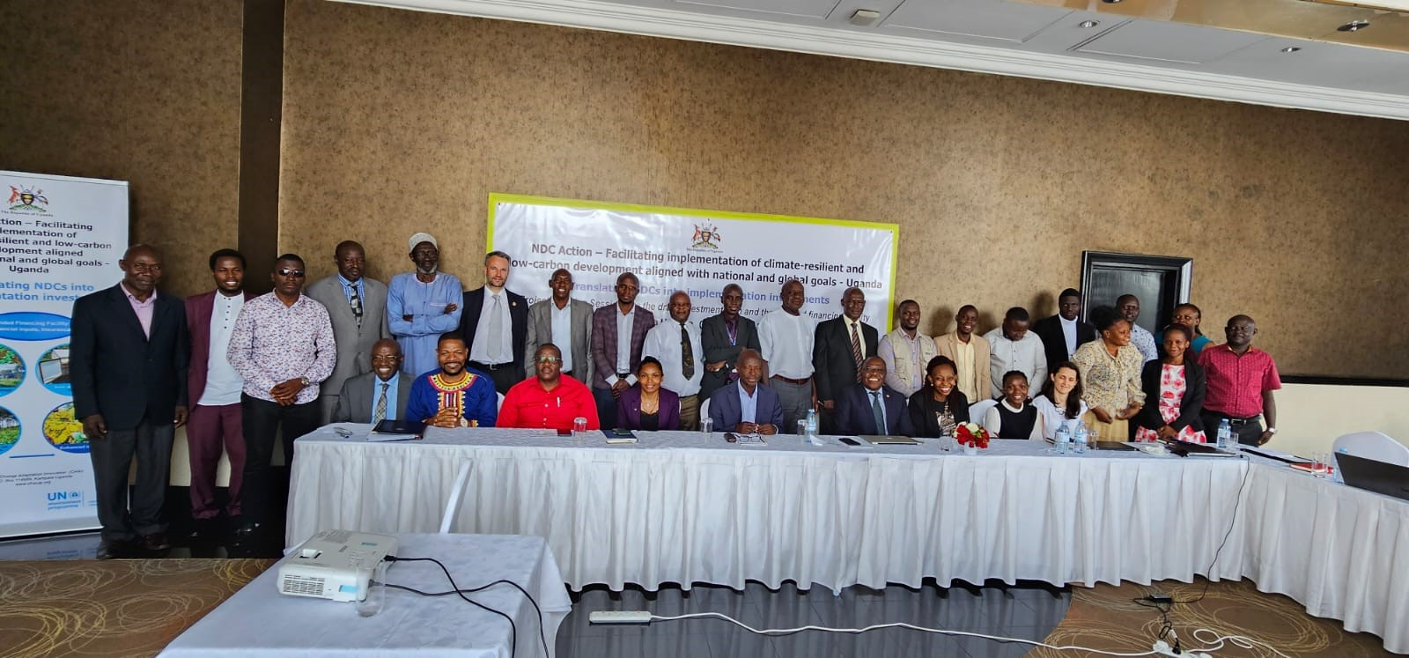
Purpose of the NDC financing webinars
Primary target audience is the National Technical Institutes and Government officials participating in the NDC Action project, but also of relevance to wider stakeholders (within and beyond the project)
NDC ACTION PROJECT | Facilitating the implementation of climate-resilient and low-carbon development aligned with national and global goals
Notes:
Focus on role and importance of global climate finance, how to access this to help overcome key barriers to climate technology uptake and market expansion and de-risk and/or unlock other sources of capital investment (including national public and private finance)

Slide 7
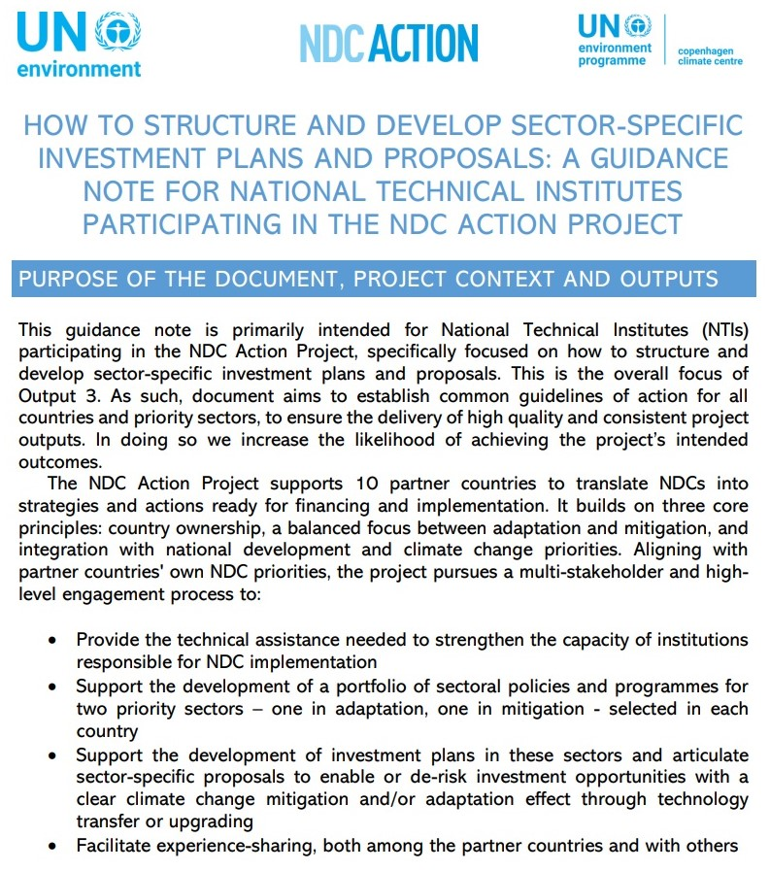
Concept notes
Agenda
Published guidance for NDC Action countries
This webinar is a complement to the technical guidance published by UNEP-CCC in January 2023, available online: https://www.unep.org/ndc/resources/toolkit-manual-and-guide/how-structure-and-develop-sector-specific-investment-plans-and
NDC ACTION PROJECT | Facilitating the implementation of climate-resilient and low-carbon development aligned with national and global goals

Slide 8
OVERVIEW
Outcome & outputs
Partnerships & SYNERGIES
Contact
5
Content
3
Financial structuring Scope Mapping sources of finance Operational instruments Fiscal reform
Barrier analysis and Theory of Change Barriers Translating barriers into action Theory of Change Log Frame
1
Introduction to climate finance Defining climate finance Flows and sources Financial instruments Central financial principles
Partner countries
6
Addressing financial and operational risks Project risks vs barriers Risk and risk mitigation Financial risks Operational Risks
4
Budgeting principles and CBA analysis​ Information requested by donors Cost Benefit Analysis Mapping costs and benefits Timewise overview of cash flows Central financial indicators Examples Sensitivity analysis
2
Climate impact scenarios Climate rationale Baselines and BAU scenarios Impacts
7
Transformational Change and ​Sustainable Development impacts Transformational change Theory of Change Examples
NDC ACTION PROJECT | Facilitating the implementation of climate-resilient and low-carbon development aligned with national and global goals
Notes:
The webinar is structured in 7 different presentations:
We start by introducing general aspects of climate finance, the different definitions, sources and flows of global climate finance and the relevant key financial principles when presenting a proposal to potential investors.
The second will cover the approach to presenting climate impacts and climate impact scenarios, how to present the climate rationale for mitigation and adaptation proposals, how to communicate baselines and business-as-usual scenarios
The third presentation covers the importance of understanding the barriers preventing investments in low carbon development or climate resilient technologies, and how performing and structuring a barrier analysis can be used to define the actions, construct a theory of change and provide the overall rationale for the proposal.
The fourth presentation covers the expected costs and benefits of a proposal, the overview of cash flows, how to apply central financial indicators, and assess the financial robustness and identify potential risks through a sensitivity analysis.
The fifth presentation introduces the concept of financial structuring, the engineering of multiple financial sources and instruments in order to bring concepts from feasibility to bankability.
The sixth presentation will describe how risks should be presented and addressed in project proposals, how risks can be identified and classified, and which financial instruments can be applied to alleviate risks and attract investment.
Finally, the last presentation will cover additional impact categories including the concept of transformational change or otherwise known as paradigm shift, and how to include this in a Theory of Change.

