Slide 1

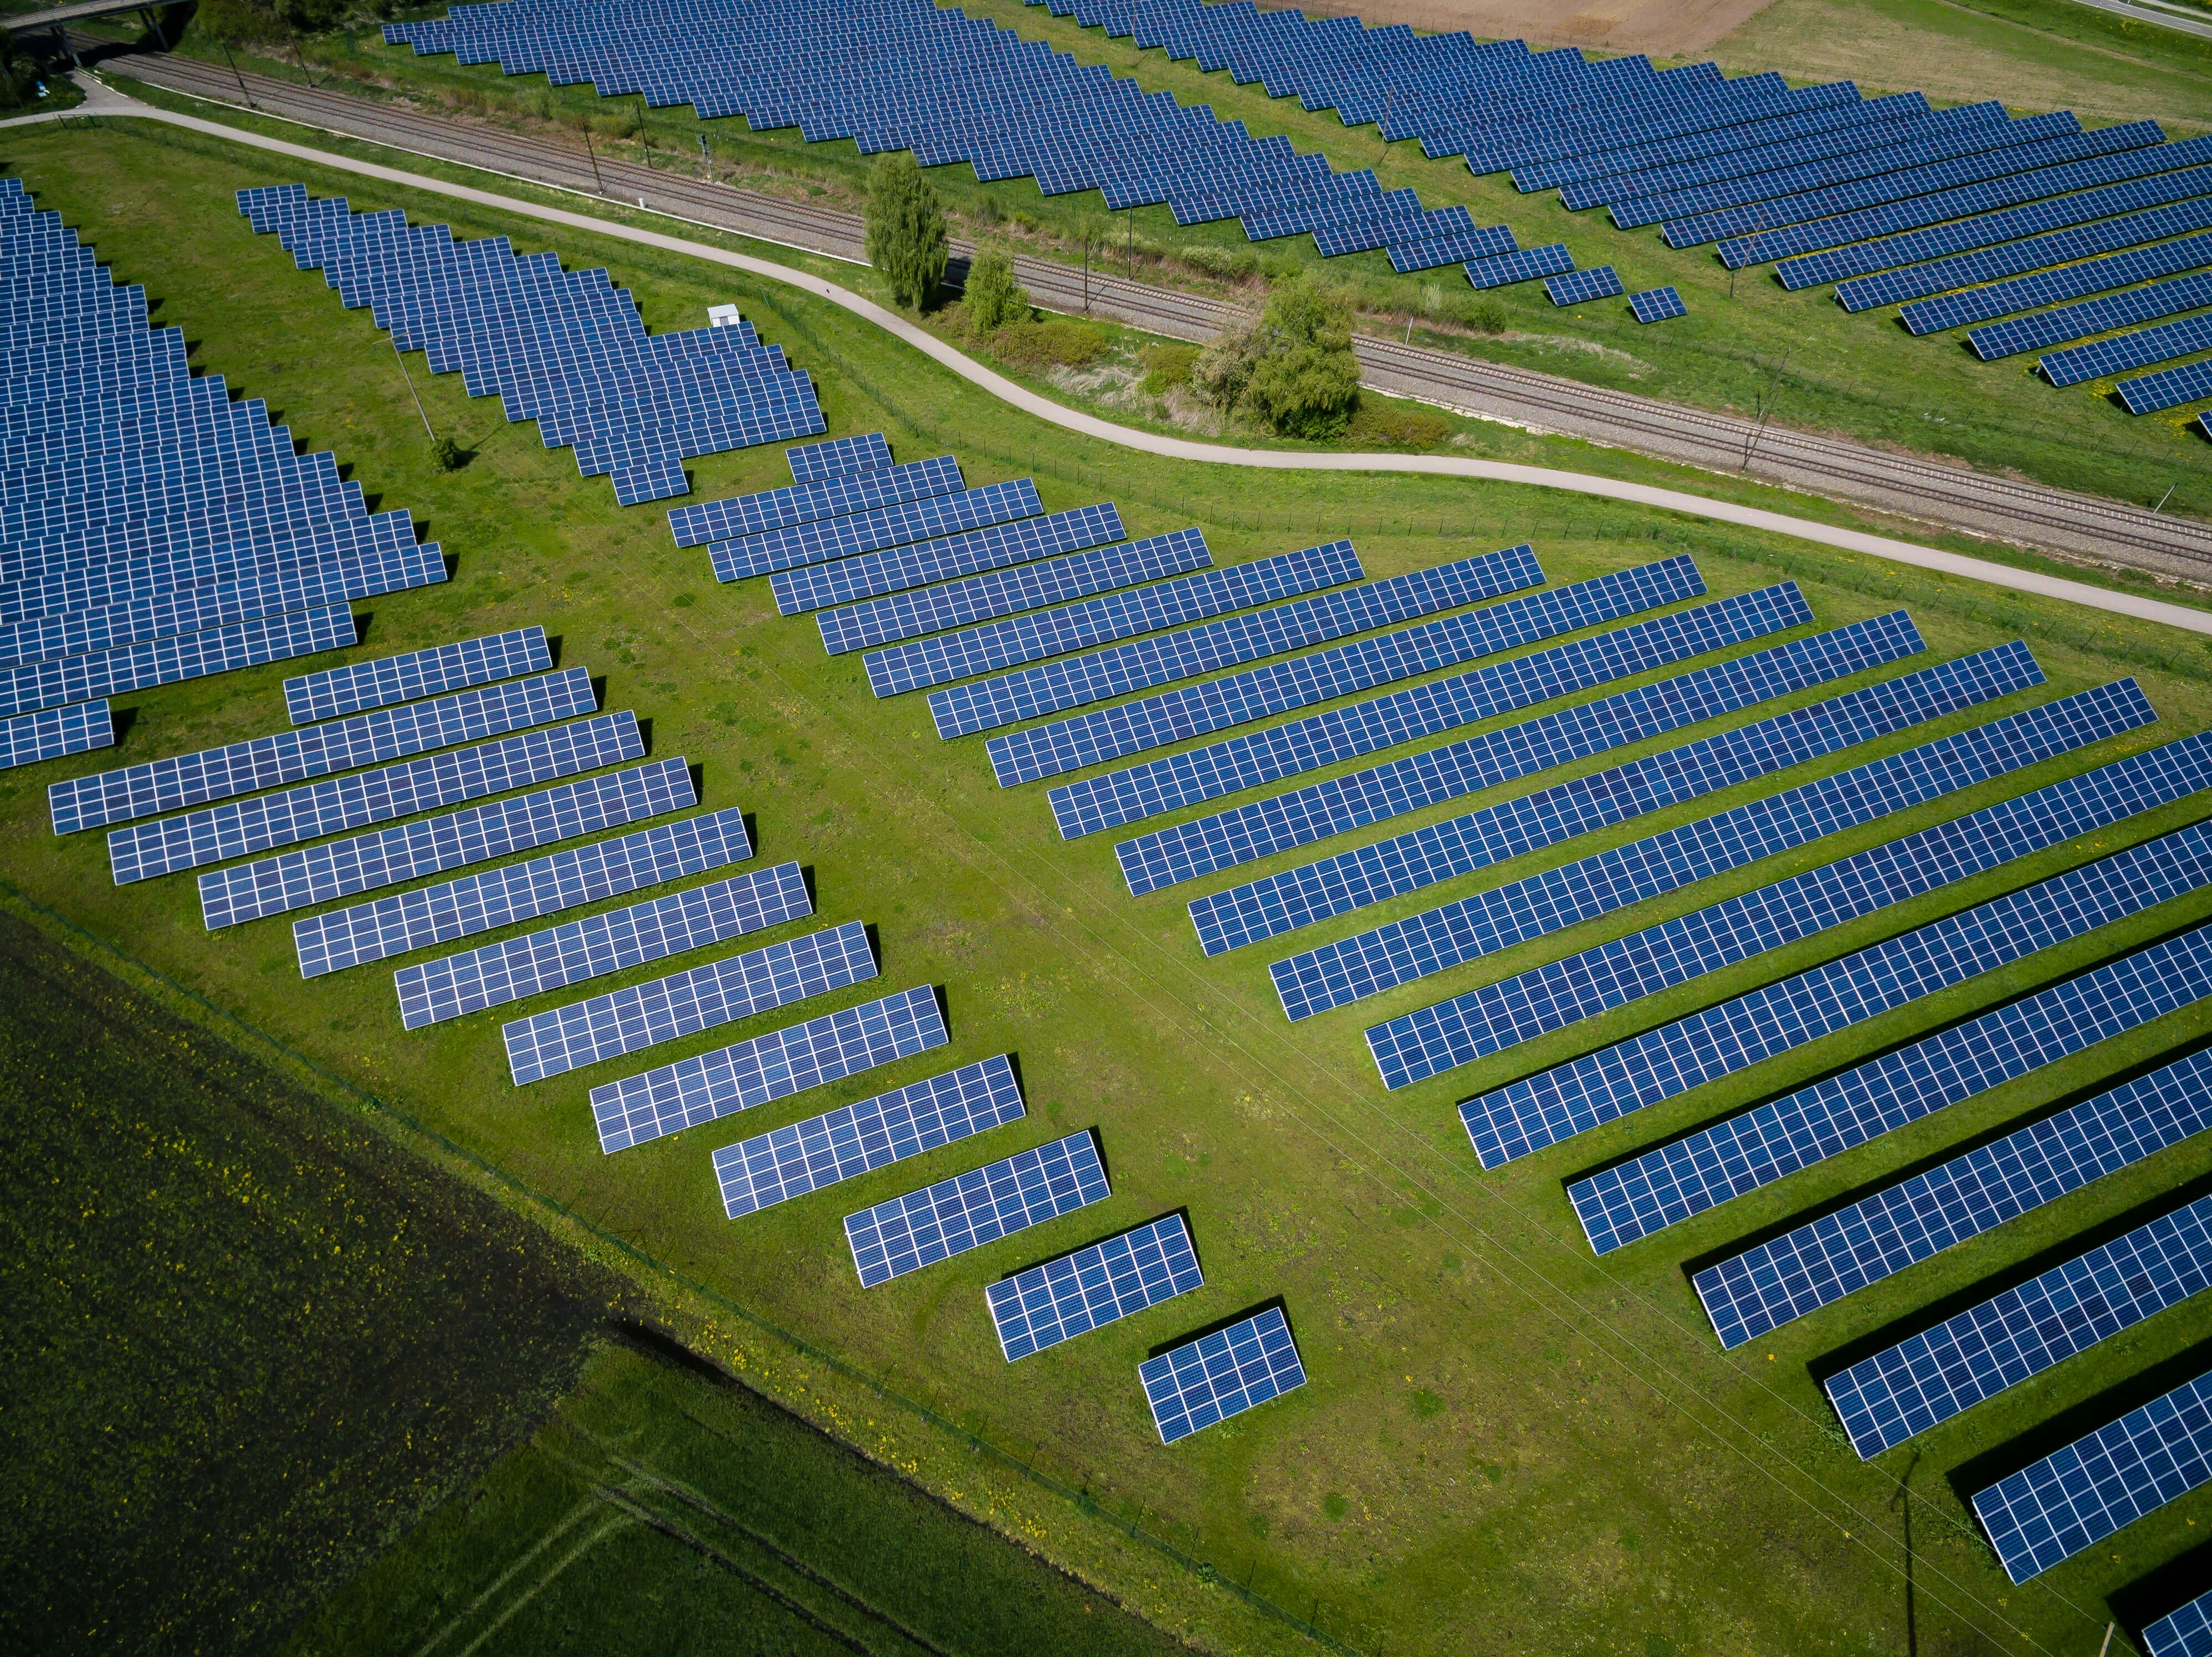
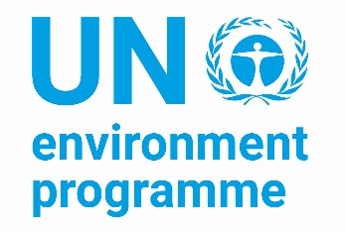
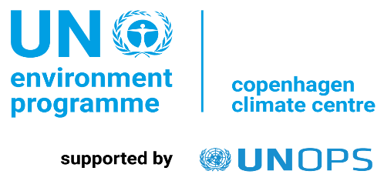

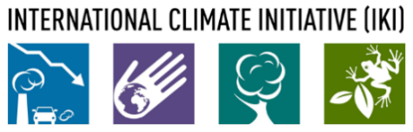
The NDC Action Project
Climate Finance Training Kit
Addressing financial and operational risks
Supported by:
based on a decision of the German Bundestag
Notes:
Thank you for joining again! In this session, we will discuss how to address financial and operational risks.
We will look at financial and operational risks from two lenses.
We will discuss how financial and operational risks should be accounted for in the design of a project in order to implement risk mitigation measures early on and improve the chances of success of a project. Estimating, addressing and mitigating risk is a requirement of many financiers to even consider investment projects for this very good reason.
Secondly, we will look into financial instruments that serve to reduce or cover for risks and thus allow for the implementation of climate action.
Let’s start!

Slide 2



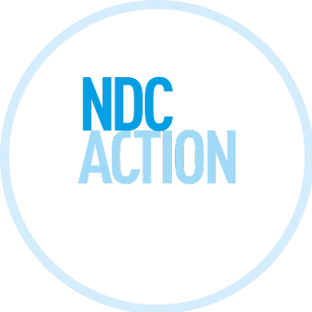
Defining risk
Project
Risk
Financial risk
Operational risk
Example
A project risk is an uncertain event that may occur during a project that may affect the intended project outcome.
Contrary to our everyday idea of what “risk” means, a project risk could have either a negative or a positive effect on progress towards project objectives.
Negative impact
Positive impact
NDC ACTION PROJECT | Facilitating the implementation of climate-resilient and low-carbon development aligned with national and global goals
Notes:
A project risk is an uncertain event that may or may not occur during a project and that may affect the intended project outcome.
While the word risk has a negative connotation, a project risk materializing could also have positive effects at the project outcome. Either way, it serves us well to try and account for project risks in the project design, estimate their likelihood and impact and include risk mitigators.

Slide 3
Project Risk versus Barrier
Project
Risk
Financial risk
Operational risk
Example
Project risk and barrier are not the same
Status Quo: High Carbon Lock-in
Future: Low Carbon Climate Resilient Development
Embeddedness into local policies
Barriers
Enabling Environments
Project risks
Project / intervention
NDC ACTION PROJECT | Facilitating the implementation of climate-resilient and low-carbon development aligned with national and global goals
Notes:
At this stage, it is important to state that project risks and barriers are not the same.
Barriers are what keeps us tethered to the status quo. What keeps the needed investments into a low-carbon and climate resilient economy from happening. We conduct the project, the intervention to overcome the barrier. If the project is fulfilling its intended output, the barrier is overcome – at least in the limited context of the project’s remit.
But even though a barriers is overcome, of course, project risks are there. Project risk is the deviation of the intended project outcome.

Slide 4
Project
Risk
Financial risk
Operational risk
Example
Risk mitigation
The Climate Policy Initiative (CPI) 2013: "currently, gaps in risk coverage hinder renewable energy investments. Risk — whether real or perceived — is the single most important factor preventing renewable energy projects from finding financial investors or raising the returns that these investors demand. It is also one thing that policymakers can cause, control, alleviate, or help mitigate."
NDC ACTION PROJECT | Facilitating the implementation of climate-resilient and low-carbon development aligned with national and global goals
Notes:
But risk is also something to address in overcoming barrier to climate action. If a technology is riskier or is even perceived as riskier than traditional technologies that will affect their uptake. If investments into climate actions include or are perceived to include risks, they may not find financing or only find financing at less advantageous conditions.
Here we have an insight from the Climate Policy Initiative on renewable energy investments from the year 2013. In 2013, the cost for renewable energy technology such as wind and solar power was already in decline and the cost have decreased further since. But what is pointed out here is that the risks associated with them were the single most important factor in holding back more investments into these technologies. It further underscores that policy makers can help mitigate risk and risk perception by investors.
This is an example of technology risk. What other risks are relevant to our efforts? Let’s discuss the different risk categories.

Slide 5
Risk categories
Project
Risk
Financial risk
Operational risk
Example
Country (political decisions, currency, debt)
Policy and Regulatory (change in laws and regulations)
Technological (technology failure)
Operational and Performance (internal operations)
Climate and Environmental (external factors)
Financial (credit, liquidity, equity)
Legal (failure to comply with law)
…
NDC ACTION PROJECT | Facilitating the implementation of climate-resilient and low-carbon development aligned with national and global goals
Notes:
Here we find risk categories.
Country risks include the risks that political decisions or macroeconomic development relating to exchange rates, currency stability and debt affect the project outcome.
Policy and Regulatory Risk are another risk category. Climate projects often rely on favorable government policies and regulations to receive incentives, subsidies, or support. Changes in these policies or regulations can impact project economics and viability. Projects may become less attractive or even financially unfeasible if government support is reduced or withdrawn.
Technological Risk: Many climate projects involve the deployment of innovative and sometimes unproven technologies, or new to the local context and relevant stakeholders. The perceived risks especially from financial stakeholders is that these technologies may face unexpected technical challenges, delays, or even failures, leading to cost overruns and operational disruptions.
Operational and Performance Risk: The long-term success of climate projects depends on their operational efficiency and effectiveness. Technical issues, inadequate maintenance, or underperformance compared to projected outcomes can undermine the financial sustainability of the project.
Climate and Environmental Risk: Indeed, climate projects themselves can be exposed to climate-related risks, such as extreme weather events, sea level rise, and changing environmental conditions. These risks can damage project infrastructure, disrupt operations, and lead to additional unplanned expenses. The impacts of climate change on climate-relevant infrastructure can be sudden and can be gradual. Hydropower, for example, in many locations is vulnerable to climate change’s impact on the water cycle. This is an example of gradual impact.
Financial risks: Climate projects often require significant upfront investment. Securing adequate funding and financing can be challenging, and if funding sources dry up or financing terms become unfavorable, projects could face delays or cancellations. Also, complex climate projects can be prone to cost overruns due to unexpected expenses, changes in project scope, or underestimated initial budgets. These overruns can strain project finances and delay completion.
To mitigate these risks, comprehensive risk assessment and management strategies are crucial. This involves identifying potential risks, evaluating their potential impact, and developing contingency plans to address them. Diversifying funding sources, using proven technologies, maintaining close alignment with regulations, and considering the long-term resilience of the project can all contribute to minimizing the financial and operational risks associated with climate projects.

Slide 6
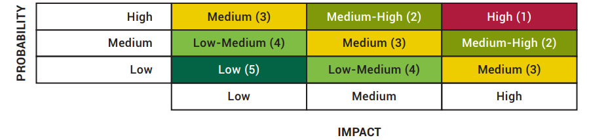
Categorising risk severity
Project
Risk
Financial risk
Operational risk
Example
We grade Probability and Impact for each risk in a matrix
NDC ACTION PROJECT | Facilitating the implementation of climate-resilient and low-carbon development aligned with national and global goals
Notes:
In your project design, the use of a so-called risk matrix helps to map risks. In fact, for many funding opportunities, the inclusion of such a risk matrix is required. Risks of various natures are assessed first for the probability of the risk materializing, and then for the impact that they have in the event of materializing. The product of both factors allows us to assess risks in terms of their severity. Risks that have both a high probability of occurring and a high impact should be prioritized in risk mitigation.
Walking through risks one by one and including risk mitigating strategies allows for forward-looking planning and better project design.
Let’s walk through two examples to illustrate risks.

Slide 7
Risk in a project
Project
Risk
Financial risk
Operational risk
Example
Example of an energy project
Does it address the defined need?
Is it technically doable and does it involve appropriate technology?
Does it integrate with existing systems? (grid, consumption)
Does it deliver the expected output?
Does it serve the people for whom it’s intended? (consumers)
Does it comply with existing laws & regulations?
Does it have adverse effects on environment?
Does it conflict with other goals?
Who charges the customers – and who pays if they don’t?
...
NDC ACTION PROJECT | Facilitating the implementation of climate-resilient and low-carbon development aligned with national and global goals
Notes:
Our first example is an energy project. Let’s say an on-shore wind power project.
When listing risks for the risk matrix, it helps to think through a projects intended purpose and outcome, its construction and its operation. Even without engineering knowledge, it helps to walk through a number of questions on these aspects.
When assessing whether our project addresses the defined need, we can browse public policies and plans. Many countries have specific growth targets for wind power or even prioritized regions for the construction of wind power projects. Licenses for the development of wind power projects may be auctioned off by the government or a regulator.
Technology risk is a risk to mitigate. How? To reduce technology risk, an in-depth feasibility study can produce clear terms and standards for eligible technologies that project developers can oblige by. This solves the question “Is it technically doable and does it involve appropriate technology?”. Such a feasibility analysis can also include the potential of our wind power project to integrate with existing systems, especially the power grid. Forecasts on consumption and data on capacity and discharge rates give indication in this regard.
The expected output of our wind power project will be its performance in terms of Megawatt Hours produced by a specified time. The specified time is the end of the construction and ramp up period. A construction delay, is a typical project risk that affects the output and thus the intended outcome of the project. This is something that a risk matrix would certainly include. Project performance is also a product of other factors – some more foreseeable than others. Wind speed, the timing of scheduled and unscheduled interruption, for example for maintenance, and the like.
Does it serve the people for whom it’s intended? (consumers)
Does it comply with existing laws & regulations? Does it have adverse effects on environment?
Does it conflict with other goals?
Who charges the customers – and who pays if they don’t?
These and other questions need to be considered.

Slide 8
How certain are the following?
Project
Risk
Financial risk
Operational risk
Example
District heating example
Price of district heating plant
Reconstruction costs at plant
Rehabilitation costs of distribution network
Retrofitting costs in housing blocks
Who pays for metering?
Who charges the customers?
How much? – i.e. the price of heating
Who pays if they don’t? – the right to shut off
The price of fuel
The price of work force – can you lay off?
The price of finance
Subsidies? (local, national, bilateral, multilateral…)
NDC ACTION PROJECT | Facilitating the implementation of climate-resilient and low-carbon development aligned with national and global goals
Notes:
A similar process and logic can be applied to projects in other sectors. For a district heating, project risks can be listed in the risk matrix and assessed in terms of probability and expected impact by thinking through uncertainties surrounding any of the following:
Price of district heating plant
Reconstruction costs at plant
Rehabilitation costs of distribution network
Retrofitting costs in housing blocks
Who pays for metering?
Who charges the customers?
How much? – i.e. the price of heating
Who pays if they don’t? – the right to shut off
The price of fuel
The price of work force – can you lay off?
The price of finance
Subsidies? (local, national, bilateral, multilateral…)

Slide 9
Take home point
Project
Risk
Financial risk
Operational risk
Example
It’s not about money – it’s all about risk
You can’t mitigate risk with high returns
Take every imaginable risk and mitigate it through
  Contracts
  Financial engineering (e.g. classic currency)
  Guarantees (Export Credit Agencies)
Risks outside of the project’s control (e.g. Political risks) not easy mitigate, consider response measures if they materialize
Then you take it to the bank
NDC ACTION PROJECT | Facilitating the implementation of climate-resilient and low-carbon development aligned with national and global goals
Notes:
The important take away from what we discussed so far is – it is not about money, it is about risk.
Risk mitigators need to be included in your project design to gain financing. You cannot mitigate risk with higher returns as some risks are simply unacceptable to the mostly risk-averse financial institutions that provide this finance.
Thus, take every imaginable risk and mitigate it through. And when looking for risk mitigators, consider wide-ranging options. It helps to take an inter-disciplinary approach here. Of course, one option is to include covenants in contracts that result in mitigated risks. That transfer the risk to other parties, for example. This is a legal option to mitigate risks. Off taker agreements in project finance, for instance, are quite common in the energy sector and secure against risk of failing demand or lower-than-expected price. An offtake agreement is a legally binding contract between a producer, say, of renewable energy and a buyer to purchase or sell portions of the produced good. Typically negotiated well before construction, it locks in demand and price for energy produced in the future.
Another option is to seek financial cover. In development cooperation, currency risk is typically something that developing country partners face when borrowing in currencies other than their home currencies, like Euros or USD. Changes in foreign exchange rates can result in a mismatch between revenues denominated in local currency and interest and principal expenses denominated in another currency. One option is to seek borrowing in local currency. This is provided in some cases by multilateral development banks.
Another option is to seek coverage for risks through a guarantee by export credit agencies. Besides currency risk, ECAs often also cover other political risks such as expropriation, payment moratoriums imposed by governments, or civil unrest.
All these are risk mitigators. And they are helpful as some risks are simply beyond a project’s control.
With your risks assessed and mitigated, finding financing will be easier.

Slide 10
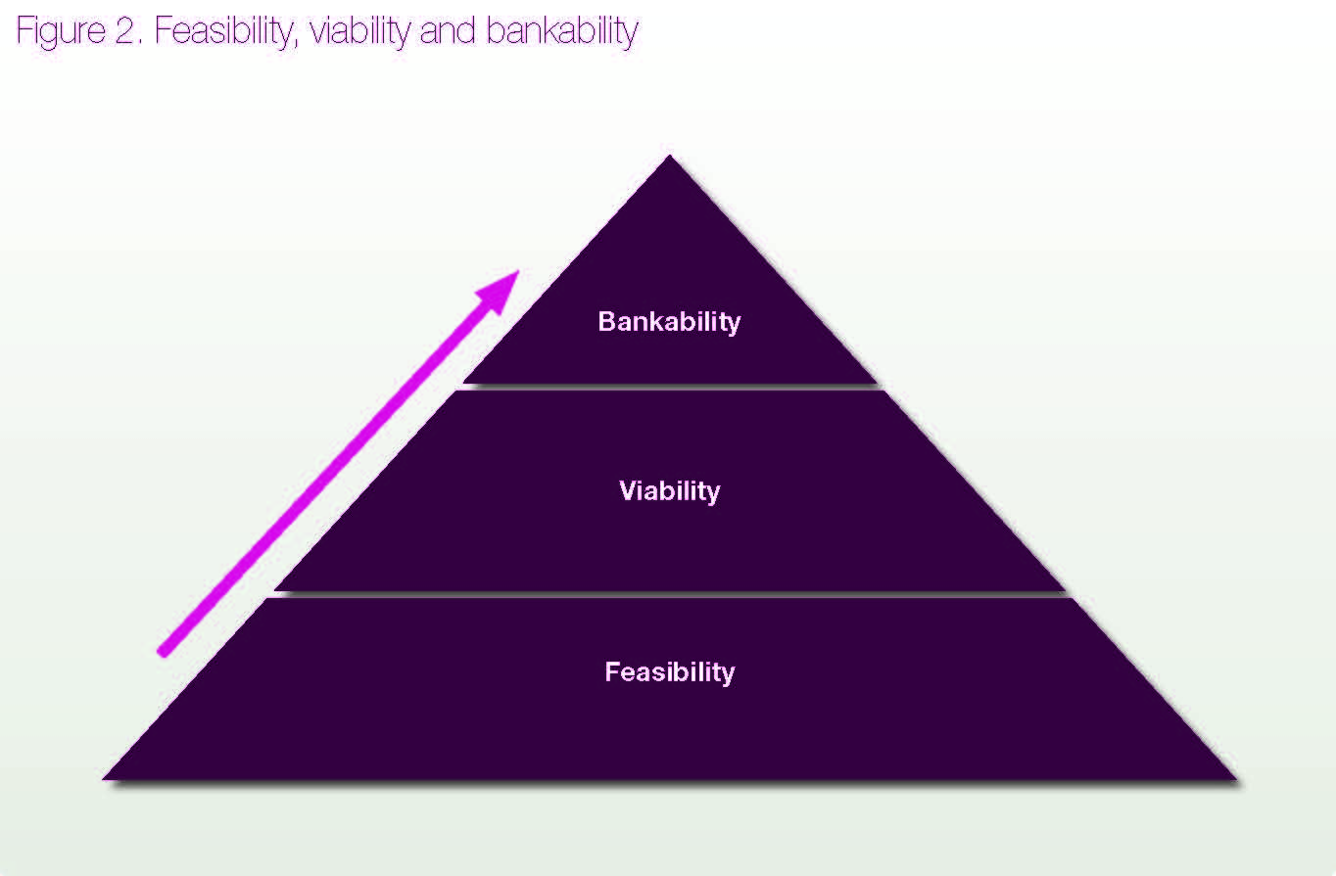
Project
Risk
Financial risk
Operational risk
Example
Risk from a project finance perspective
risk
NDC ACTION PROJECT | Facilitating the implementation of climate-resilient and low-carbon development aligned with national and global goals
Notes:
Now let’s look into financial risk specifically. In this part of the session, we will discuss financial risk and what instruments we can use to cover for this financial risk.
To do this, it will help us to discuss a couple of project finance concept and terms first. When we refer to the bankability of a project, what do we mean? And how does this differ from other terms such as feasibility and viability?
‘Feasible' refers to projects that are technically and politically doable, basically disregarding the cost or making assumptions about the cost that justifies undertaking a study of the project’s feasibility.
'Viable' projects are feasible projects that, under realistic assumptions, produce acceptable returns on investment as determined by the investor.
But a project is 'bankable' only if such returns are produced with a sufficient level of certainty as perceived by third-party financiers, typically banks, and if they are convinced that the project can service the debt. And here is where financial risk comes in. Most financial structuring is about comforting the financiers, it is about the latter. And to attain bankability of a project we need to minimize risk, which is no small feat as high risk or high risk perception drives the high cost of financing in developing countries.
Let’s look into this more closely.

Slide 11
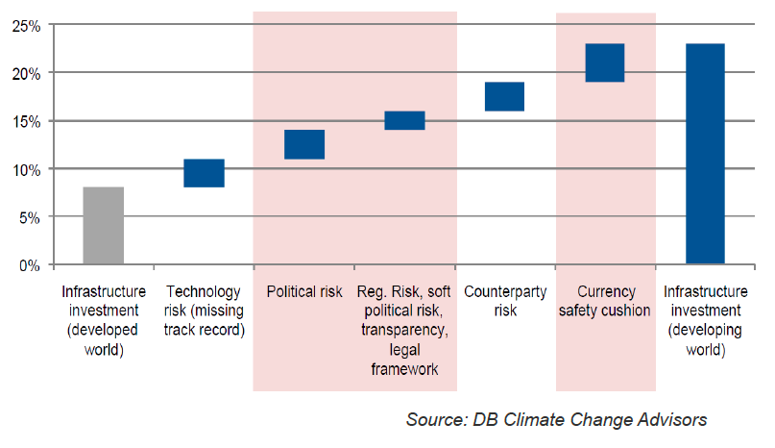
Cost of Types of Risk
Project
Risk
Financial risk
Operational risk
Example
NDC ACTION PROJECT | Facilitating the implementation of climate-resilient and low-carbon development aligned with national and global goals
Notes:
This chart illuminates how cost of additional risk cover for infrastructure investments in the developing world are composed – and why they exceed the cost of the same infrastructure in the developed world. The source is DB climate Change Advisors.
Technology risk is prevalent in the event that the technology has no track record. Fair enough. But what about the other risks associated with developing countries that drive the financing cost. Political risk must be covered – usually in the form of higher interest rates. Currency risk might result in the demand for higher rates, and so on.
As you can see, risk cover boosts the cost of capital in developing countries significantly leading one to conclude that there is need for a mitigation of these financial risks – for example, in the form of guarantees – to cut the cost.

Slide 12
Financial Instruments
Project
Risk
Financial risk
Operational risk
Example
NDC ACTION PROJECT | Facilitating the implementation of climate-resilient and low-carbon development aligned with national and global goals
Notes:
Among the financial and insurance products we discussed earlier in this training, let’s look into more detail into a few that seek to cover for financial risk.
In this table, you see a number of financing tools and instruments ranging from public sector instruments to source investments to operational instruments used by the public sector to private sector financing instruments. Let’s focus on the once highlighted in red as these serve to cover for the financial risk we are discussing.
Risk cover instruments and guarantees provided by public sources can mitigate the financial risks of projects significantly. Provision of guarantees reduces the cost of financing
Several instruments provided by either the public or the private sector, most often in the form of insurances against certain events. Governments will typically be providing political (policy) guarantees, government agencies may be insuring such guarantees; private-sector entities may be providing technical (technology) risk cover. Guarantees (except government guarantees) are paid for like an insurance policy.
Typical providers include export credit agencies, insurance companies, banks, governments, and sometimes technology suppliers.
For example, the United States' Overseas Private Investment Corporation (OPIC) has pioneered a feed-in-tariff insurance product which provides policy risk coverage in developing countries, but these are unavailable to domestic investors.

Slide 13
Risk hierarchy – an entertaining example
Project
Risk
Financial risk
Operational risk
Example
NDC ACTION PROJECT | Facilitating the implementation of climate-resilient and low-carbon development aligned with national and global goals
Notes:
Now that we have discussed financial risk and what instruments to use to mitigate project risk, let’s clarify one thing.
Risk management consists not least in an appropriate understanding of a risk hierarchy, as this entertaining example should show. Here we have a valuable wind turbine in a perilous location. Of course, you could place it there and try and seek a financial guarantee in case a physical hazard make your wind turbine ineffective. But you are unlikely to succeed. What could happen?

Slide 14
Risk hierarchy
Project
Risk
Financial risk
Operational risk
Example
avoid
insure
manage
NDC ACTION PROJECT | Facilitating the implementation of climate-resilient and low-carbon development aligned with national and global goals
Notes:
Rather than placing the project in a perilous location, let’s seek to avoid risks like this early. Then, as a next step, let’s seek to insure our project against them, and then adopt a risk management approach that mitigates risks further.

Slide 15
Operational Risks
Project
Risk
Financial risk
Operational risk
Example
Projects in different sectors have different risk profiles:
  Normally, pure privatization of existing infrastructure with a known history and position in the market have a more easily predictable risk profile and are therefore easier to finance than greenfield projects.
  Similarly, for the replication of a pilot project, risks are more predictable, and thus easier to mitigate.
  It may also be easier to attract commercial debt for energy supply projects than for road projects, because traffic forecasting is more difficult than predictions of power consumption
Actual risk and perceived risk is far from the same. The larger the gap the better the chances to offer affordable risk cover products
NDC ACTION PROJECT | Facilitating the implementation of climate-resilient and low-carbon development aligned with national and global goals
Notes:
Projects in different sectors have different risk profiles:
Normally, pure privatization of existing infrastructure with a known history and position in the market have a more easily predictable risk profile and are therefore easier to finance than greenfield projects.
Similarly, for the replication of a pilot project, risks are more predictable, and thus easier to mitigate.
It may also be easier to attract commercial debt for energy supply projects than for road projects, because traffic forecasting is more difficult than predictions of power consumption
Actual risk and perceived risk is far from the same. The larger the gap the better the chances to offer affordable risk cover products

Slide 16
Risk cannot always be fully mitigated
Project
Risk
Financial risk
Operational risk
Example
Some gaps in risk cover are:
  Investment guarantees for local investors (no access to ECAs)
  Public sector breach of contract
  Feed-in tariffs with private stakeholders
NDC ACTION PROJECT | Facilitating the implementation of climate-resilient and low-carbon development aligned with national and global goals
Notes:
Risk cannot always be fully mitigated.
Even in the landscape of donor-supported or publicly supported instruments, there are gaps. There is a lack of investment guarantees for local investors. While foreign investors in developing countries may have access to guarantees through their export credit agencies, local investors may not have the same benefit. A Danish company interested in undertaking a wind power project in a developing country has the option to seek cover for the regulatory risk from the Danish export credit agency. But local investors may have no equivalent source of risk cover.
Public sector breach of contract is a risk that is hard to mitigate. Of course there are sources to cover for political risks, like the World Bank’s Multilateral Investment Guarantee Agency. Their Breach of Contract coverage offers shield against losses stemming from a government’s breach or repudiation of a contract. This could be, for instance, a concession or a power purchase agreement that is broken. In certain circumstances, such coverage may be extended to the contractual obligations of state-owned enterprises and in other cases it may not.
Also, we should state here that for some risks the cost of risk mitigation is too high.

Slide 17
Project
Risk
Financial risk
Operational risk
Example
Risk Management
Green Climate Fund example
NDC ACTION PROJECT | Facilitating the implementation of climate-resilient and low-carbon development aligned with national and global goals
Notes:
In order to illustrate how risk management works in practice in your effort to gain financing for your project, let’s study the Green Climate Fund (GCF) as an example. It has pretty sophisticated risk management procedures and therefore it makes for a good example.

Slide 18
Basic thinking of climate funds on risk – GCF example
Project
Risk
Financial risk
Operational risk
Example
On the one hand:
GCF is explicitly risk willing
GCF seeks to de-risk climate investments, ie transfer the risk of investments from unwilling investor to GCF, thereby attracting investors and enabling the investment to take place
On the other hand:
GCF has high integrity and zero tolerance for prohibited practices etc.
Risk management practices, including at the project level
NDC ACTION PROJECT | Facilitating the implementation of climate-resilient and low-carbon development aligned with national and global goals
Notes:
Like other climate funds, GCF is explicitly willing to accept many kinds of risk – technology risk, political risk, and so on – in order to demonstrate, say, the bankability of an innovative financial mechanism, the viability of a new business model, or the feasibility of a solution that should be demonstrated in a certain context.
GCF seeks to de-risk climate investments, that is, to transfer the risk of investments from unwilling investor to GCF, thereby attracting investors and enabling the investment to take place. GCF seeks to overcome the barrier of lack of access to finance by accepting risk. It is capitalized to do just that.
On the other hands, GCF seeks to minimize risk in two important aspects. GCF has high integrity standards and zero tolerance for prohibited practices. This is, amongst others, to reduce reputational risk, ensure continuity of its operation, and also to safeguard that it is pursuing its mission. Its risk appetite statement of 2017 relays as much.
Another aspect is that GCF has a risk management policy practices, including at the project level. In order to achieve the Fund’s sizeable impact and promote the often-mentioned paradigm shift, the Fund is willing to accept considerable uncertainties around investment risks in return for impact. But in order to demonstrate what we mentioned – say, the bankability of an innovative financial mechanism or the viability of a new business model – the Fund is well served to include risk assessment and management practices that ensure the best conditions to achieve impact.

Slide 19
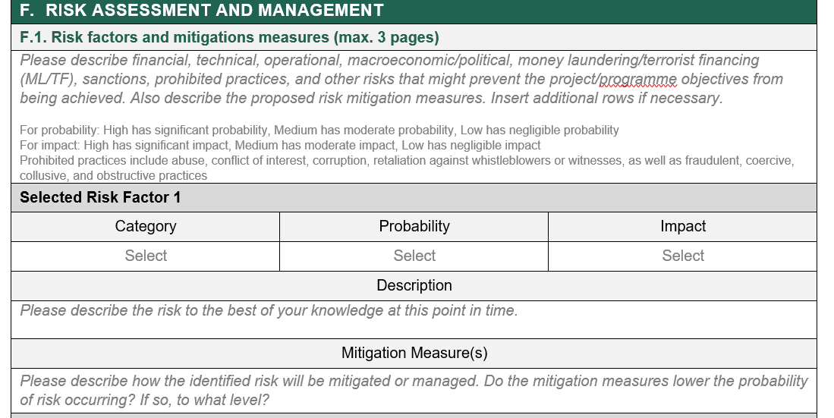
GCF concept note and funding proposal on risks
Project
Risk
Financial risk
Operational risk
Example
Concept note: "Please provide a brief overview of the key financial and operational risks and any mitigation measures identified at this stage".
Funding Proposal: (much more guidance in manual)
NDC ACTION PROJECT | Facilitating the implementation of climate-resilient and low-carbon development aligned with national and global goals
Notes:
Both in the concept note stage that precedes actual funding proposals and in the actual funding proposals, applicants are required to discuss risks.
In the concept note, a brief overview of key financial and operational risks and any mitigation measures identified at this stage will suffice.
For the funding proposal, a detailed look at risks per category their probability and impact and risk mitigation measures have to be discussed. As you can see, this format consists in the risk matrix we described earlier.

Slide 20
How to understand risks from the Fund’s perspective?
Project
Risk
Financial risk
Operational risk
Example
Variety of risk categories:
Governance (of project), legal (aspects of project), financial (change in value of asset, unable to pay back), technical and operational (disruption e.g. covid 19, staff turnover), reputational (negative perception that will affect GCF) etc.
Categorising the severity of risks: GCF terminology uses significant, moderate, negligible
Responses:
prevention (preventing risk from occurring, reducing its impact)
contingency response (response when it occurs)
NDC ACTION PROJECT | Facilitating the implementation of climate-resilient and low-carbon development aligned with national and global goals
Notes:
In the perspective of the GCF, risk categories vary widely. They can include governance risks (of project), legal risks (relating aspects of project), financial risks (change in value of asset, unable to pay back), technical and operational risks (disruption e.g. covid 19, staff turnover), reputational risks (negative perception that will affect GCF) etc.
When categorizing the probability, that is the likelihood of occurrence/materializing of risk, GCF used three categories – low, medium and high. Similarly, when assessing the impact in the event of occurrence, the same three categories apply.
In terms of responses, the GCF distinguishes between two type of responses. There are measures of prevention, which seek to reduce the probability of the risk materializing and to decrease the severity of impact. Contingency responses include responses to apply once the risk has materialized.
For the risk of construction delay, prevention measures could include a variety of measures to include in the project design. For instance, the project could seek to include time buffers, conduct thorough supplier assessment, etc. to reduce the risk of a delay in construction. A contingency response to a construction delay would consist in measures to respond to the delay. For instance, calling a guarantee, if this has been arranged for, to cover the delay in revenues and thus debt settlement payments.

Slide 21
How to cover risk in a concept note?
Project
Risk
Financial risk
Operational risk
Example
Narrative
Focus on: Operational e.g. risk of being unable to implement the project as planned and financial risk e.g. risk of not being able to service the loan, or risk to the business model/case of the project
Mitigation measures: How to counter the risks, avoid or address them if they arise. After mitigation measures - is the risk reduced or disappearing?
Optional extra (usually required in full funding proposal): Probability - how likely the risk will come true. Impact - how severe the effect if it comes true
NDC ACTION PROJECT | Facilitating the implementation of climate-resilient and low-carbon development aligned with national and global goals
Notes:
Our advice for the concept note is to include a compelling narrative on the risk assessment and mitigation.
Be sure to include at minimum the following: Operational risk , that is, the risk of being unable to implement the project as planned must be discussed. Financial risk consists in the risk of not being able to service the loan, or risk to the business model/case of the project.
Mitigation measures: How to counter the risks, avoid or address them if they arise. After implementing the mitigation measures, be clear whether the risk is merely reduced or fully disappearing.
You could of course at this stage already include a more detailed risk matrix if you have the relevant knowledge. But it is at this stage optional. It will become mandatory for the funding proposal to discuss probability and impact per risk, as discussed.

Slide 22
Thank you for contributing to a brighter future
Supported by:
based on a decision of the German Bundestag

