Slide 1




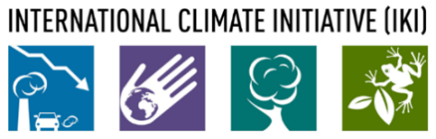
The NDC Action Project
Climate Finance Training Kit
Introduction to climate finance
Supported by:
based on a decision of the German Bundestag

Slide 2

Definition
Flows and sources
Instruments
Principles
Defining climate finance
No clear agreed definitions
Financial flows from developed to developing countries for climate change mitigation and adaptation activities.
It does not recognize national efforts in developing countries
"Incremental" or "additional" investments beyond a BAU case
Lack of agreement on what qualifies as "additional" or how to quantify it, also incremental costs investment costs might come with lower lifetime costs.
All climate-related investments (public and private, national and international).
What is the climate component versus development or other regular financing?
NDC ACTION PROJECT | Facilitating the implementation of climate-resilient and low-carbon development aligned with national and global goals
Notes:
There are no clear agreed definitions of what climate finance actually is:
One way to look at it is to look only at financial flows from developed to developing countries for climate change mitigation and adaptation activities. This interpretation is based on the premise that developed countries have an obligation to help developing countries transform their economies to be less carbon-intensive and more resilient to climate change.
Although, this approach does not recognize national efforts in developing countries
We could consider climate finance to be the "Incremental" or "additional" investments beyond a BAU case. Although, it is hard to track incremental support for climate compared to regular ODA, as climate is being mainstreamed into development assistance. If we look at incremental costs of investments, initial higher CAPEX for climate technologies might have lower lifetime costs, so this approach is also challenging. We will come back to the topic of incremental cost when describing the principles of climate finance.
We can also choose to look at all climate-related investments (public and private, national and international). This approach is most commonly used in the context of UNFCCC reporting and analysis by international institutions seeking to map climate finance in the context of global trends towards low-carbon investments. Still, under this approach, it can be hard to differentiate the climate component versus development or other regular finance?

Slide 3
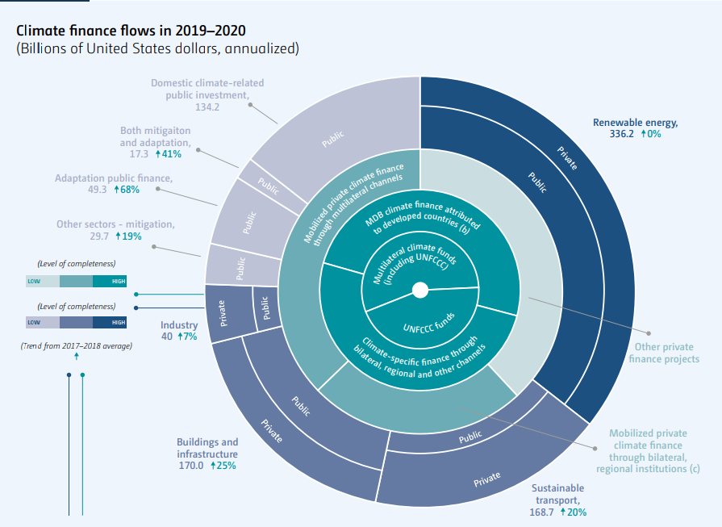
Definition
Flows and sources
Instruments
Principles
In the context of the UNFCCC
Not only concessional finance
Not only grant finance
Not only financing of incremental costs
Not only financing from climate focused financiers
But also leveraging instruments such as guarantees
And instruments that can turn future cash flows into up front financing
Source: UNFCCC, 2022: Biennial Assessment and Overview of Climate Finance Flows
Finance consistent with reducing emissions, and enhancing sinks of GHG and aiming at reducing vulnerability, and maintaining and increasing the resilience of human and ecological systems to negative climate change impacts
NDC ACTION PROJECT | Facilitating the implementation of climate-resilient and low-carbon development aligned with national and global goals
Notes:
If we look at the existing definitions used in the context of the UNFCCC, climate finance involves all financial flows, public, private, national and international, including those mobilized, that "aim to reduce emissions and enhance GHG sinks and aim to reduce vulnerability, and maintain and increase the resilience of human and ecological systems to the negative impacts of climate change." This includes grants, the smallest part, loans, both on concessional terms and at market rate and capital. The UNFCCC's Biennial Assessment and Overview of Climate Finance Flows shows a total of $803 billion of climate finance flows in 2020. Other analysis arrive at different figures, which highlights the challenge of counting the total flows of climate finance, even when approaching the analysis with the same definition.

Slide 4
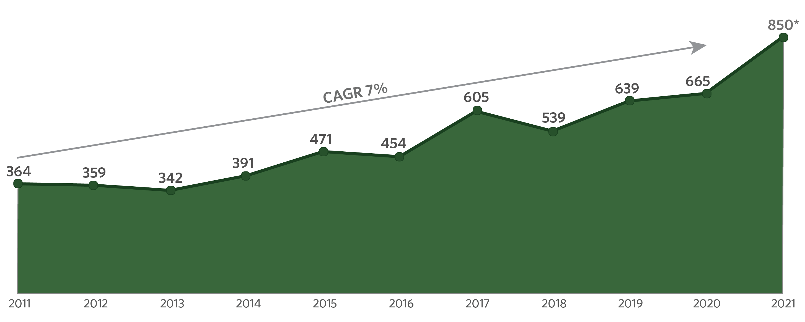
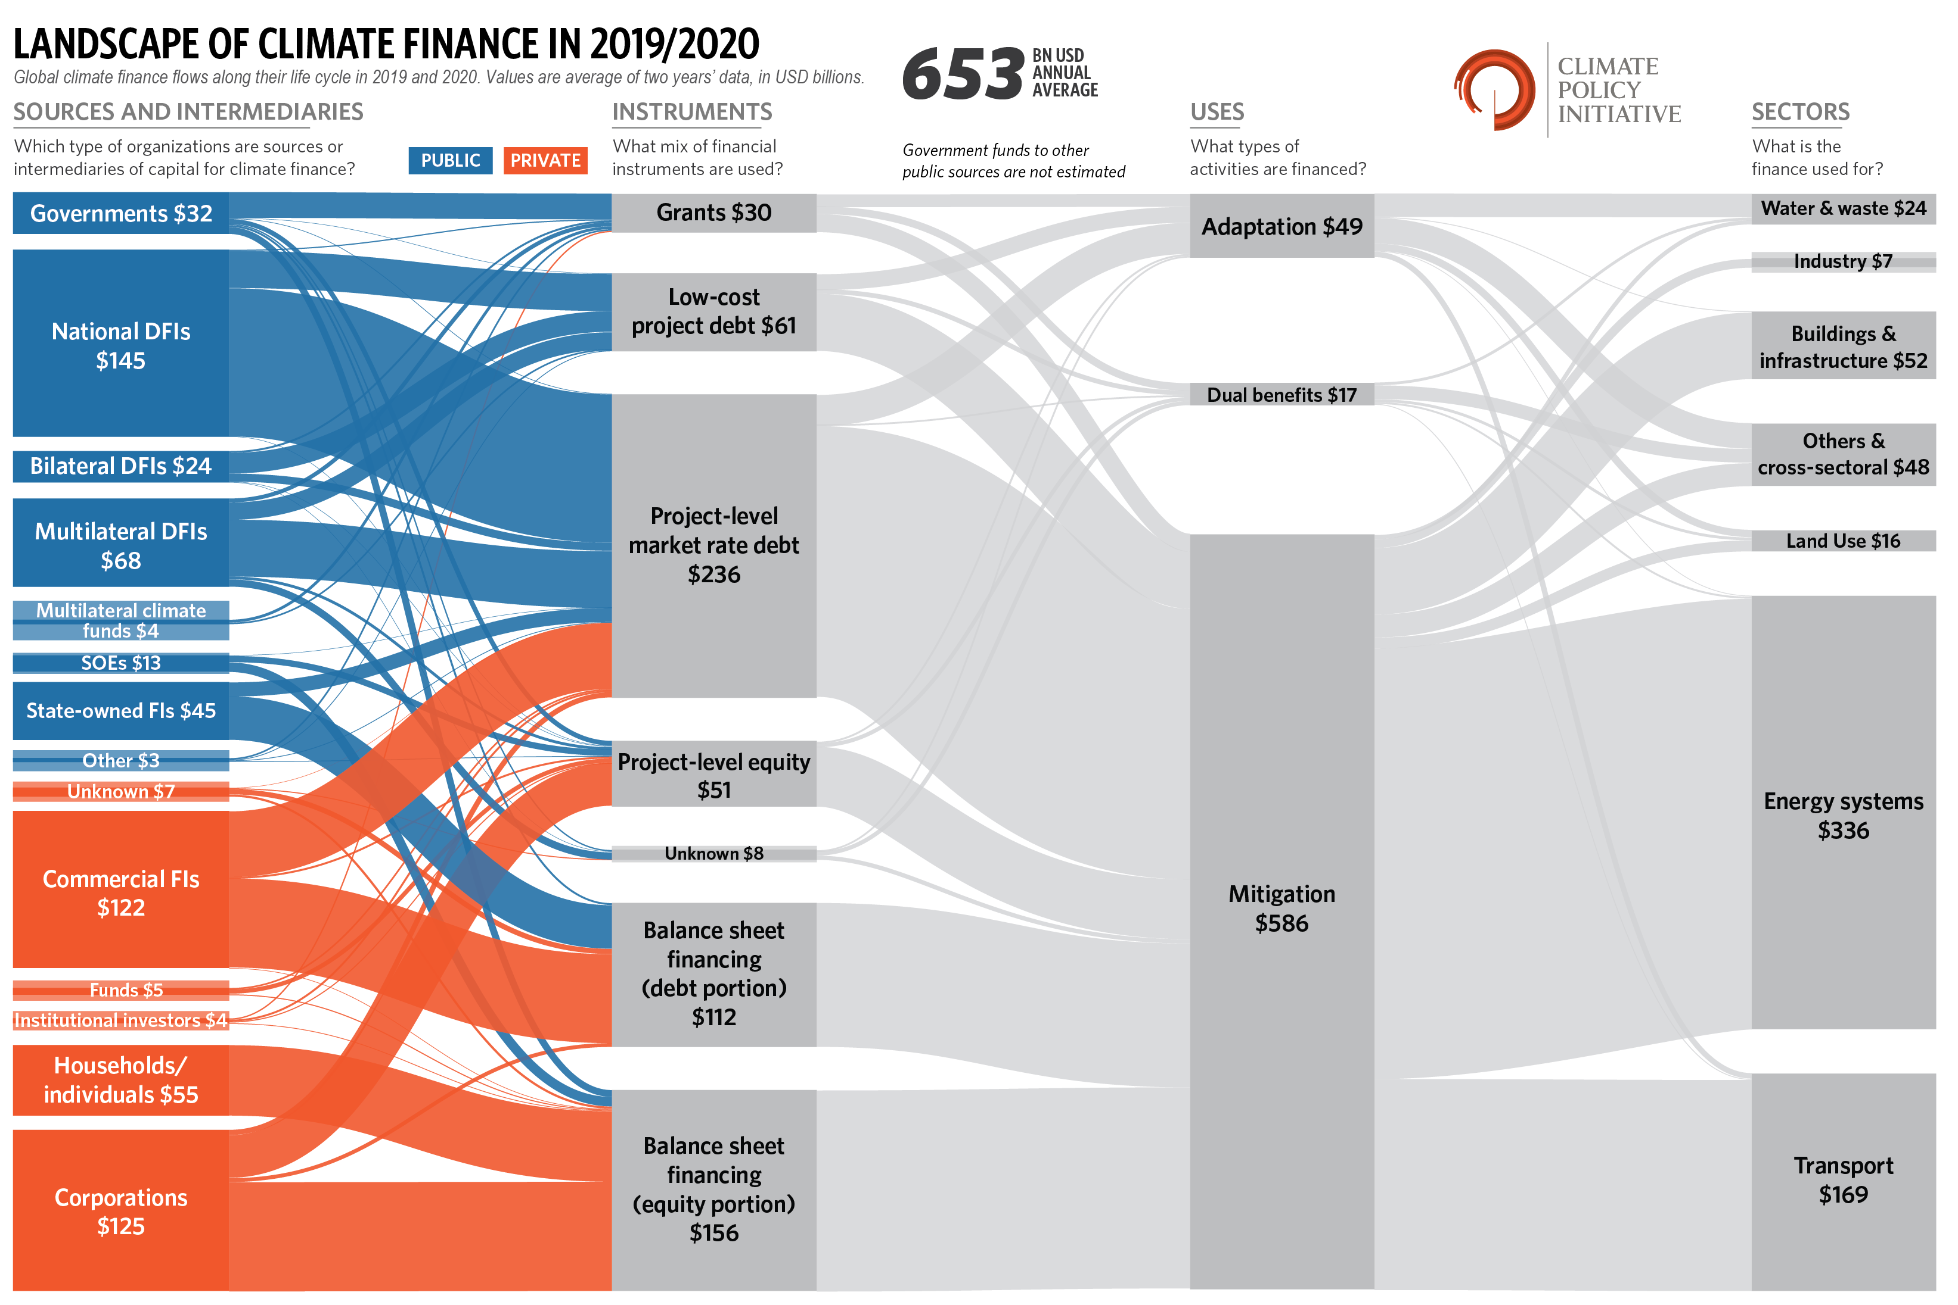
Definition
Flows and sources
Instruments
Principles
Climate finance flows
  Adaptation eclipsed by mitigation
  The major share of climate finance flows are private investments
  Grants a minor portion
  Debt the most used
  RE the largest beneficiary
  Most finance come from within the same country
  National DFIs are the largest providers of climate finance among all DFIs
NDC ACTION PROJECT | Facilitating the implementation of climate-resilient and low-carbon development aligned with national and global goals
Notes:
Climate finance flows have been increasing in recent years, now standing at approximately 653 billion annually (CPI, 2018). A review of global climate finance flows reveals certain tendencies:
Private investments from project developers, corporations and commercial banks account for by far the major share of climate finance flows (CPI, 2019). This highlights the need for climate interventions to seek to be bankable to be successful in attracting considerable amounts of private finance and emphasizes that it is difficult to mobilize grant-based climate finance.
Investments in renewable energy (RE) are the largest beneficiary of total climate finance flows. RE used to be the largest beneficiary of public investment, but in recent years it has been outpaced by investments in transport (CPI, 2019). This development illustrates how the decreasing costs of RE have led to a shift in financing from the public to the private domain, and how public investments are mainly directed towards sectors or technologies in need of more risk-willing support to become bankable.
Adaptation finance is eclipsed by finance for mitigation (CPI, 2019), public sources of finance for adaptation being by far the largest proportion (CPI, 2019). This illustrates that adaptation interventions do not provide many options for 100% bankable investments yet, many cases still being dependent on public and grant financing for implementation.
Most financing comes from within the country itself, both public and private (CPI, 2019). Therefore, it is important to involve the local stakeholders, finance institutions and corporations as much as possible when designing climate interventions.
Public funding is a large contributor to investments in energy efficiency, land use and projects with cross-sectoral impacts (CPI, 2019). Domestic, bilateral and multilateral development finance institutions (DFI) account for most public finance, with national DFIs being the largest providers of climate finance among all DFIs (CPI, 2019). This highlights the importance of involving national development banks when considering financing climate interventions.
Grants only account for a very small proportion of total climate finance. Almost all grants originate from public sources and mostly have public recipients as their beneficiaries. Grants tend to focus on geographies and sectors that are currently underserved by commercial finance (e.g. transport, agriculture, forestry, land use and natural resource management; CPI, 2019).
Debt is the most important financing instrument. Concessional (low-cost) debt almost completely originates from public sources, with DFIs providing the bulk of concessional loans. The second commonest type of instrument is equity, mostly balance-sheet equity, but also equity invested directly in the project itself (CPI, 2019)

Slide 5
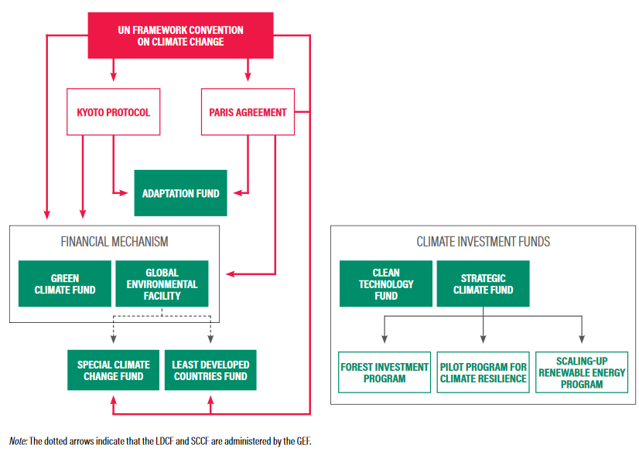
Definition
Flows and sources
Instruments
Principles
Financing from dedicated climate finance institutions
With the UNFCCC came the GEF – designated the Climate Finance Mechanism of the Convention. It hands out <1 billion USD/year
CIF – Climate Investment Funds. 10 Sub-programmes that provide ≈ 1 billion USD/year
Green Climate Fund – driven by the 100 billion USD/year call, but far from the main source of it. ≈ 1 billion USD/year (2014-23). 1st replenishment 9.8 billion USD.
Climate related investments are measured in the hundreds of billions of USD per year, so where are they coming from?
Source: WRI, 2017: Future of the Funds: Exploring the Architecture of Multilateral Climate Finance
NDC ACTION PROJECT | Facilitating the implementation of climate-resilient and low-carbon development aligned with national and global goals
Notes:
Multilateral climate funds and the finance they provide are in many ways what we think about when we talk about climate finance. As showed in the climate finance overview slide earlier, they only represent a small proportion of international climate finance flows, but they are although important providers of finance for climate action that outside of normal market conditions, and they play a crucial role in leveraging additional private finance.
The Global Environment Facility (GEF), established in 1991, is an operational entity of the financial mechanism of the UNFCCC and the Paris Agreement. The GEF works through accredited Agencies to implement and execute their projects. The GEF also administers the Least Developed Countries Fund (LDCF), with emphasis on supporting LDCs and Adaptation Plans of Action (NAPA), and the Special Climate Change Fund (SCCF), targeting key sectors for adaptation and technology transfers.
The Adaptation Fund (AF) also serves the Paris Agreement and assists developing countries in building resilience and adapt to climate change. The AF pioneered direct access to climate finance for developing countries through accredited National Implementing Entities.
The Green Climate Fund (GCF) is also an entity of the Financial Mechanism of the UNFCCC and the Paris Agreement, and has just become the largest contributor of climate finance to developing countries. It implements projects through private or public, non-governmental, sub-national, national, regional or international accredited entities.
Ideally, the actions identified in the Technology Action Plans should be the basis of project proposals that are intended to be financed from the funds.
There are also other dedicated climate funds, like the Climate Investment Funds (CIFs) which are managed by the World Bank, and operate through the regional development banks, including the African Development Bank (AfDB), the Asian Development Bank (ADB), the European Bank for Reconstruction and Development (EBRD) and the Inter-American Development Bank (IDB) (CFU, 2019).
The Climate Investment Funds include the Clean Technology Fund (CTF) and the Strategic Climate Fund (SCF). The Strategic Climate Fund (SCF) is again composed of three different programmes with a specific focus:
the Pilot Program for Climate Resilience (PPCR), provides grant finance (up to 1.5m USD) to prepare countries’ Strategic Programs for Climate Resilience, and grants and loans to cover costs associated with mainstreaming climate resilience into investments.
The Forest Investment Program (FIP) supports countries’ REDD efforts and promote sustainable forest management through grants, concessional loans, guarantees, or equity.
The Scaling-Up Renewable Energy Program for Low Income Countries (SREP) finances renewable energy initiatives through grants and other concessional financial instruments.
So as you can see, there are multiple climate funds with different scopes and access modalities. It is therefore important to scout for appropriate support providers and financiers early in the process in order to identify a good match in terms of scope and probability of accessing finance, and match the concept note or proposal to the specific fund.

Slide 6
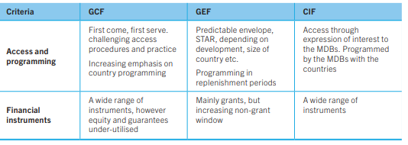
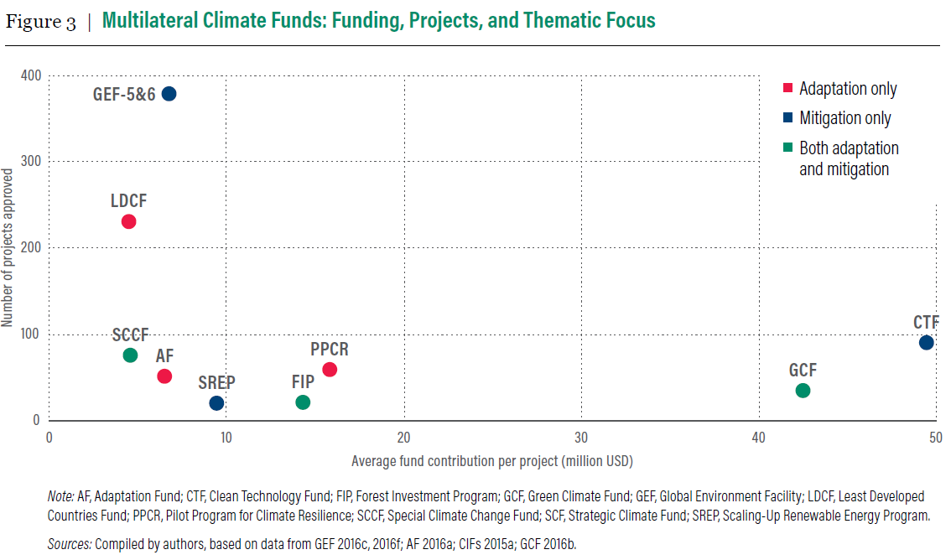
Definition
Flows
Principles
Instruments
Financing from dedicated climate finance institutions
Source: WRI, 2017: Future of the Funds: Exploring the Architecture of Multilateral Climate Finance
Source: WRI, 2017: Future of the Funds: Exploring the Architecture of Multilateral Climate Finance
NDC ACTION PROJECT | Facilitating the implementation of climate-resilient and low-carbon development aligned with national and global goals
Notes:
We will get back to the financial instruments later in the presentation

Slide 7
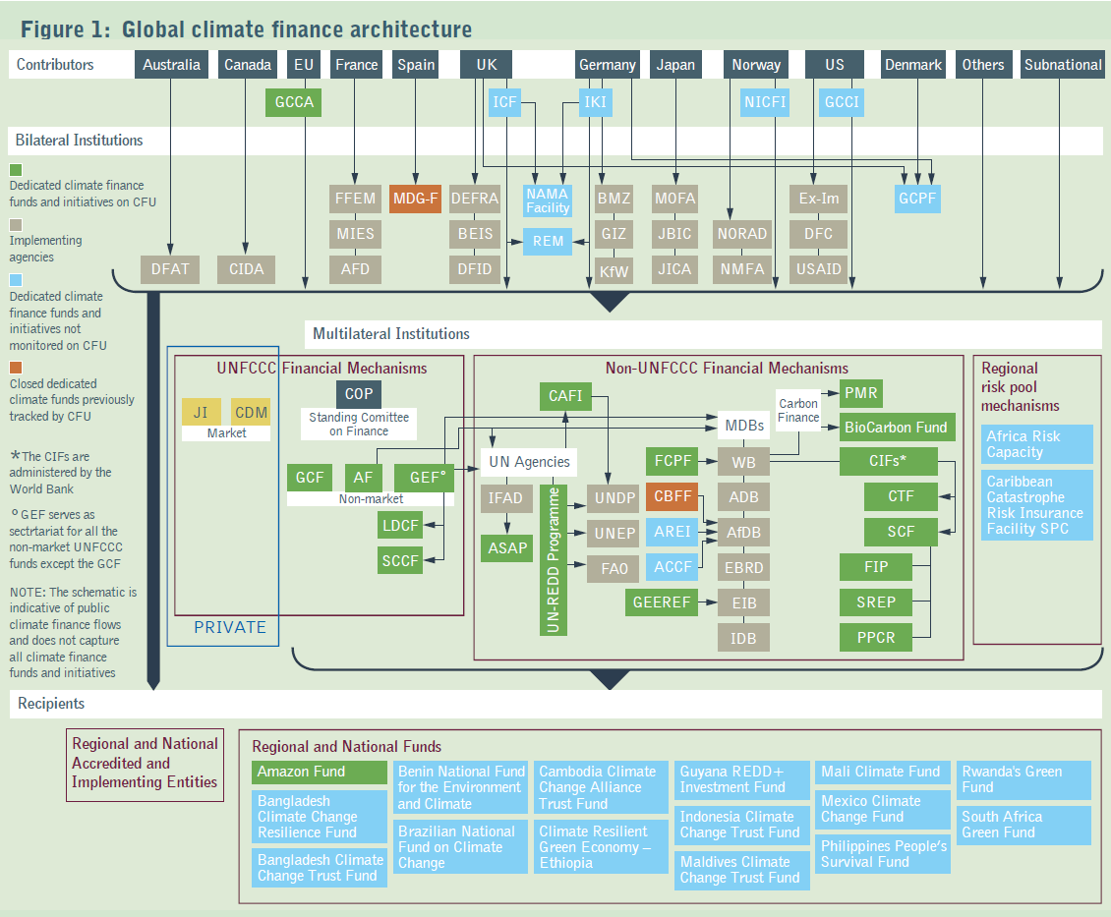
Definition
Flows and sources
Instruments
Principles
The broader picture of public climate finance sources
Source: ODI, 2020: The Global Climate Finance Architecture (2020), Climate Funds Update
NDC ACTION PROJECT | Facilitating the implementation of climate-resilient and low-carbon development aligned with national and global goals
Notes:
Implementing Agencies and Institutions
AfDB African Development Bank
AFD Agence Française de Développement (French development agency)
ADB Asian Development Bank
BEIS Department for Business, Energy & Industrial Strategy (UK)
BMZ Bundesministerium für Wirtschaftliche Zusammenarbeit und Entwicklung (federal ministry of economic cooperation and development, Germany)
CIDA Canadian International Development Agency
DEFRA Department for Environment, Food and Rural Affairs (UK)
DFAT Department of Foreign Affairs and Trade (Australia)
DFC United States International Development Finance Corporation
DFID Department for International Development (UK)
EBRD European Bank for Reconstruction and Development
EIB European Investment Bank
Ex-Im Export-Import Bank of the United States
FAO Food and Agriculture Organization of the United Nations
FFEM Fonds Français pour l'Environnement Mondial (French global environment facility)
GIZ Deutsche Gesellschaft für Internationale Zusammenarbeit GmbH (German technical cooperation)
IDB Inter-American Development Bank
IFAD International Fund for Agricultural Development
JBIC Japan Bank of International Cooperation
JICA Japan International Cooperation Agency
KfW Kreditanstalt für Wiederaufbau (German development bank)
MIES Mission Interministérielle de l’Effet de Serre (inter-ministerial taskforce on climate change, France)
MOFA Ministry of Foreign Affairs (Japan)
NMFA Norwegian Ministry of Foreign Affairs
NORAD Norwegian Agency for Development Cooperation
UNDP United Nations Development Programme
UNEP United Nations Environment Programme
USAID United States Agency for International Development
WB World Bank
Multilateral Funds and Initiatives
AF Adaptation Fund (GEF acts as secretariat and WB as trustee)
ACCF Africa Climate Change Fund
AREI African Renewable Energy Initiative
ASAP Adaptation for Smallholder Agriculture Programme
CAFI Central African Forest Initiative
CBFF Congo Basin Forest Fund (hosted by AfDB)
CDM Clean Development Mechanism (implemented under the Kyoto Protocol)
CIF Climate Investment Funds (implemented through WB, ADB, AfDB, EBRD and IDB)
CTF Clean Technology Fund (implemented through WB, ADB, AfDB, EBRD and IDB)
FCPF Forest Carbon Partnership Facility
FIP Forest Investment Program (implemented through WB, ADB, AfDB, EBRD and IDB)
GCCA Global Climate Change Alliance
GCF Green Climate Fund
GEF Global Environment Facility
GEEREF Global Energy Efficiency and Renewable Energy Fund (hosted by EIB)
JI Joint Implementation (implemented under the Kyoto Protocol)
LDCF Least Developed Countries Fund (hosted by the GEF)
PMR Partnership for Market Readiness
PPCR Pilot Program on Climate Resilience (implemented through WB, ADB, AfDB, EBRD and IDB)
SCCF Special Climate Change Fund (hosted by the GEF)
SCF Strategic Climate Fund (implemented through WB, ADB, AfDB, EBRD and IDB)
SREP Scaling Up Renewable Energy Program for Low Income Countries (implemented through WB, ADB, AfDB, EBRD and IDB)
UN-REDD Programme United Nations Collaborative Programme on Reducing Emissions from Deforestation and Forest Degradation
Bilateral Funds and Initiatives
GCCI Global Climate Change Initiative (US)
GCPF Global Climate Partnership Fund (Germany, UK and Denmark)
ICF International Climate Finance (UK)
IKI Internationale Klimaschutzinitiative (international climate initiative, Germany)
MDG-F MDG Achievement Fund (implemented by UNDP)
NAMA Facility Nationally Appropriate Mitigation Action facility (UK, Germany, Denmark and the EC)
NICFI Norway’s International Climate Forest Initiative
REM REDD+ Early Movers (Germany and UK)

Slide 8
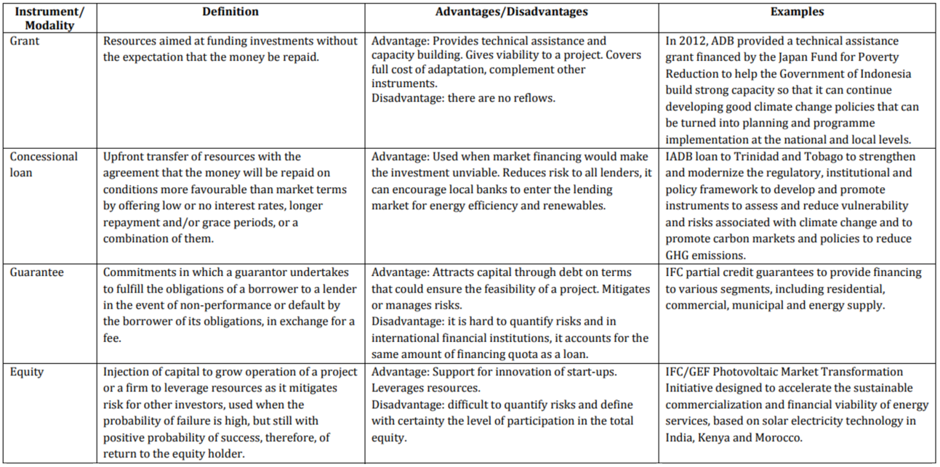
Definition
Flows and sources
Instruments
Principles
A few instruments – the most common
Source: GCF 2013: Business Model Framework: Financial Instruments
NDC ACTION PROJECT | Facilitating the implementation of climate-resilient and low-carbon development aligned with national and global goals

Slide 9
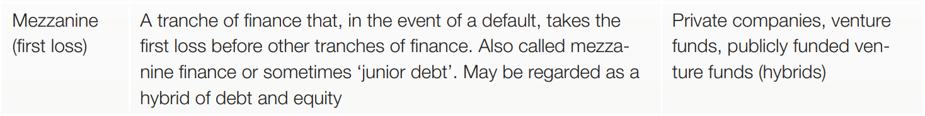
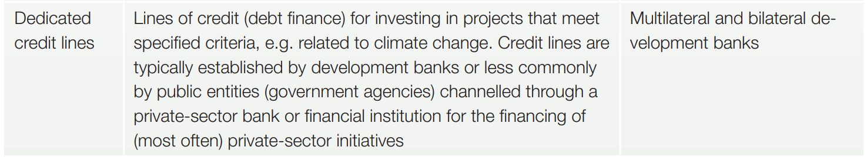
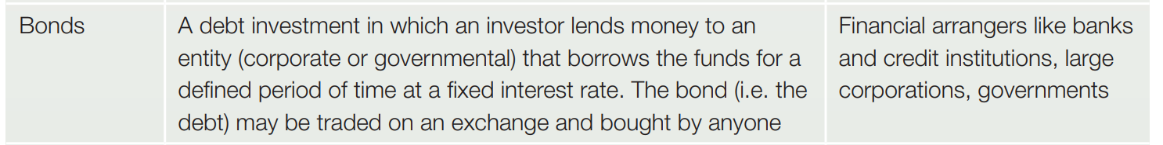
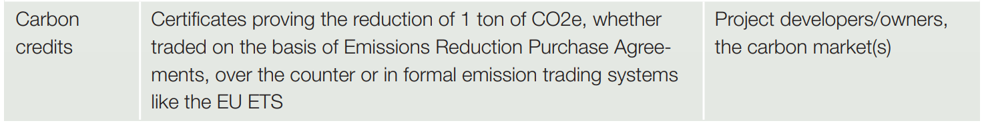
Definition
Flows and sources
Instruments
Principles
A few instruments – the more complex
Debt for Climate Swaps | an instrument where partial debt relief is provided, conditional on debtor commitments to undertake climate/nature related investments. | Bilateral governmental agreements, Commercial swap of International Sovereign Bonds
NDC ACTION PROJECT | Facilitating the implementation of climate-resilient and low-carbon development aligned with national and global goals

Slide 10
Definition
Flows and sources
Instruments
Principles
Multilateral Funds and Their Instruments
Fund | Grants | Loans | Risk Mitigation Instruments | Equity
Global Environment Facility | x
Least Developed Countries Fund | x
Special Climate Change Fund | x
Adaptation Fund | x
Clean Technology Fund | x | x | x | x
Forest Investment Program | x | x | x | x
Pilot Program for Climate Resilience | x | x | x | x
Scaling-Up Renewable Energy Program for Low Income Countries | x | x | x | x
Green Climate Fund | x | x | x | x
NDC ACTION PROJECT | Facilitating the implementation of climate-resilient and low-carbon development aligned with national and global goals

Slide 11
Definition
Flows and sources
Instruments
Principles
Concessionality
Express how "soft" the financial terms are e.g. "below market terms"
Rationale:
Climate Finance institution facilitates concessional (below market terms) finance to facilitate high impact climate action, which would otherwise not take place. (=de risk the investment.)
Climate Finance institution seeks a minimum concessionality to make an investment viable, without "crowding out" private sector and distort markets. Investments that are viable or almost viable will get less/low concessionality.
Concessionality often determined on a case-by-case basis:
Full concessionality (grant) e.g. for Technical Assistance and capacity building, where no return/reflow on such an investment
Some concessionality e.g. in the form of lower interest rates, longer pay back periods, first loss etc. when potential for some, but not full return e.g. adaptation, new technologies
No concessionality for investments which are viable
NDC ACTION PROJECT | Facilitating the implementation of climate-resilient and low-carbon development aligned with national and global goals
Notes:
The term concessionality expresses how "soft" financial conditions are, for example, concessional means "below market conditions"
The rationale for the use of concessionality is that the benefits of climate action are undervalued/valued (and not privatized), leading to suboptimal investment decisions, for example, investors do not invest enough in climate action. This is a market failure
Funds generally use concessional financing (below market terms) to facilitate high-impact climate action, which would not otherwise take place. GCF takes risk off the investment.
They generally seek a minimum concessionality to make an investment viable, without "displaced" the private sector and distorting markets. Investments that are viable or near viable usually obtain a lower/low concessionality.
Concessionality is normally determined on a case-by-case basis:
Full concessionality (grant), e.g. for technical assistance and capacity building, where there is no return/reflux of such investment
Some concessionality is provided, for example, in the form of lower interest rates, longer repayment periods, first loss, etc. when it is possible that you have positive cash flows and the investment is returned.
No concession for viable investments

Slide 12
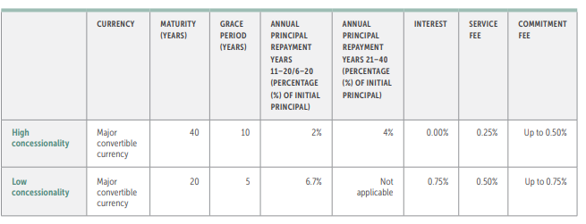
Definition
Flows and sources
Instruments
Principles
Concessionality – GCF example
NDC ACTION PROJECT | Facilitating the implementation of climate-resilient and low-carbon development aligned with national and global goals

Slide 13
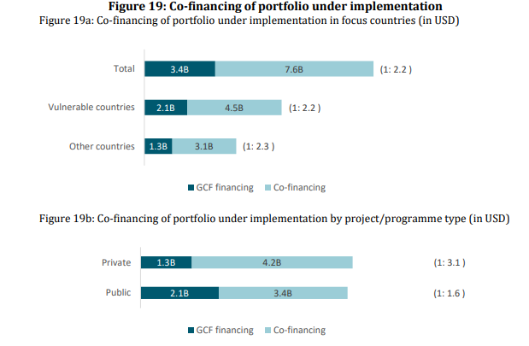
Definition
Flows and sources
Instruments
Principles
Co-finance
Project proposals should seek to incorporate appropriate level of co-finance to maximize impact of the resources from the finance institution.
Below example from GCF from 2021
Direct: public/private resources together with GCF funding and in direct causal relationship
Indirect co-financing: Any third-party financing towards GCF-funded projects with causal links
Leveraged/mobilized/catalyzed: Assumed to be the result of GCF funding
Sequenced: Along with GCF finances, there is no causal relationship
Source: GCF: 2021
NDC ACTION PROJECT | Facilitating the implementation of climate-resilient and low-carbon development aligned with national and global goals
Notes:
GCF Definitions:
Direct co-financing: public/private financial resources flowing through the EA together with GCF funding and in direct causal relationship
Indirect co-financing: Any public/private funding from third parties flowing to GCF-funded projects with causal links
Leveraged/mobilized/catalyzed financing: It is reasonably assumed to be the result of GCF financing
Sequenced finances: Along with GCF finances, there is no causal relationship

Slide 14
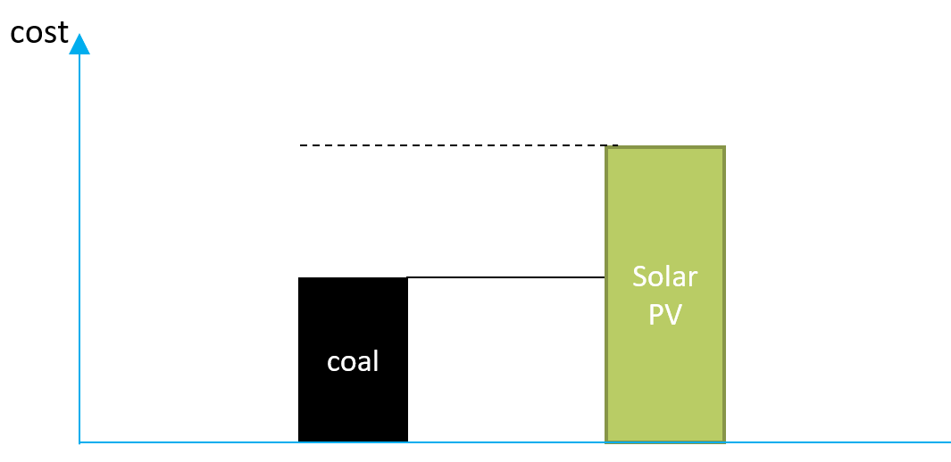
Definition
Flows and sources
Instruments
Principles
Incremental Costs
Definition: Additional expenses to produce outputs that results in adaptation and mitigation.
Full costs: Baseline/business-as-usual costs and/or counterfactual scenario + incremental costs
Net costs: The economic benefit (from the project with mitigation and adaptation) is subtracted, costs are therefore reduced
Full cost applications can be justified under certain circumstances, but requires arguments:
  capacity building projects
  barrier removing activities to climate change
  pilot project demonstrating new technologies
NDC ACTION PROJECT | Facilitating the implementation of climate-resilient and low-carbon development aligned with national and global goals

Slide 15
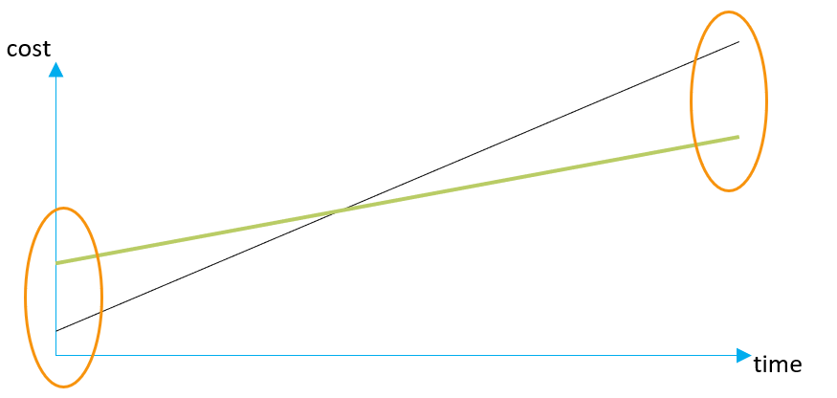
Definition
Flows and sources
Instruments
Principles
Financing of incremental costs
CAPEX, OPEX and IRR
CAPEX – practically all low carbon tech comes at a higher CAPEX, which needs to be financed
But they also come at a lower OPEX and thus with higher operational profits to service the debt
NDC ACTION PROJECT | Facilitating the implementation of climate-resilient and low-carbon development aligned with national and global goals
Notes:
But they also come at a lower OPEX and thus with higher operational profits to service the debt
In projects that have registered for carbon credit (CDM, VCS, Gold Standard and now Article 6), an IRR benchmark is used – but compared to what benchmark?
Are e.g. risks – perceived or real – priced into the benchmark?
The question is, can you raise say 30% more investment capital for an energy project if the project IRR is the same?
Or in other words, can you finance the ‘incremental investment’?

Slide 16
Definition
Flows and sources
Instruments
Principles
Relation between incremental cost,
concessionality and co-finance – GCF example
NDC ACTION PROJECT | Facilitating the implementation of climate-resilient and low-carbon development aligned with national and global goals

Slide 17
Thank you for contributing to a brighter future
Federico Antonio Canu
Advisor - Finance
UNEP Copenhagen Climate Centre
federico.canu@un.org
Supported by:
based on a decision of the German Bundestag

