Slide 1





The NDC Action Project
Climate Finance Training Kit
Describing climate impact scenarios
Supported by:
based on a decision of the German Bundestag

Slide 2
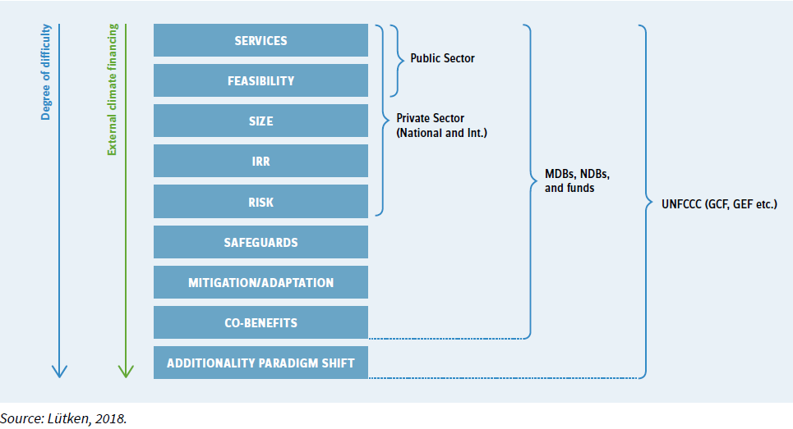

Rationale
Baseline
BAU
Impacts
What impacts matter?
NDC ACTION PROJECT | Facilitating the implementation of climate-resilient and low-carbon development aligned with national and global goals
Notes:
Identifying the right financier or funds is crucial to increase the chances of success of the proposal and the various sources of funding have their own priorities and requirements. In general, the more concessional financing is needed, the greater the degree of difficulty and documentation of other impacts than just the financial viability of the project. In some cases there are federal and local government programs that can finance mitigation actions and these programs have their requirements, in greater case the viability of the project. Financiers in the private sector will take into account the viability and above all, the total return on investment (size of the investment and internal rate of return), and the risk of the investment.
Bilateral and multilateral climate sources are often intended to support national/sectoral programmes, so companies should propose sectoral programmes in collaboration with government entities.

Slide 3


Rationale
Baseline
BAU
Impacts
Climate rationale
Environmental challenges are interrelated, for example, water, agriculture, biodiversity, pollution and climate change. Development vs. climate.
Climate finance institutions finance climate action, addressing the challenges of climate change, not development. Poverty, inequality are co-benefits.
Climate finance institutions expect applications to have an explicit climate justification.
NDC ACTION PROJECT | Facilitating the implementation of climate-resilient and low-carbon development aligned with national and global goals

Slide 4
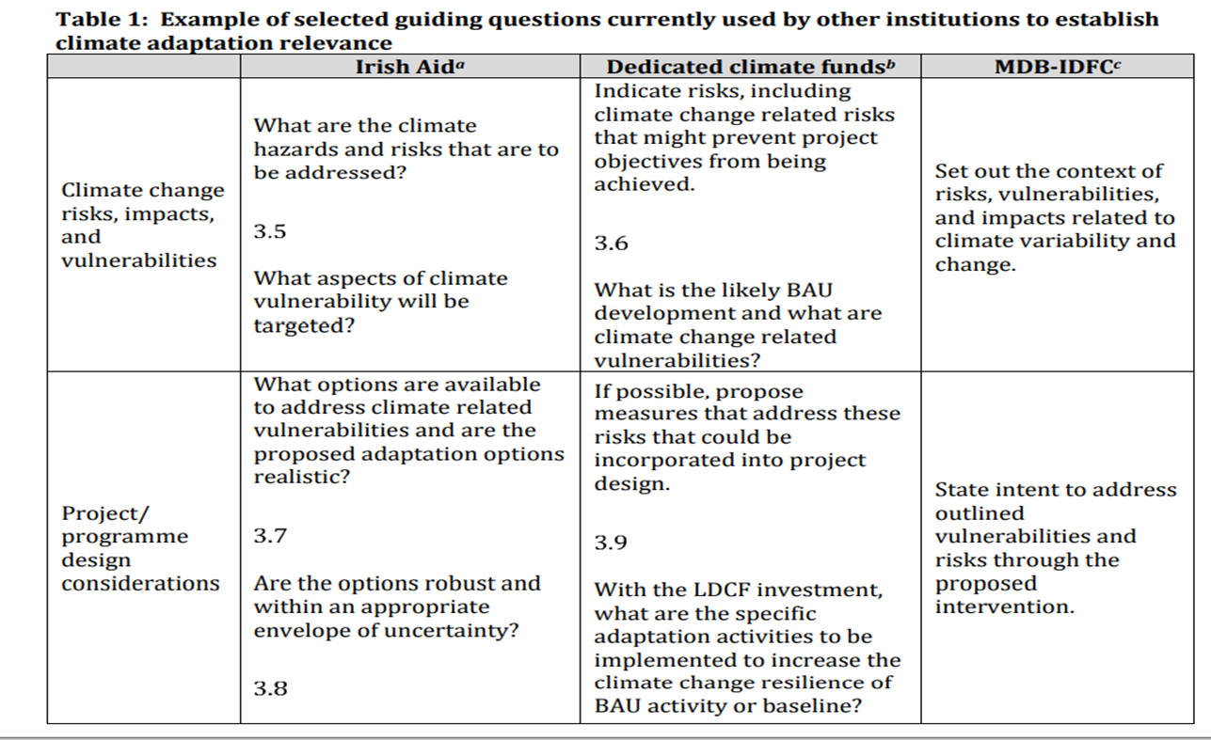
Rationale
Baseline
BAU
Impacts
How to present the climate rationale
What is the problem the project seeks to address?
What role does climate change play in the problem?
Example: water scarcity, competition for water, etc., partly caused by climate change (warmer temperatures, increased evaporation, reduced rainfall, etc.).
How is it different in mitigation and adaptation projects?
Basic steps to establish climate justification:
Describe the problem induced by climate change (cause-effect climate)
Validate the role of climate change in the problem (data)
Identify solutions to address the climate-induced problem (= investment focus)
May include specific assessments/analyses, e.g. vulnerability, GHG emissions scenarios
Source: Green Climate Fund
NDC ACTION PROJECT | Facilitating the implementation of climate-resilient and low-carbon development aligned with national and global goals

Slide 5
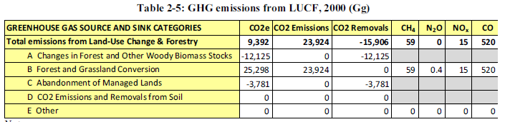
Rationale
Baseline
BAU
Impacts
Baseline and reference indicators
To describe the expected impacts, we need to map the current situation.
Mitigation indicator: Total tonnes of CO2eq to be avoided or reduced per year
Adaptation indicator: Total expected number of direct and indirect beneficiaries and number of beneficiaries in relation to total population
Identify relevant mitigation indicators/adaptation aspects
Mitigation, describe current status and quantify emissions
Adaptation: it can be more qualitative, but it is still important to quantify it
Other indicators:
Financial / economic indicators
Sustainable development
Capacity-building
Search for NC, BUR, NDC, TNA, sector reports, etc.
NDC ACTION PROJECT | Facilitating the implementation of climate-resilient and low-carbon development aligned with national and global goals
Notes:
The concept of baselines is central to climate change policy and is used to describe the current situation, and as a basis for constructing a normal development from which a deviation is desired. Defining a baseline is important because to say something about the expected impacts, we must first clearly define the initial situation.
In general, the following two basic indicators can be applied in quantitative terms:
Basic mitigation indicator: Total tonnes of CO2 eq to be avoided or reduced per year
Core adaptation indicator: Total expected number of direct and indirect beneficiaries and number of beneficiaries in relation to the total population (e.g. total lives to be saved from shocks due to climate-related disasters)
At the baseline we simply need to describe the current state. To quantify current emissions, we must first identify basic indicators that can be used to translate into emissions, using emission factors. These can be the current energy mix in the electricity sector and grid emission factor, current unsustainable practices leading to deforestation and loss of carbon stocks, etc. These basic mitigation indicators can usually be found in the national GHG inventory, although, for specific actions at sub-sectoral or sub-national level such as 2-wheelers in transport, public buildings or other more specific interventions, additional calculations might be necessary to isolate the expected beneficiaries and current emissions related to their practices.
For adaptation, methodologies for establishing a baseline are not as streamlined as for mitigation, tend to be more descriptive and could take a more qualitative approach. However, it is important to try to quantify if possible, for example by describing the number of people/businesses at risk of reduced income or displacement due to expected climate impacts.
If possible, you should also try to quantify the baseline in monetary terms, such as current energy costs compared to international/regional averages, and loss of agricultural production due to failed harvests.
There may also be other relevant indicators, depending on the type of activities envisaged in the project. If the project has a large component related to sustainable development benefits, other indicators could be air quality in urban areas, health benefits of improved water quality, ecosystem health, etc., but also indicators related to the number of people trained in projects with a large capacity-building component.
National documents, such as national communications

Slide 6
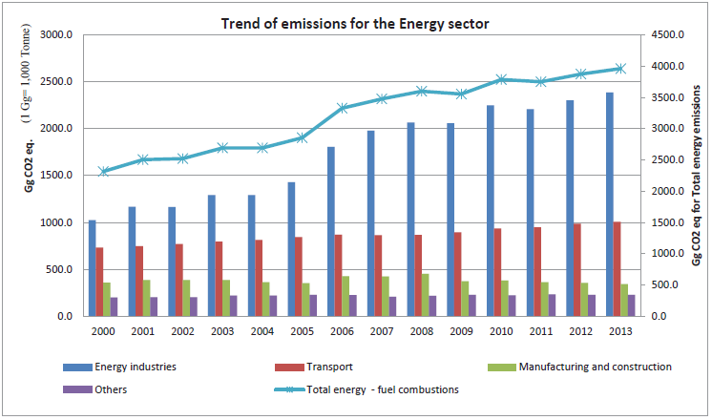
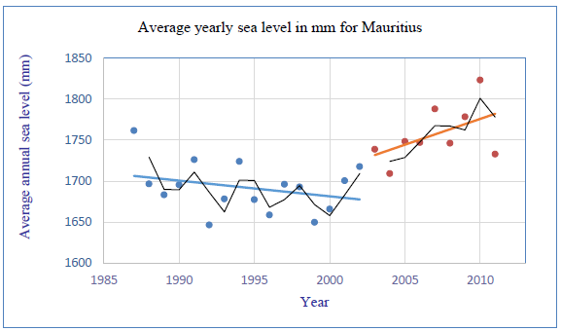
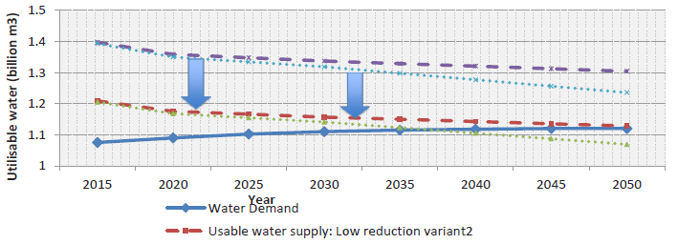
Rationale
Baseline
BAU
Impacts
Projecting a BAU scenario
Multiple approaches to establish scenarios from simple to very complex.
Baseline of the project towards the future (linear or with growth factors)
Historical trends
Modeling tools (drivers such as population, GDP, technology)
Provides the argument for climate relevance (climate justification)
Science-based and needs solid data
Search for information in NC, BUR, NAP, TNA, sector reports, etc.
If possible, also project economic, environmental and social indicators from the baseline.
Source: Mauritius Third National Communication
NDC ACTION PROJECT | Facilitating the implementation of climate-resilient and low-carbon development aligned with national and global goals
Notes:
When describing the baseline and current situation, we must make assumptions about what the future will look like if climate action is not taken, setting BAU scenarios. The definition of a BAU scenario also helps provide arguments for climate justification. In other words, why is this action needed to make a significant contribution to mitigating, adapting to or improving resilience to climate change? There are multiple ways to build scenarios, from very simple to very complex approaches. The starting point is always the baseline, and could then be projected into the future based on identifying growth drivers, analyzing historical trends, or with more complex modeling tools that take into account multiple drivers, such as expected population and GDP growth, which could take into account improvements in technologies, and more.
Central national documents such as national communications, GHG inventories, NAPs and sectoral reports can contain information on emissions projects, expected growth in sectors and sectoral trends, which can be used as inputs to construct a BAU scenario. For the energy sector, sectoral studies or utility reports are usually consulted. These often provide expected growth factors for energy/electricity use. Typically, this can also be found for the forest sector in deforestation rates, but might be harder to find for subsectoral activities. Overall, solid science and data are needed to provide credible BAU scenarios, and while scenarios are always based on assumptions, and will always be an experiment, they are important to illustrate the climate logic of projects and highlight why the project is of great relevance to climate change, and not just a regular development project.
Information on expected economic, social and environmental impacts provides a more nuanced picture and highlights other important development/sustainable development impacts, which are also outcomes sought by climate finance providers.

Slide 7
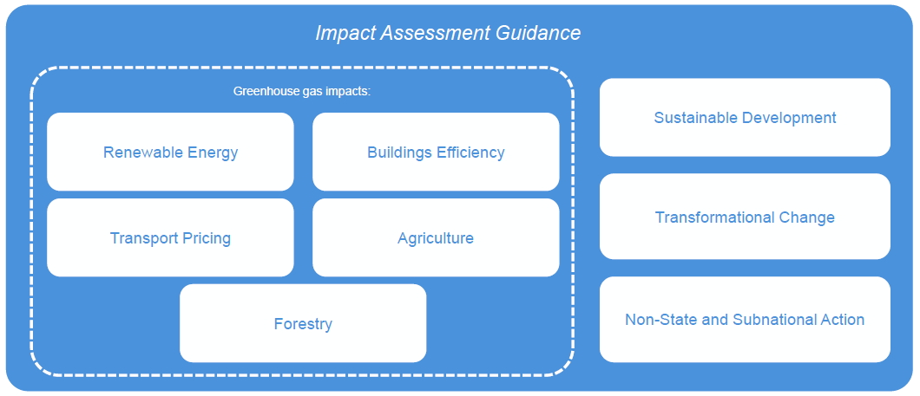
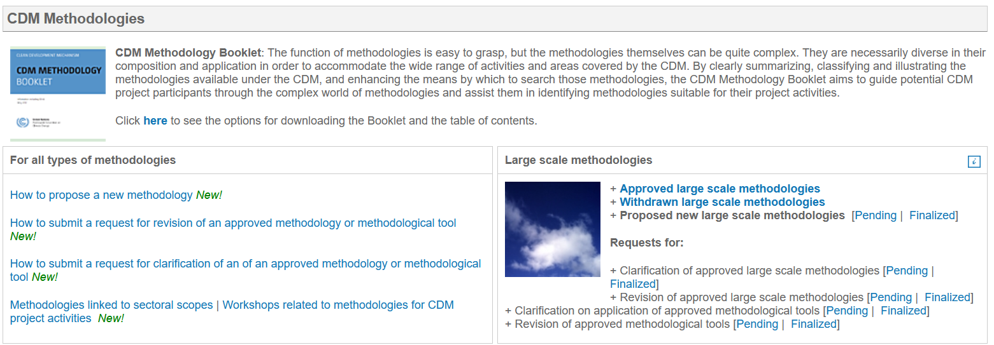
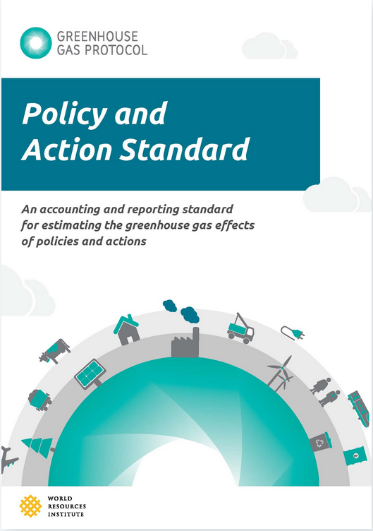
Rationale
Baseline
BAU
Impacts
Baseline and BAU methodologies - Mitigation
ICAT (policies)
https://climateactiontransparency.org/icat-toolbox/
CDM (projects)
https://cdm.unfccc.int/methodologies/index.html
GHG Protocol (both)
https://ghgprotocol.org/policy-and-action-standard
A large variety of Energy modelling tolos
LEAP, MARKAL TIMES, RETscreen etc.
Source: ICAT, 2021
Source: UNFCCC, 2021
Source: Greenhouse Gas Protocol, 2021
NDC ACTION PROJECT | Facilitating the implementation of climate-resilient and low-carbon development aligned with national and global goals

Slide 8
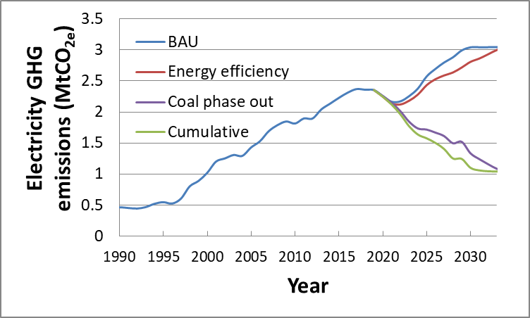
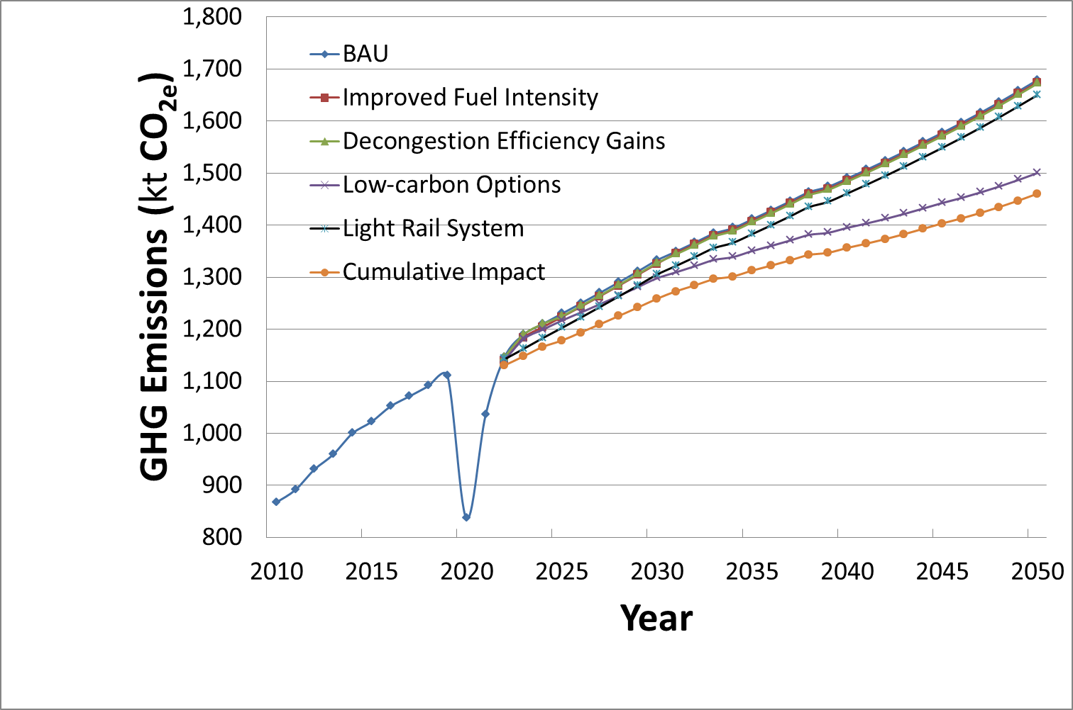
Rationale
Baseline
BAU
Impacts
Impacts – Mitigation
Provide a reasonable description of penetration of technologies over time based on the intended project activities
Consider the probability of implementation of existing initiatives and plans.
  Is the proposed intervention contributing to or adding to existing plans and strategies?
Emission reductions = BAU emissions – mitigation scenario emissions
NDC ACTION PROJECT | Facilitating the implementation of climate-resilient and low-carbon development aligned with national and global goals

Slide 9
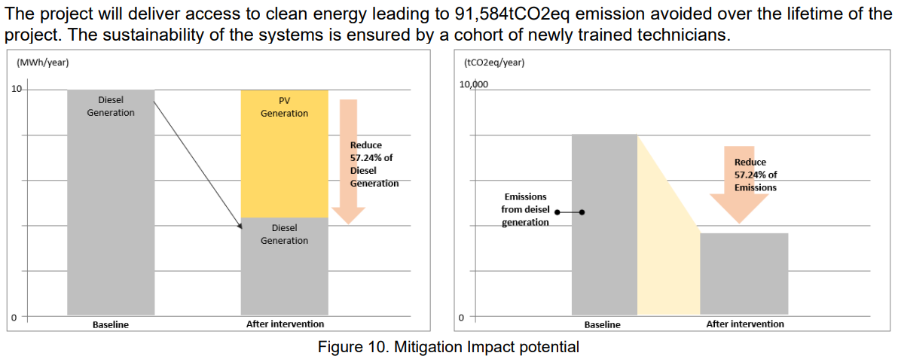
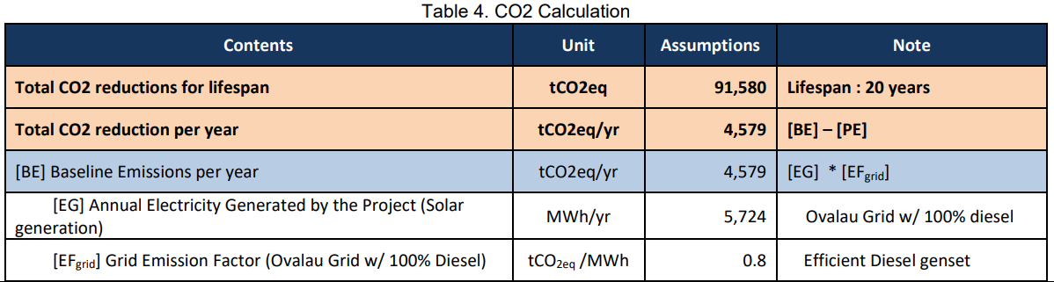
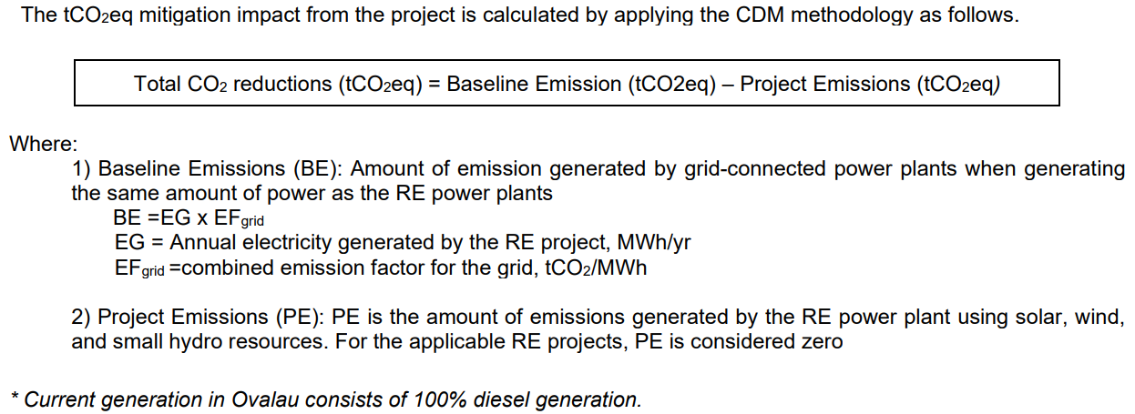
Rationale
Baseline
BAU
Impacts
Impacts – Mitigation example
Mitigation scenario
Mitigation scenario
Baseline
Baseline
GCF Proposal: SAP016, Fiji Agrophotovoltaic Project in Ovalau
NDC ACTION PROJECT | Facilitating the implementation of climate-resilient and low-carbon development aligned with national and global goals

Slide 10
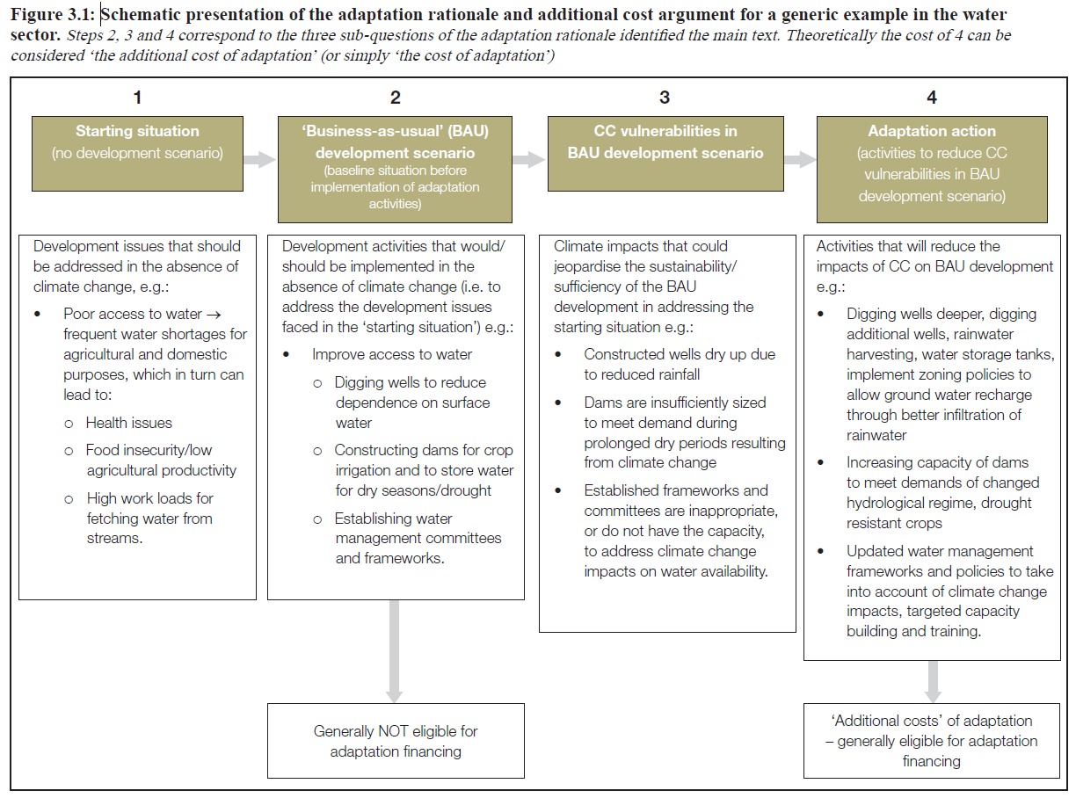
Rationale
Baseline
BAU
Impacts
Baseline, BAU and impacts – Adaptation
BAU without CC impacts
BAU with CC impacts
NDC ACTION PROJECT | Facilitating the implementation of climate-resilient and low-carbon development aligned with national and global goals
Notes:
For adaptation, we could theoretically do the same as for mitigation, take the relevant indicators identified at the baseline and project them into the future. Although, making adaptation projections is a bit more complex. In adaptation, we generally split between the BAU in regular circumstances and the BAU, including the expected impacts of climate change. Under normal circumstances, the BAU should illustrate "development as it would have occurred in the absence of investments in adaptation", in other words, including the effects of regular development projects or investments made for purposes other than climate change. This already has some inherent uncertainty, and including future climate change projections for the BAU, including climate change impacts, only adds to the uncertainty.
The important questions that need to be asked to guide the description of the BAU without and with climate change are therefore two:
Therefore, for the BAU without the expected future impacts of climate change, the first question is. What would be the development in the target sector/area without the project/activity in the next 20-30 years (should you align the years with the life of the project)? In this case the BAU (this is the second step illustrated in the figure), is the current situation without projections of CC impacts.
This can be difficult in itself as economic development, population development, education, markets, etc. It can be difficult to predict even without CC – these are all factors that affect CC vulnerability.
For the BAU with the expected impacts of climate change the question is: What is the expected impact of CC in the next 20 30, etc.? years in addition to the BAU stage? There is also great uncertainty here both in terms of how many global emissions we can expect and what the spin-off effect will be, especially in reduced local scenarios. In principle, this scenario should be set out in your climate justification, where you can then point to specific vulnerabilities in specific sectors and orient project activities towards them.
In monetary terms here too, expect to have to argue the additional costs of climate change. For example, the additional cost of climate protection of existing infrastructure beyond a normal development scenario. If the current expected rainfall intensity requires you to implement certain flooding measures, you should argue why additional measures are needed due to the expected future increase in rainfall intensity.
Note that baseline and BAU scenarios may include projections of multiple aspects and impacts, not only related to the population with greater resilience or adaptive capacities. Information on expected economic, social and environmental impacts provides a more nuanced picture
For the BAU with the expected impacts of climate change the question is: What is the expected impact of CC in the next 20 30, etc.? years in addition to the BAU stage? There is also great uncertainty here both in terms of how many global emissions we can expect and what the spin-off effect will be, especially in reduced local scenarios. In principle, this scenario should be set out in your climate justification, where you can then point to specific vulnerabilities in specific sectors and orient project activities towards them.
In monetary terms here too, expect to have to argue the additional costs of climate change. For example, the additional cost of climate protection of existing infrastructure beyond a normal development scenario. If the current expected rainfall intensity requires you to implement certain flooding measures, you should argue why additional measures are needed due to the expected future increase in rainfall intensity.
Note that baseline and BAU scenarios may include projections of multiple aspects and impacts, not only related to the population with greater resilience or adaptive capacities. Information on expected economic, social and environmental impacts provides a more nuanced picture and highlights other important development/sustainable development impacts, which are also outcomes sought by the GCF.

Slide 11
Rationale
Baseline
BAU
Impacts
Baseline, BAU and impacts – Adaptation
Indicator type | Example | Use
Climatic parameters | Temperature, precipitation, extreme events | Describe the baseline and trends to describe BAU and BAU + CC
Climate impacts | Number of people affected by the expected impacts of climate change Expected economic losses | It is used to identify the scope of adaptation action and a specific BAU+CC
Adaptation action (activities) | Number of farmers implementing improved water management/soil improvement activities | Used to describe and track project implementation
Adaptation results (outcome) | % increase in crop yield per hectare during the dry season | It is used to predict, monitor and evaluate the outcomes of adaptation strategies
NDC ACTION PROJECT | Facilitating the implementation of climate-resilient and low-carbon development aligned with national and global goals
Notes:
Since adaptation is a bit more complex, I thought it was good to dig a little deeper and provide some examples of different types of potential indicators to look for, their purpose and use. Adaptation indicators can be broadly divided into:
Climate parameters: Information about observed weather conditions, e.g. temperature, precipitation, extreme events. These indicators are used to describe the baseline and trends.
Climate impacts: Information on the observed impacts of climate variability and change on socio-ecological systems, e.g. number of people affected by the expected impacts of climate change and/or expected economic losses: these indicators are used to identify the scope of adaptation action, to adapt or improve resilience to observed impacts.
Adaptation Action (Implementation): These are indicators used to describe and track the implementation of farmers applying improved water management/soil improvement activities, etc.
Adaptation outcomes (outcome): These are indicators used to predict, monitor and evaluate the outcomes of adaptation strategies, e.g. % increase in crop yield per hectare during the dry season, % of household income used to treat waterborne diseases after floods.
Take a look at the GCF proposals that have been approved, and see how they have "built their baseline and their BAU argumentation.

Slide 12
Thank you for contributing to a brighter future
Federico Antonio Canu
Advisor - Finance
UNEP Copenhagen Climate Centre
canu@un.org
Supported by:
based on a decision of the German Bundestag

