Slide 1





The NDC Action Project
Climate Finance Training Kit
Transformational Change and
Sustainable Development co-benefits
Supported by:
based on a decision of the German Bundestag

Slide 2
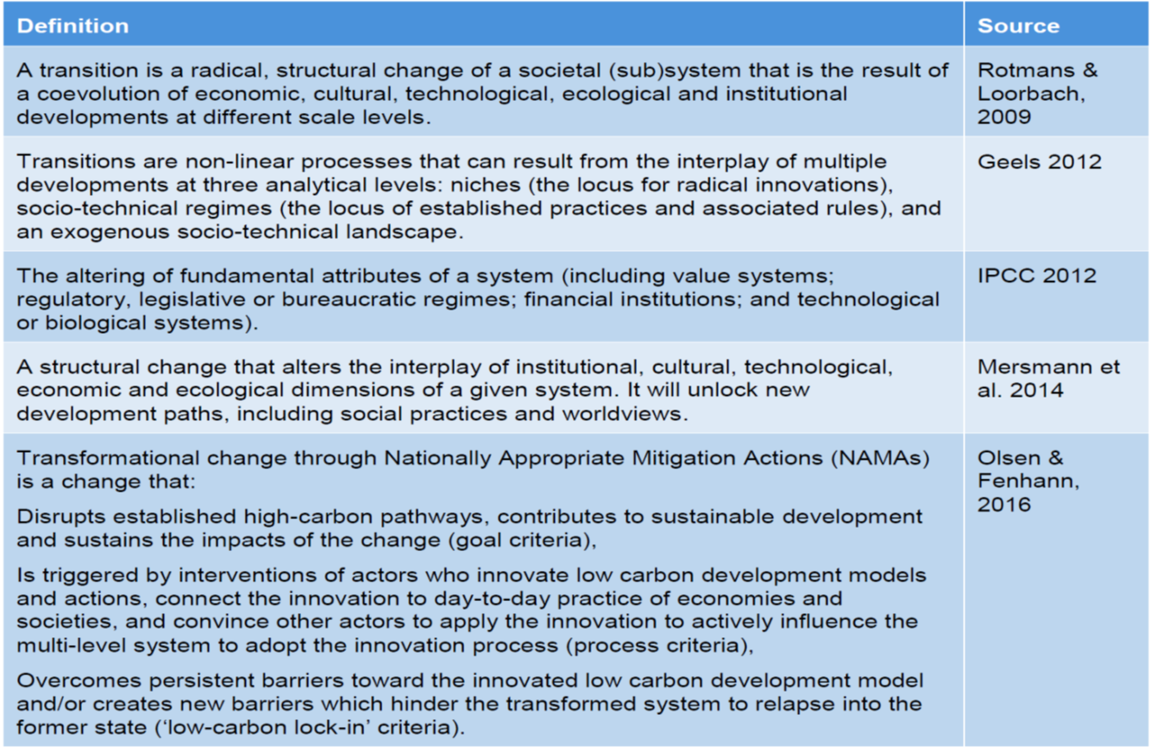

What is Transformational change?
Transformational Change
Theory of Change
GCF example
NDC ACTION PROJECT | Facilitating the implementation of climate-resilient and low-carbon development aligned with national and global goals

Slide 3
Transformational Change
Transformational Change
Theory of Change
GCF example
(1) Disrupts established high-carbon pathways, contributes to sustainable development and sustains the impacts of the change (goal dimension),
(2) Is triggered by interventions of actors who innovate low carbon development models and actions, connect the innovation to day-to-day practice of economies and societies, and convince other actors to apply the innovation to actively influence the multi-level system to adopt the innovation process, (process dimension)
(3) Overcomes persistent barriers toward the innovated low carbon development model and/or create new barriers which hinder the transformed system to relapse into the former state (sustains ‘low-carbon lock-in’).”
NDC ACTION PROJECT | Facilitating the implementation of climate-resilient and low-carbon development aligned with national and global goals

Slide 4
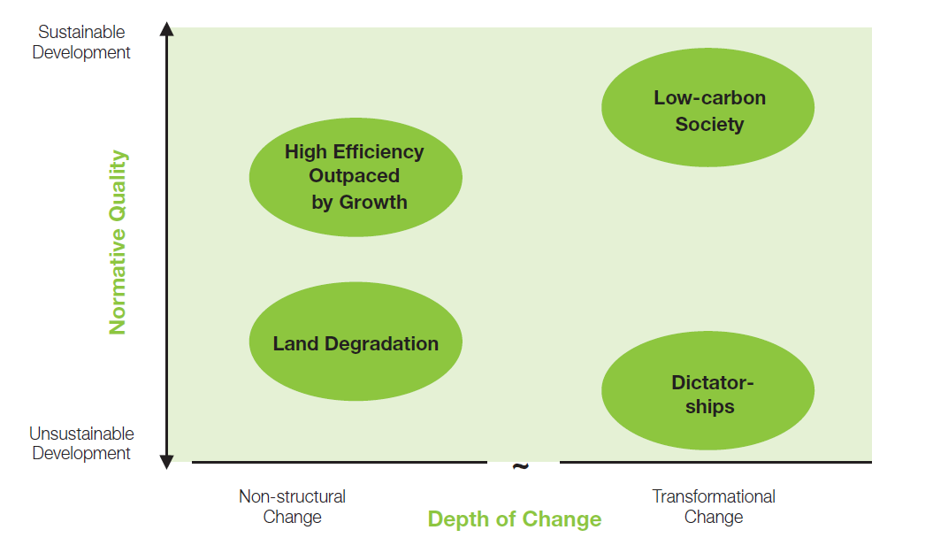
Transformational Change and link with Sustainable Development
Transformational Change
Theory of Change
GCF example
Sustainable development is a normative concept defining the direction and the goal of development.
Transformational Change is a descriptive concept defining the process and depth of change.
NDC ACTION PROJECT | Facilitating the implementation of climate-resilient and low-carbon development aligned with national and global goals

Slide 5
Use the Theory of Change to describe transformation
Transformational Change
Theory of Change
GCF example
Theory of Change – A reminder
A description of how and why an intervention is expected to work.
Logic model (LFA) - plus information about the context, actors/stakeholders (incl. other interventions), conditions, etc., but especially the causal links between steps in the project.
- A rigorous yet participatory process whereby groups and stakeholders identify the conditions they believe have to unfold for their long-term goals to be met.
- Working model against which to test hypotheses and assumptions about what actions will best bring about the conditions/outcomes in the model.
NDC ACTION PROJECT | Facilitating the implementation of climate-resilient and low-carbon development aligned with national and global goals

Slide 6
Use the Theory of Change to describe transformation
Transformational Change
Theory of Change
GCF example
Start with the intended outcome, and link outputs and activities in order to explain HOW and WHY the desired change is expected to come about, and how the change is:
  Permanent, meaning that it establishes a new situation, which does not fall back into its point of departure once the dedicated project implementation phase ends.
  Radical, meaning that it deviates significantly from an already expected path of change and development (business-as-usual) and at considerable scale.
  Abrupt, meaning that the expected change happens in a much shorter time frame that it would otherwise be possibly expected.
NDC ACTION PROJECT | Facilitating the implementation of climate-resilient and low-carbon development aligned with national and global goals
Notes:
Transformational change should be considered as being achieved through outcomes that are permanent, radical and abrupt: Permanent, meaning that it establishes a new situation, which does not fall back into its point of departure once the dedicated project implementation phase ends (This could be described through a project funding “sustainable phase-out concept”). Radical, meaning that it deviates significantly from an already expected path of change and development (business-as-usual) and at considerable scale. (e.g. transit oriented development combined with reduced individual car transport, leading to 20% less cars during congestion hours). Abrupt, meaning that the expected change happens in a much shorter time frame that it would otherwise be possibly expected. (e.g. 80% of farmers apply water saving and solar pumping practices within 8 years and well in advance of expected extreme drought events). The project should as a minimum be able to show that they will have a transformative effect including the characteristics described above, while effectively reducing climate risks.

Slide 7
GCF investment criteria
Transformational Change
Theory of Change
GCF example
6 investment criteria, that guide the choice of- and design of investments (= funding proposal). GCF looking ex-ante for "potential" for achievement of the criteria. Criteria are:
Impact Potential
Paradigm Shift Potential
Sustainable Development Potential
Needs of the Recipient
Country Ownership
Efficiency and Effectiveness
NDC ACTION PROJECT | Facilitating the implementation of climate-resilient and low-carbon development aligned with national and global goals

Slide 8
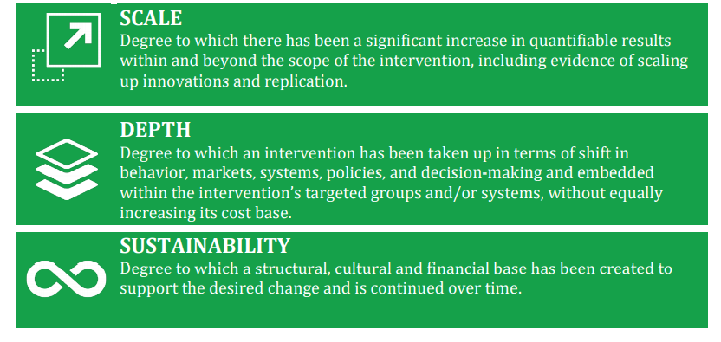
GCF's paradigm shift criteria
Transformational Change
Theory of Change
GCF example
Paradigm shift - the degree to which the proposed activity can catalyse impact beyond a one-off project or programme investment though scaling up and replication of investments
Use three key dimensions, simplified for measurability – Scale, Depth, and Sustainability
NDC ACTION PROJECT | Facilitating the implementation of climate-resilient and low-carbon development aligned with national and global goals

Slide 9
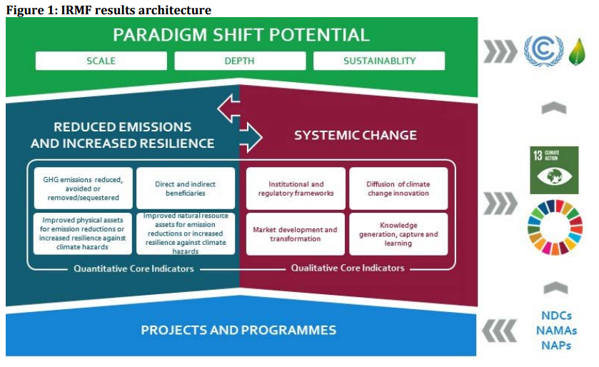
GCF's paradigm shift criteria – Assessing scale, depth and sustainability
Transformational Change
Theory of Change
GCF example
NDC ACTION PROJECT | Facilitating the implementation of climate-resilient and low-carbon development aligned with national and global goals

Slide 10
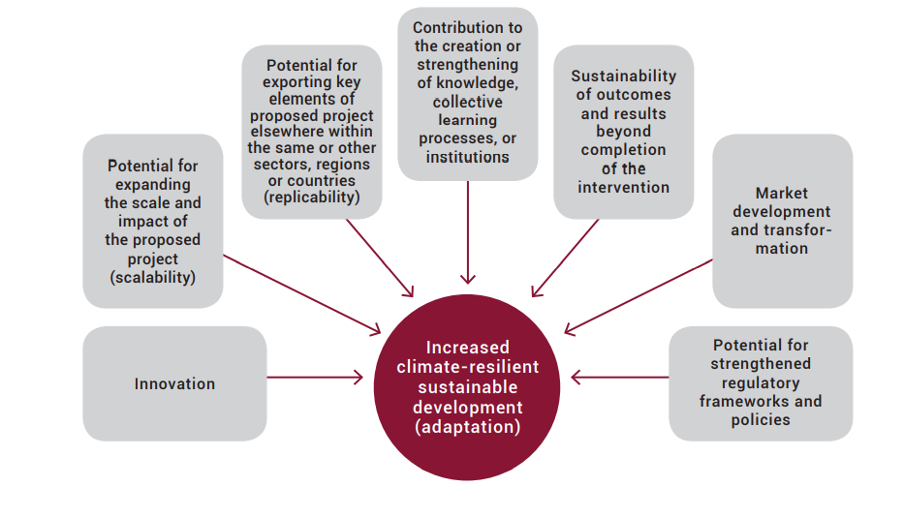
GCF's paradigm shift considerations
Transformational Change
Theory of Change
GCF example
NDC ACTION PROJECT | Facilitating the implementation of climate-resilient and low-carbon development aligned with national and global goals

Slide 11
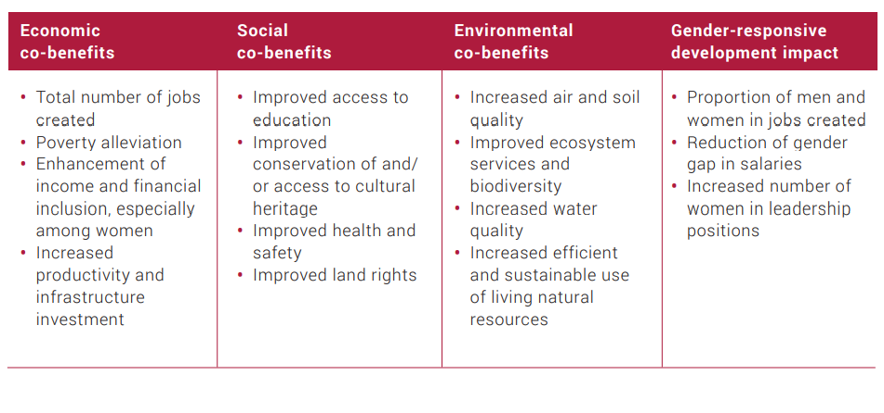

Sustainable Development Potential - co-benefits indicators
Transformational Change
Theory of Change
GCF example
Purpose: Demonstrate that the project is firmly anchored in sustainable development.
Identify relevant co-benefits – w/ indicator, baseline and target values, ideally disaggregated for men and women. Where appropriate, proposals refer to Sustainable Development Goals.
NDC ACTION PROJECT | Facilitating the implementation of climate-resilient and low-carbon development aligned with national and global goals

Slide 12
Thank you for contributing to a brighter future
Name
Position
UNEP Copenhagen Climate Centre
email
Supported by:
based on a decision of the German Bundestag

