Slide 1





The NDC Action Project
Climate Finance Training Kit
Barrier Analysis and Theory of Change
Supported by:
based on a decision of the German Bundestag

Slide 2

Barriers
Translate to actions
Theory of change
Log Frame
Barriers
A condition that reduces the probability of adoption of mitigation measures
Provides inputs for argumentation of paradigm shift
Help identifying the actual activities, outputs and outcomes
Organizing the process
Identification and classification of barriers
Analysis, decomposition and prioritization of barriers
Translation of barriers into actions, and
Development of a plan to create enabling environments
NDC ACTION PROJECT | Facilitating the implementation of climate-resilient and low-carbon development aligned with national and global goals
Notes:
A barrier can be described as any condition that substantially reduces the probability of adoption of mitigation ands adaptation measures. Barriers are the defining element with regard to why a country, sector, or sub-sector is locked into a development path towards increasing GHG emissions or cannot improve its resilience and adaptive capacities in response to increasing vulnerability to the effects of climate change. Therefore, overcoming barriers is at the heart of achieving the scope of the projects and a paradigm shift in the given sector/sub-sector we are addressing. T
alking about paradigm shift,, the GCF evaluates proposal against the activities capacity to overcome systematic barriers to allow for market development and transformation. In the context of the GCF, the definition of barriers also receives particular importance related to the envisioned financial structure and instruments; and to what extent these can help overcome the existing barriers (GCF, 2015a). It is therefore crucial to analyze barriers, identify root causes, and devise an action plan for barrier removal. In fact, the central activities in a proposal consist of activities that create enabling environments which are meant to overcome the barriers identified in the analysis. By presenting a comprehensive barrier analysis and actions for barrier removal, the project implementers demonstrate that they are knowledgeable of the sector, technologies and/or national circumstances, in control of the process and dedicated to implementation.
The primary goal of the barrier analysis is to understand the nature of the barriers and their interrelation, to determine which barriers are central to the lock-in situation, to identify which ones are likely to remain as risks after implementation since they are not fully within the developer’s control, and how to address the identified barriers. There is no exact way on how to perform a barrier analysis, and the process will vary depending on the envisioned activities, the stakeholders and the local context, but the set of steps suggested here can serve as a guideline to structure the process:
Organizing the process
Identification and classification of barriers
Analysis, decomposition and prioritization of barriers
Translation of barriers into actions, and
Development of a plan to create enabling environments
The first step involves a consideration on how to organize the process of the barrier analysis, given the envisioned actions and the national context. A starting point is a preliminary desk study that should complement the national literature and information identified in the country ownership process earlier by researching policy papers and other relevant documentation related to the envisioned actions, such as economic assessments, feasibility studies, environmental impact assessments or similar documents.
Further, barriers are frequently identified in a semi-structured way, e.g. in sectoral focus groups, ministerial or inter-ministerial committees, working groups, or any other forum in which the project has been discussed or prepared. For a more thorough barrier analysis organizing dedicated expert and stakeholder interviews or focus group sessions with an expanded typology of stakeholders is helpful.

Slide 3
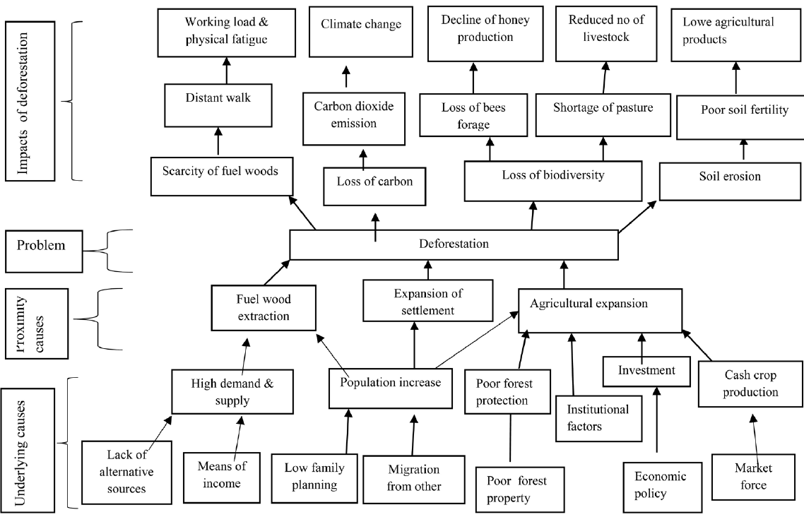
Barriers
Translate to actions
Theory of change
Log Frame
Identification of Barriers
Impacts
Problem
Root causes
NDC ACTION PROJECT | Facilitating the implementation of climate-resilient and low-carbon development aligned with national and global goals
Notes:
A simple visualization can help stakeholders increase their knowledge of what to consider as barriers, identify root causes, and define the impacts of these barriers. Ideally, relevant stakeholders should be consulted through structured working groups to elicit input from various relevant/impacted sources. An easy way to guide the process is to use a problem tree. The first thing to do is to identify the problem, here exemplified by deforestation, but it could also be "farmers vulnerable to prolonged droughts", "waste is not managed, it is disposed of and burned". Next, it is important to move to the roots and define the causes of why this is happening, for example, lack of regulation, market, support structures, lack of infrastructure or others. Moving downwards, we identify the root causes and barriers that need to be overcome. Root causes make it possible to specify the barrier, clarify the reason for its existence, and identify possible ways to remove the barrier. This can also be used as a method to exclude non-crucial barriers; If a barrier category does not have components at lower levels, the identified barrier might not be a crucial barrier to implementation. When we move to the branches of the tree, we describe the impacts of the problem, for example, if the problem is "the lack of development of renewable energies regardless of price competitiveness", the impacts could be, high energy costs, energy dependence on imports, etc. Further progress on this could have a negative impact on the trade balance, negative impacts on the economy, productivity and competitiveness, etc. This visualization will clarify to stakeholders that different types of barriers will arise for a different set of actions along the entire process chain.
The result of this first exercise is a very preliminary list of barriers identified under the causes. Essentially, it is a brainstorming of the factors that have kept the country in the status quo and prevented it from transitioning to the low-carbon/resilient scenario so far.

Slide 4
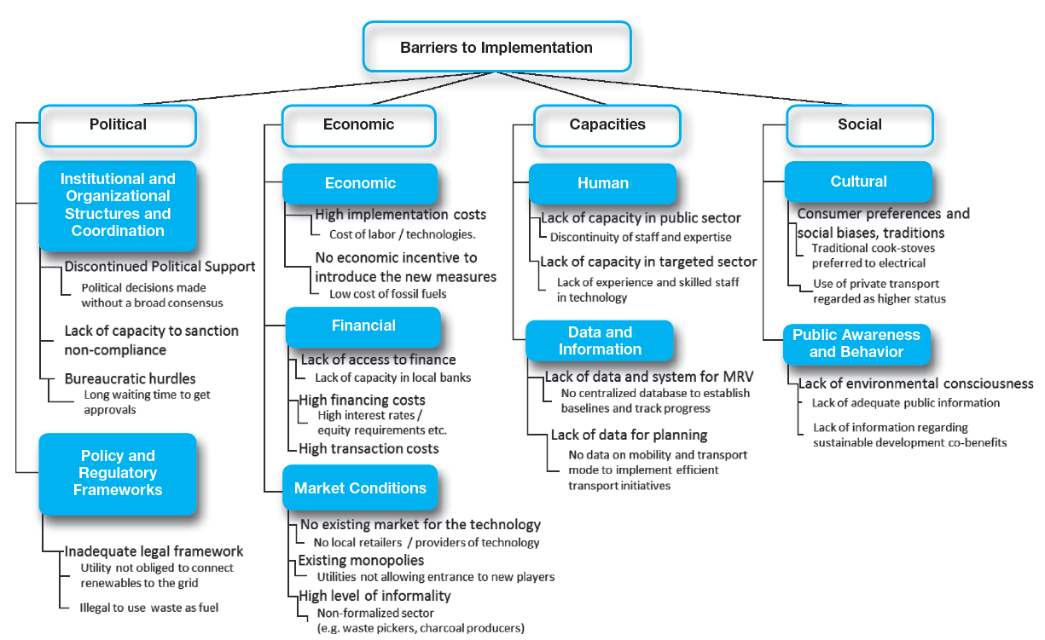
Barriers
Translate to actions
Theory of change
Log Frame
Classification and decomposition of barriers
Focus on critical barriers
Differentiate between barriers and risks
Ryfisch et.al. (2018)
NDC ACTION PROJECT | Facilitating the implementation of climate-resilient and low-carbon development aligned with national and global goals
Notes:
Classification of barriers
In order to clearly describe and classify the identified barriers, the stakeholders can be guided by departing from a very generic list of barrier types before decomposing the barriers in a second step:
Political
This category comprises all elements within the political sphere, ranging from the regulatory framework, legislation and policies over the more practical elements like broad, cross-party support and cross-governmental coordination to the day-to-day work with the public sector, e.g. issuing permits, etc.
Economic
This category extends from the firm-level, at which the technology may be too costly, the sectorial lobby too strong or the power concentrated by a few, over the financial sector, which relates mostly to commercial banks, to political economy issues that provide incentives to remain in the status quo.
Social
This category develops along the lines of cultural and educational awareness and behaviour, creating pre-conditions which do not allow end-users to obtain an unobstructed view on the beneficiary components of the NAMA.
Capacities
This category is composed of technical capacities which include the absence or lack of experience with a technology and, consequently lack in corresponding human capacities within the labour force and public sector regulators; and spans to incomplete and non-accessible data needed to feed relevant models.
In general, hard technologies like the equipment needed for the beneficial usage of landfill gas or the recycling of waste are usually diffused under market conditions, and consequently fall within the generic barrier grouping corresponding to economics, but will likely also face other non-economic barriers as well, such as the lack of capacities needed for implementation, usage, and maintenance.

Slide 5
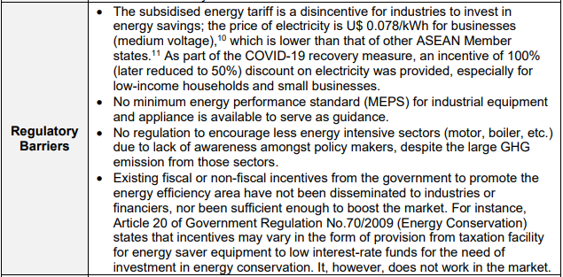
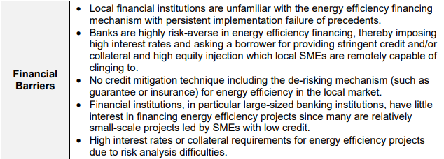
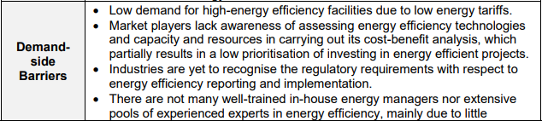
Barriers
Translate to actions
Theory of change
Log Frame
Classification and decomposition of barriers –
EE example
NDC ACTION PROJECT | Facilitating the implementation of climate-resilient and low-carbon development aligned with national and global goals

Slide 6
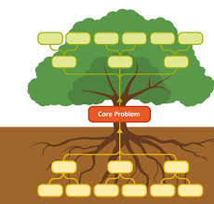
Barriers
Translate to actions
Theory of change
Log Frame
Prioritization of Barriers and Translating into Actions
Effects
List identified barriers and filter them according to their importance
Translating barriers into positive statements solutions - tree of solutions to identify activities and effects
Identify measures and describe how enabling frameworks are created
  Financial measures: grants, power purchase agreements, loan guarantees, etc.
  Technical measures: legal and regulatory interventions, on demonstration projects for capacity building and educational and awareness-raising campaigns
Negative Statements
Core Problem
Causes
Ends
Positive Statements
Changed State
Means
NDC ACTION PROJECT | Facilitating the implementation of climate-resilient and low-carbon development aligned with national and global goals
Notes:
Analysis, decomposition and prioritization of barriers
The initial list of barriers should be analysed and filtered according to their significance. This enables the project developer to keep barriers that are crucial and disregard those of lower importance for the main objective of the project. The process of screening should be a continuation from the identification process, using the same working groups and stakeholders. The relative relevance of barriers should ideally be decided by consensus, where participants engage in an open discussion. The process could also include a voting system.
Along the same lines as the financial barrier example, the introduction of a new technology will evenly challenge the human and technical capacities within a country. Assuming that the technology was previously not available, there will be a lack of technology providers in the country and, correspondingly, the capacity for installation and maintenance. On the end-user side, no previous knowledge will be available in terms of operation. This lack of knowledge can impede the implementation since it will entail potentially significant upfront costs to the firms. Even if implemented in the private sector, the public sector will need to have sufficient oversight capacity, both in terms of knowledge and time. This exemplifies how the barriers to the implementation have to be examined from a diverse set of angles in order to minimize post-implementation risks.
Translation of barriers into actions
When the critical barriers and their causal factors have been identified through a decomposition of the barriers, the barrier analysis should go on to translate the barriers into actions to overcome them. Barriers can be transformed into solutions by transforming the negative statements into positive statements, and identifying their causal relationship. This will translate the barriers’ causes into measures to overcome the identified barriers and will be the first step to identify; what kind of enabling environments needs to be created, and what kinds of activities need to be implemented. So underlying and proximity causes guide the definition of activities, and upward you will find outputs and outcomes. Merete will go more into detail on how to structure your theory of change with outcomes, outputs and activities later.
The positive statements can be translated into measures. E.g. here Poor forest protection will be translated into "good forest protection enforced", but we need to describe how we envision this will happen. In essence describe the measures to overcome barriers.
Measures can roughly be divided into financial and technical measures, which will often require one or several forms of source financing. Financial measures entail those actions that are directly associated with the availability of financing to the implementer or end-user, like subsidies, power purchase agreements and loan guarantees. Technical measures tend to have a wider range, including everything from legal and regulatory interventions, over demonstration projects to capacity building, and educational and awareness campaigns. Hence, even though donors tend to differentiate between financial and technical components, everything that is evidently non-financial is considered technical. There is not necessarily a direct correspondence between financial / technical measures and market / non-market barriers. For example, a barrier for a hard technology, e.g. the reluctance of households to install solar PV, might be overcome by a mix of financial and technical actions.
Depending on the identified decomposition of barriers, there might be a need for a solar PV feed-in-tariff, legislation requiring the electricity utility company to buy electricity and bear the cost of connection to the grid in addition to information campaigns and training.
When actions to create enabling environments for the project have been identified, the proposed actions need to be assessed in order to define their feasibility. In their assessment a range of criteria should be taken into consideration before deciding on the specific actions; the actions’ costs and cost-effectiveness, their potential social and environmental impacts, the interdependencies between different actions, the institutional feasibility and their complexity should be considered before deciding on the specific actions.

Slide 7
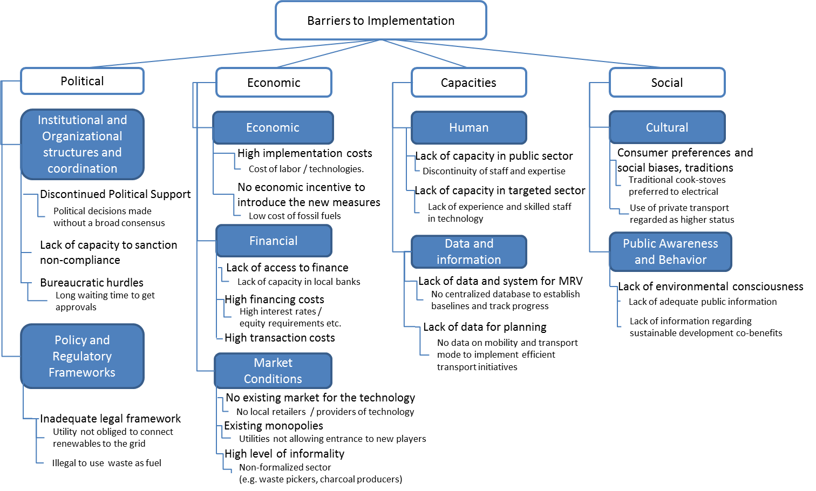
Barriers
Translate to actions
Theory of change
Log Frame
Identifying the appropriate instruments
E.g. Tax holidays
E.g. Grant for technical support
E.g. Green Credit Lines
Concessional loan
Guarantees
NDC ACTION PROJECT | Facilitating the implementation of climate-resilient and low-carbon development aligned with national and global goals
Notes:
Any decision on which financing instruments to apply and their final details (for example, the interest rate of a concessional loan) will in the end be a result of the interaction betwen the interested parties and the leverage of the other applied instruments, but as project designers we need to present an initial design for a potential financing mechanism and which financing instruments that could apply. The identification of financing instruments should always be based on the specific barriers for implementation identified for the specific measure we try to introduce, and the local context we operate in. To make a simplified example. let's imagine that we want to introduce a RE technology, but the initial capital investment required hinder the implementation of the given technology, one approach could be to reach an agreement for temporary tax brakes for the import of the technology. If the problem is the high interest rates of the local banks, we could look for financing partners who have green credit lines with favourable conditions. If there is a lack of experience and skilled staff in the technology, we could look for grants for technical support and demonstration projects. Of course every proposed instruments should be based on an argument for why it is needed, and one instrument alone will in many cases not be enough. Often there is the need to mix regulatory instruments together with financial ones to reach favourable financing conditions. It is the aggregation of these instruments that leads to the creation of a financing mechanism that gets it "just right" to make the wanted measures implementable which is the critical task of project design. Here illustrated by public sector intervention through tax holidays and guarantees, which could facilitate attracting concessional finance. In any case, government commitment illustrated through direct action is often a very successful tool leverage finance and reduce the risk perception of investors.

Slide 8
Barriers
Translate to actions
Theory of change
Log Frame
OECD Definitions
Input
“The financial, human and resources used for the development intervention”
Activities
“Actions taken or work performed through which inputs…are mobilized to produce specific outputs”
Output
“The products, capital goods and services which result from an development intervention”
Outcome
Impact
“The likely or achieved short-term and medium-term effects of an intervention output” (WB: the change in systems or behavior)
“Positive and negative, primary and secondary long term effects produced by a development intervention, directly or indirectly, intended or unintended“
Source: ibid DAC Glossary of Key Terms in Evaluation and RBM, OECD 2010
NDC ACTION PROJECT | Facilitating the implementation of climate-resilient and low-carbon development aligned with national and global goals

Slide 9
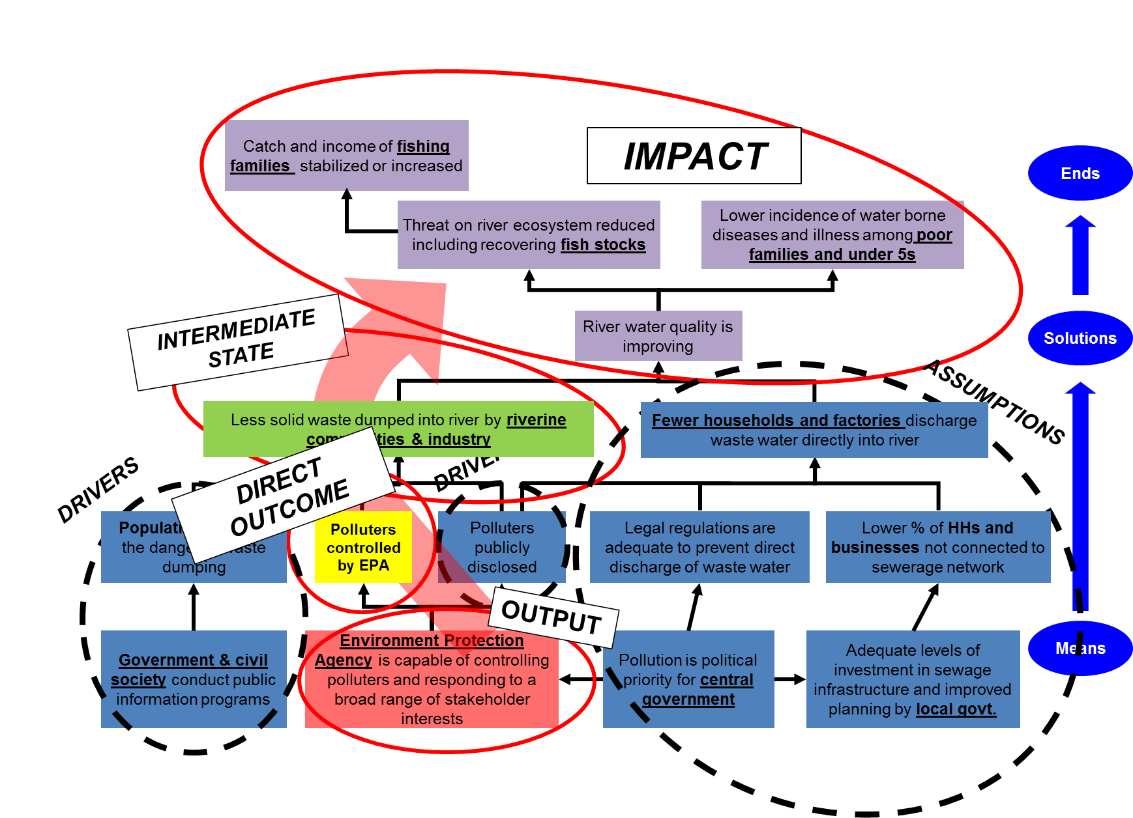
Barriers
Translate to actions
Theory of change
Log Frame
Translate into ToC terminology
Source: Janet Wildish, UN Environment
NDC ACTION PROJECT | Facilitating the implementation of climate-resilient and low-carbon development aligned with national and global goals

Slide 10
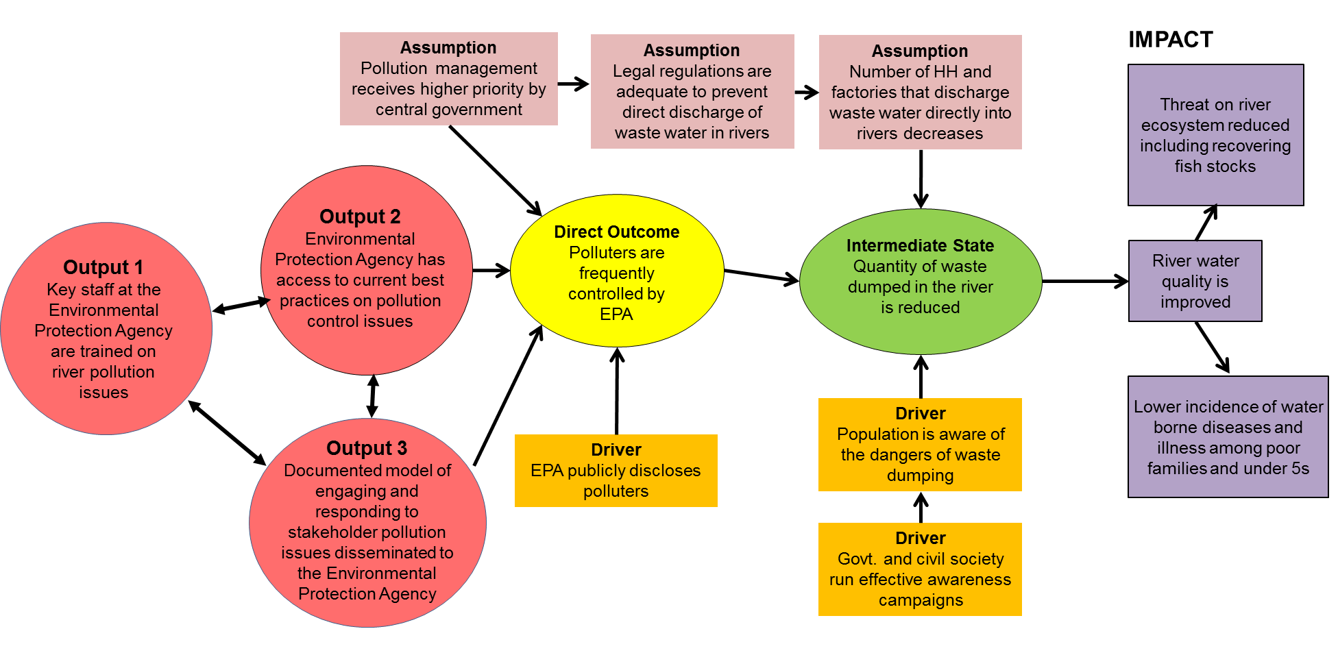
Barriers
Translate to actions
Theory of change
Log Frame
Transferring to a Theory of Change Diagram
Source: Janet Wildish, UN Environment
NDC ACTION PROJECT | Facilitating the implementation of climate-resilient and low-carbon development aligned with national and global goals

Slide 11
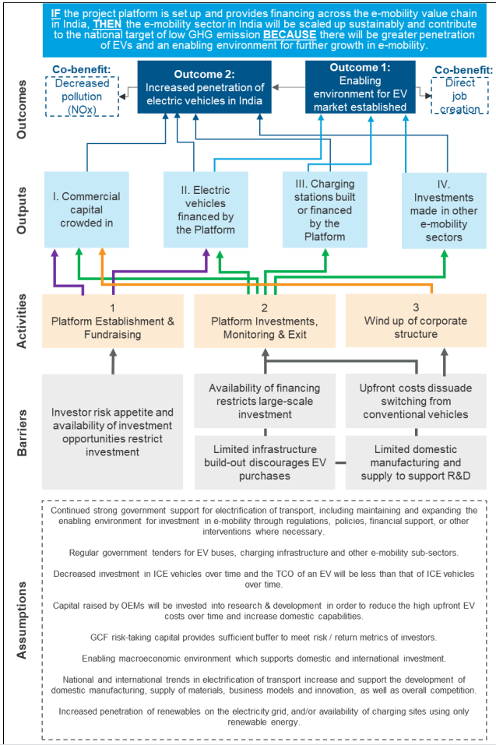
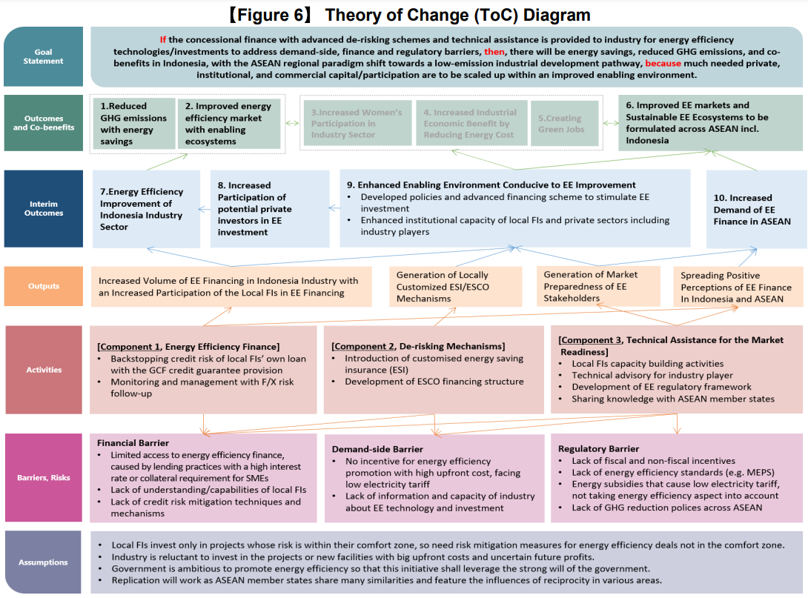
Barriers
Translate to actions
Theory of change
Log Frame
Examples
GCF Proposal: 196, Supporting Innovative Mechanisms for Industrial Energy Efficiency Financing in Indonesia with Lessons for Replication in other ASEAN Member States
GCF Proposal: 186, India E-Mobility Financing Program
Source: Janet Wildish, UN Environment
NDC ACTION PROJECT | Facilitating the implementation of climate-resilient and low-carbon development aligned with national and global goals

Slide 12
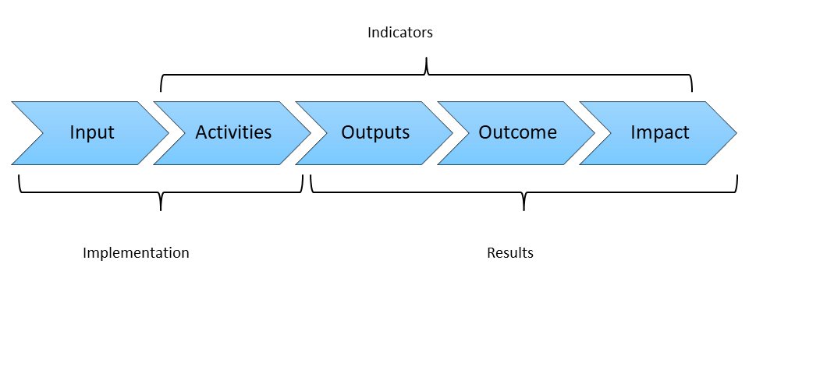
Barriers
Translate to actions
Theory of change
Log Frame
The results chain
NDC ACTION PROJECT | Facilitating the implementation of climate-resilient and low-carbon development aligned with national and global goals

Slide 13
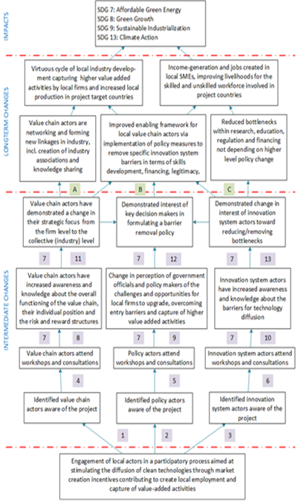
Barriers
Translate to actions
Theory of change
Log Frame
ToC vs LFA
LFA Matrix
ToC diagram
NDC ACTION PROJECT | Facilitating the implementation of climate-resilient and low-carbon development aligned with national and global goals

Slide 14
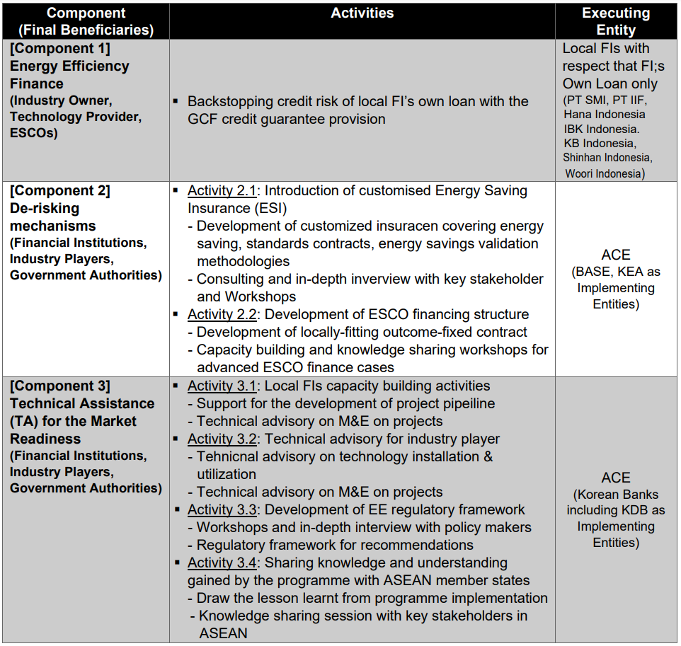
Barriers
Translate to actions
Theory of change
Log Frame
Examples
Examples
GCF Proposal: 196, Supporting Innovative Mechanisms for Industrial Energy Efficiency Financing in Indonesia with Lessons for Replication in other ASEAN Member States
Source: Janet Wildish, UN Environment
NDC ACTION PROJECT | Facilitating the implementation of climate-resilient and low-carbon development aligned with national and global goals

Slide 15
Barriers
Translate to actions
Theory of change
Log Frame
Examples
Examples
GCF Proposal: 196, Supporting Innovative Mechanisms for Industrial Energy Efficiency Financing in Indonesia with Lessons for Replication in other ASEAN Member States
Source: Janet Wildish, UN Environment
NDC ACTION PROJECT | Facilitating the implementation of climate-resilient and low-carbon development aligned with national and global goals

Slide 16
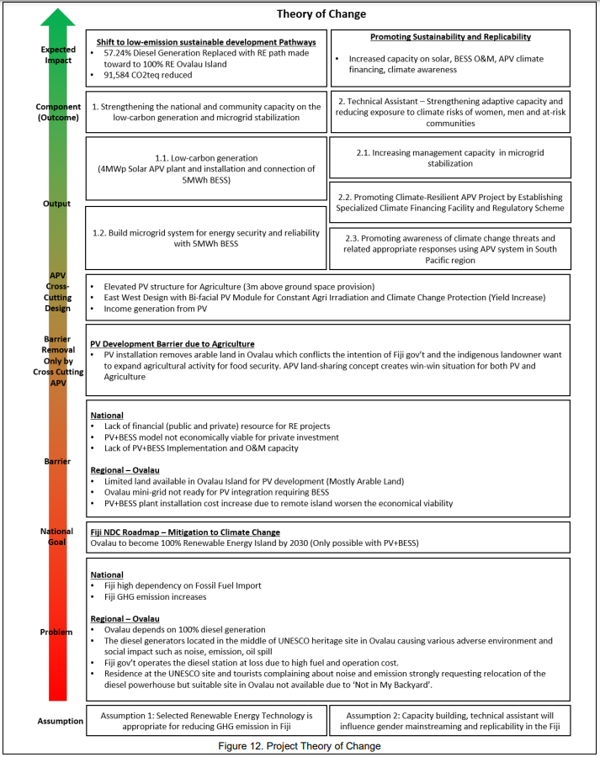
Barriers
Translate to actions
Theory of change
Log Frame
Examples
Examples
GCF Proposal: SAP016, Fiji Agrophotovoltaic Project in Ovalau
NDC ACTION PROJECT | Facilitating the implementation of climate-resilient and low-carbon development aligned with national and global goals

Slide 17
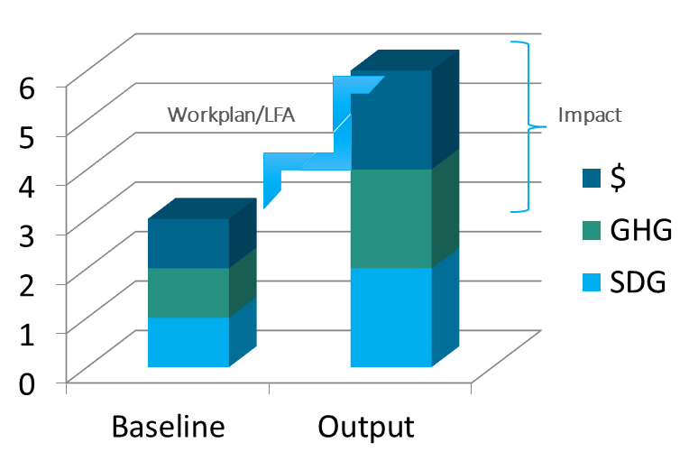
Barriers
Translate to actions
Theory of change
Log Frame
Examples
Relationship with mitigation/impact scenario
Well defined Baseline
Well defined Output
Well defined Work plan
Well defined Impact
Best value for money
  Impact vs costs
NDC ACTION PROJECT | Facilitating the implementation of climate-resilient and low-carbon development aligned with national and global goals

Slide 18
Barriers
Translate to actions
Theory of change
Log Frame
Examples
Process to present impacts and outcomes and identify activities
1. Problem & objective tree
Identify key stakeholders
Identify causes and effects
Convert problems into an Objective Tree
2. Establish the Theory of Change
Establish the effects the project can reach (Outcome)
Identify drivers (contributing conditions inside the project)
Identify assumptions (contributing conditions outside the project)
Identify other results (Outputs, Intermediate States, Impact)
3. Formulate the Logframe
Formulate activities to overcome barriers and define needed inputs
Formulate results statements (for outputs and outcomes)
Identify indicators
Set milestones
NDC ACTION PROJECT | Facilitating the implementation of climate-resilient and low-carbon development aligned with national and global goals

Slide 19
Thank you for contributing to a brighter future
Federico Antonio Canu
Advisor - Finance
UNEP Copenhagen Climate Centre
federico.canu@un.org
Supported by:
based on a decision of the German Bundestag

