Slide 1





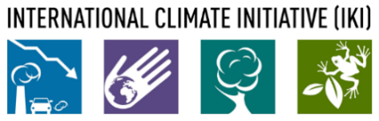
The NDC Action Project
Climate Finance Training Kit
Budgeting principles and CBA analysis
Supported by:
based on a decision of the German Bundestag

Slide 2
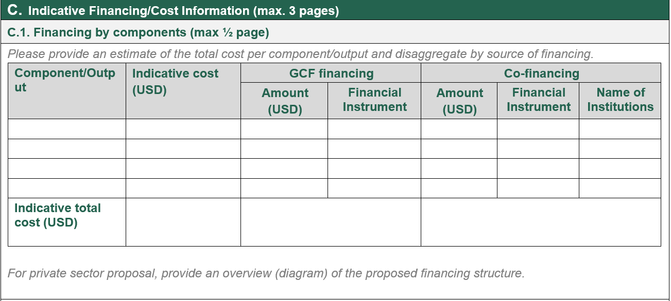

Information
CBA
Costs and Benefits
Cash Flows
Indicators
Examples
Sensitivity
Information required by donors on the Business Case
Capacity building, policy development etc. (grant-based)
  Assumptions on manpower and consultancy service
Investment in technologies/practices (non-grant)
  CBA
Assist in structuring the justification funding
  Financial instruments
  Concessionality
NDC ACTION PROJECT | Facilitating the implementation of climate-resilient and low-carbon development aligned with national and global goals
Notes:
The tables illustrate the information requested by the Green Climate Fund and the Mitigation Action Facility.
Generally, donors, including GCF, as we can see from the table, require you, or the agency applying for the funding to provide information on the total budget, requested amounts, co-finance and source and financial instruments to be used.
Financial instruments that can be used for financing can be grants, which are essentially non-repayable funds provided to support the project, loans, funds that have to be returned with an interest rate and other instruments like equity investments, guarantees, etc.
Activities related to capacity building, policy and regulation support, institutional strengthening, etc., which might have big transformational impacts but are smaller investments in monetary terms and are more likely to be financed by, e.g grants, could be estimated based on assumptions on time needed to develop the needed capacities, policies etc. Potential use and need of external consultants, and their fees etc.
Activities related to investments and implementation of technologies, often more related to financial instruments such as loans, guarantees, equity, etc. and often involve the largest share of the total project finance, these need to be estimated based on the business case itself, alongwith a mapping of costs and benefits and analysis of the required support in order to make the investment viable. And this is the focus of this presentation.
Providing this information, building up your business case and through a cost-benefit analysis approach, comparing various options will assist you in structuring the arguments and the justification for why Donor support is needed to ensure the viability/bankability of your projects.
It will assist you in providing a justification for the amount and level of concessionality of funding requested, and the financial instrument(s) proposed in order to close the funding gap. In the case of grant funding without repayment contingency, you should present a convincing financial and/or economic argument, and that the level of concessionality should correspond to the level of the proposal’s expected performance against the investment criteria.

Slide 3
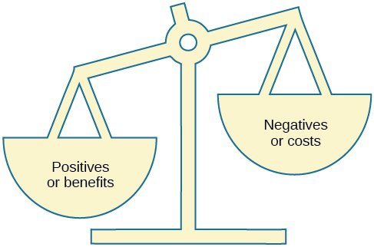
Information
CBA
Costs and Benefits
Cash Flows
Indicators
Examples
Sensitivity
Cost Benefit Analysis
'a systematic approach to estimating the (economic) strengths and weaknesses of alternatives
Oftentimes used to determine the prospective merits of policy proposals.
CBA is slightly related to cost-effectiveness analysis - part of the donors investment criteria
Benefits and costs in CBA are expressed in monetary terms and adjusted for the money’s time value.
CBA is simple at face value.
It is complicated in practice.
This Photo by Unknown Author is licensed under CC BY
NDC ACTION PROJECT | Facilitating the implementation of climate-resilient and low-carbon development aligned with national and global goals
Notes:
Cost-Benefit Analysis (CBA) is a systematic approach to estimating the strengths and weaknesses of alternatives used to determine options that provide the best approach to achieve benefits while preserving savings. It is a method used in both the public and private sectors to evaluate the potential outcomes of a decision, project, or policy. The goal of CBA is to determine if the benefits of a decision or action outweigh its costs, and by how much relative to other alternatives.
e.g. the U.S. Securities and Exchange Commission has to conduct cost-benefit analysis before instituting regulations or de-regulations.
It can be said that CBA is related to cost-effectiveness analysis – which is also part of the Donor investment criteria.
Benefits and costs in CBA are expressed in monetary terms and are adjusted for the time value of money. I will talk more about the time value of money and discount rates later.
CBA is simple at face value. But can bes complicated in practice, depending on the extent of your analysis.

Slide 4
Information
CBA
Costs and Benefits
Cash Flows
Indicators
Examples
Sensitivity
Cost Benefit Analysis
Let's do the simple first:
Step One: Brainstorm Costs and Benefits
  All costs associated with the project, imaginable and unimaginable; make a list of these. Then, consider the lifetime of the project. When are costs and benefits likely to occur?
Step Two: Assign a Monetary Value to the Costs
  Costs of physical resources and human effort involved in all phases of a project. "Costs are often relatively easy to estimate (compared with revenues)". Include also costs incurred over the lifetime of the project. Costs after the project’s lifetime?
Step Three: Assign a Monetary Value to the Benefits
  More complicated because everything is in the future (cost/investment is upfront). Benefits in the value of services rendered, direct and indirect costs saved, time saved (common for transport), (health) value of pollution eliminated. Benefits after the project’s lifetime?
Step Four: Compare Costs and Benefits
This Photo by Unknown Author is licensed under CC BY
NDC ACTION PROJECT | Facilitating the implementation of climate-resilient and low-carbon development aligned with national and global goals
Notes:
Let's look at the simple aspects of CBA first. It usually consists of four steps.
Step One: Brainstorm Costs and Benefits
All costs associated with the project, imaginable and unimaginable; make a list of these. Then, consider the lifetime of the project. When are costs and benefits likely to occur?
Step Two: Assign a Monetary Value to the Costs
Costs of physical resources and human effort involved in all phases of a project. "Costs are often relatively easy to estimate (compared with revenues)". Include also costs incurred over the lifetime of the project. Costs after the project’s lifetime?
Step Three: Assign a Monetary Value to the Benefits
More complicated because everything is in the future (cost/investment is up front). Benefits in the value of services rendered, direct and indirect costs saved, time saved (common for transport), (health) value of pollution eliminated. Benefits after the project lifetime?
Step Four: Compare Costs and Benefits

Slide 5
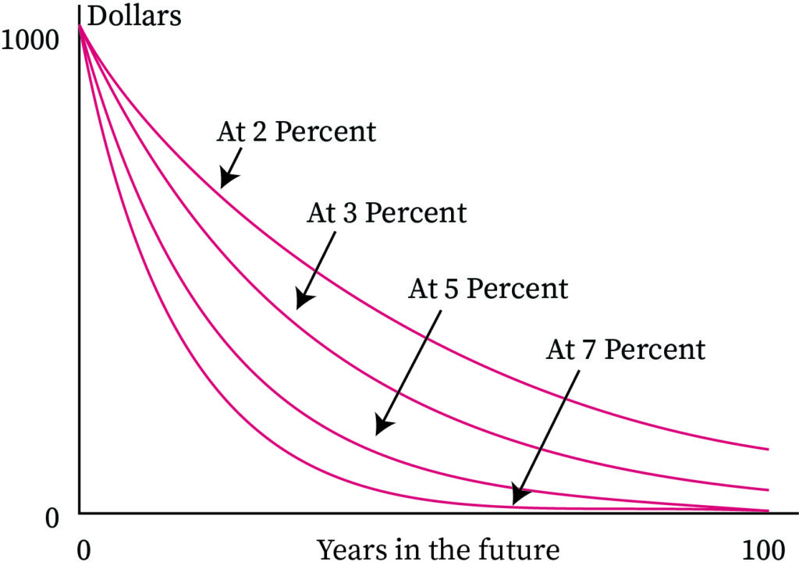
Information
CBA
Costs and Benefits
Cash Flows
Indicators
Examples
Sensitivity
Cost Benefit Analysis
The more complicated approach:
Three simple questions to illustrate the complication:
The cost to whom? (externalities?)
Which benefits?
What is the value of assets and money in the future?
Source:https://www.bartleby.com/subject/business/finance/concepts/time-value-of-money
NDC ACTION PROJECT | Facilitating the implementation of climate-resilient and low-carbon development aligned with national and global goals
Notes:
Now, looking at the more complicated aspects…
When we think about costs, basically, where do we draw the line about what costs we incorporate in our analysis? As an example, in the case of mangrove protection, do we assess the costs of livestock not being able to graze mangroves if more surveillance and enforcement are introduced to prevent mangrove degradation? What about costs related to biodiversity loss if the land is cleared for a PV power plant or the cost of farmers downstream if we build a water catchment infrastructure upstream?
The same goes for the benefits. We know there are air quality benefits of solar PV compared to other sources, but can we monetize it? What is the value of human health or of a species or mangrove nursery?
In addition, there is the whole aspect of the time value of money. Basically. 1 dollar in hand today is worth more than 1 dollar in hand tomorrow. Discount rates dictate the future value of money. Discount rates are set to reflect the human perception of the future value of money, but are, at the same time, a theoretical construct. The graph here shows the different values of money depending on different discount rates, so basically, the choice of the discount rate (usually set by the Ministry of Finance) has a huge impact on the perception of the viability and value of different investments. In simple terms, a high discount rate values a highly short-term perspective and quick returns. This usually disfavours technologies with long lifespans and low operation costs, like solar, compared to diesel generators. It also disfavours projects with long-lasting positive benefits in the long run. There are discussions in some countries and fields about the need to change towards applying different discount rates depending on the level of sustainability of the intervention.

Slide 6
Information
CBA
Costs and Benefits
Cash Flows
Indicators
Examples
Sensitivity
Mapping costs and benefits
Divide activities in blocks of time
  Development / planning
  Pre-operation
  O&M
Estimate costs and revenues for each activity
Distribute cost and revenues in chronological order under a BAU scenario
Consider grants, subsidies and the concessional finance you request
Activities | Estimated cost | Start | Finish
Proposal preparation
Permits | 15,000 | 1 | 12
Technical analysis | 15,000 | 1 | 24
Consultancy Contracts | 15,000 | 1 | 24
Construction
Land acquisition | 240,000 | 6 | 12
Engineering | 110,000 | 6 | 12
Machinery 1 | 2,381 | 6 | 12
Machinery 2 | 200,000 | 13 | 24
Machinery 3 | 111,000 | 13 | 24
Machinery 4 | 22,333 | 13 | 24
Testing 1 | 300,000 | 25 | 36
Testing 2 | 33,334 | 25 | 36
Interest payment | 50,952 | 6 | 36
 | Revenues | Year 1 | Year 2 | ….. | Years 6-15
 | Units Sold | 400 | 550 |  | 700
 | Revenue per unit | 200 | 200 |  | 200
R1 | Revenue from Energy | 80,000 | 110,000 |  | 140,000
 | Units Sold | 300 | 520 |  | 670
 | Revenue per unit | 200 | 200 |  | 200
R2 | Revenue from heat | 60,000 | 104,000 |  | 134,000
 | Units Sold |  | 150 |  | 150
 | Revenue per unit | 0 | 27,000 |  | 30,000
R3 | Revenue from Residue | 140,000 | 241,000 |  | 304,000
NDC ACTION PROJECT | Facilitating the implementation of climate-resilient and low-carbon development aligned with national and global goals
Notes:
So now that we have understood the principles of a cost benefit analysis, we can try to structure the information on costs and benefits into a business case.
In order to say something about the cost of the activities, you first need to create an overview of the costs related to the introduction of the intended activity or practice. But keep in mind that the introduction of the intended technology or practices creates returns or savings; the Climate finance facility will not be willing to cover all the cost of the investment. You should try to incorporate revenues into your calculations and only seek the minimum amount of support needed to make the activity viable. In addition, since the Climate finance facility is willing to invest in activities that become self-sustainable over time, it is a good idea to illustrate how the intervention will be financially sustainable in the long run. To do this, it is a good idea to prepare a business case.
In order to build a base case, it is helpful to think of activities in terms of blocks of time, i.e., Development Phase, Construction and Pre-Operation Phase, and Operation and Maintenance Phase. In each phase, different activities are carried out, which should be identified in their turn, e.g. using a logical framework approach and/or a theory of change framework. Once we are clear about the activities, the next step is to estimate the costs and revenues for the activities that need to be obtained, divided into phases.
Project developers should go through each activity until every one of the costs and revenues/savings are identified. Once this has been done, the costs and revenues have to be distributed over chronological time. This should be done both for the baseline, in other words, based on the current financial environment, such as loans with interests at market rate, or the concessional finance you can access currently, but might have some limitations. For instance, the Central Bank of Sudan has a Micro Finance Guarantee Agency. Could this be used to leverage additional finance for small loans to finance agricultural and mangrove restoration practices? Could other national agencies or programmes could provide parts of the finance, even though not able to cover the whole investment? It is very important to note that showing even a limited potential co-finance from other sources will greatly improve the standing of your proposal. Having more financiers on board only means that the risk is shared and that others already believe in your project. This is the easiest way to leverage additional finance and attract financiers. Of course this is a chicken and egg problem, but important to keep in mind, and an example of where a small contribution from the national government also can assist in going far in leveraging additional funds.
Sorry for the digression.
The next step is to consider the concessional finance you are applying for in the project, or the financial / economic enabling environment that will be created with the project. Being loans, grants, creation or removal of subsidies or disincentives etc. What your analysis ideally will show is that the BAU financial situation has some inherent barriers that prevents the investment from happening, while the alternative support scenario is actually a successful one.

Slide 7
Information
CBA
Costs and Benefits
Cash Flows
Indicators
Examples
Sensitivity
Cash Flows - Costs and Revenue over the timeline
of project
Details to consider:
Interest rate of debt
Tenure of debt (years)
Income Tax Rate
Discount Rate
Debt / equity ratio
Central financial indicators to provide:
Net Present Value (NPV)
Internal Rate of Return (IRR)
Pay-Back Time
NDC ACTION PROJECT | Facilitating the implementation of climate-resilient and low-carbon development aligned with national and global goals
Notes:
The information needs, of course, to be generated using assumptions regarding the current and potential interest rates on debt, loan conditions, discount rates and tax rates to develop a base case for a financial plan. Are we all clear on these terms? Using a financial calculator, we can then calculate various financial ratios such as Net Present Value (NPV), Internal Rate of Return (IRR) and Pay-Back Time.
NPV is an expression of the time value of money, meaning that current cash flows have more value than future cash flows, and where the current value of future cash flows is discounted based on a chosen discount rate. NPV is a metric used to estimate the profitability of investments.
The discount rate applicable can vary from country to country, and the type of investment.
IRR is calculated by reducing the discount rate of the net present value (NPV) of all cash flows from a particular project to zero. IRR provides a metric used to estimate the profitability of investments. While the IRR says something about the return on the investment, i.e. how much money you get back per dollar spent, the NPV say something about the total value of the investment, giving an understanding of the size of the investment.
Pay back time says something about the time it will take until the project starts creating revenues. Pay back time is important to some investors and their choice of financial instrument, for example, an investor might not be willing to invest equity in projects that have a pay back time far into the future, as this would mean they would bind the money that could have been invested in other activities for a very long time. In this case a loan might be more interesting as some funds will start flowing back early in the process.

Slide 8
Information
CBA
Costs and Benefits
Cash Flows
Indicators
Examples
Sensitivity
Financial Analysis - Indicators
Variable | Value
Inputs
Construction cost | 1,115,000
Year 1 revenue | 140,000
Revenue all years | 4,290,000
Operating costs, all years | 1,880,000
Cost of debt | 8.5%
Discount Rate | 5.0%
Financial Ratios
Project IRR Pre Tax (IRR) | 10.3%
NPV | 263,237
Avg DSCR | 2.2
To further understand financial viability
Net Present Value (NPV) - Should be positive
Debt Service Coverage Ratio (DSCR) - Should be above 1
Internal Rate of Return (IRR) - Should be positive and above discount rate
IRR:
Negative = no go
Below discount rate = Self-sustaining, but no private sector interest
Above discount rate = might be relevant for long term interested investors, sustainability focused private sector
10% and up, Private sector with little chance of concessional finance
NDC ACTION PROJECT | Facilitating the implementation of climate-resilient and low-carbon development aligned with national and global goals
Notes:
Net Present Value (NPV) - Should be positive
Debt Service Coverage Ratio (DSCR) – This indicates cash available to pay back the Debt. This should be above 1
Internal Rate of Return (IRR) - Should be positive and above the discount rate
The most common ratio used for a project appraisal by a funding entity is the IRR. Among the rules of thumb used in interpreting IRR are:
If the IRR is negative, revenues and existing grants cannot cover the capital and operating costs for the proposal. Without additional revenues, grants or subsidies, the proposal is probably not financially viable.
If the IRR is positive but below the discount rate, the proposal is financially self-sustaining but may be of limited interest to the private sector, as it does not generate a profit. Specialised impact lenders, investors and donors who value development, environmental and market transformation impacts may be prepared to consider such a proposal.
If the IRR is positive and just above or equal the discount rate, the proposal's financial details (especially tax implications, debt structure and any additional revenues) need to be developed further and different financing schemes considered; the result may or may not be of interest to the private sector. Specialised lenders, investors and donors who are interested in blended investments are likely to be the targets.
If the IRR is substantially above the discount rate, e.g. at 10 per cent, the financial details need to be developed with a strong view towards engaging private-sector investors and lenders.

Slide 9
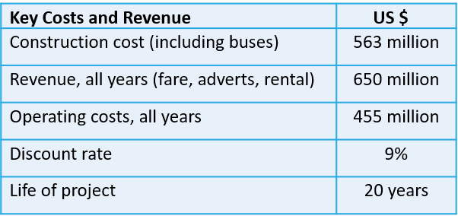
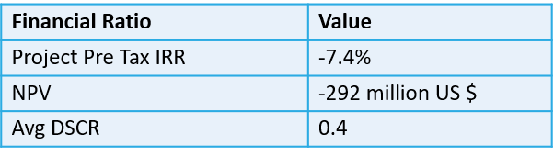
Information
CBA
Costs and Benefits
Cash Flows
Indicators
Examples
Sensitivity
Financial Analysis - Green Bus Rapid Transit, Karachi
Key Financial Inputs
Scope : 30 km BRT with bio-methane hybrid buses
Objectives :
  Provide a credible public transport option
  GHG reduction of 2.6MtCO2e over 30 years
Barriers
  High upfront costs
  Low revenues from fares, adverts and rent
Key Financial Ratios
NDC ACTION PROJECT | Facilitating the implementation of climate-resilient and low-carbon development aligned with national and global goals
Notes:
In this case the TIR and the NPV are negative and the Project is not bankable under commercial conditions. A typical case where the upfront costs are high and the revenues are low because of fare regulations etc. But the Project moved forward anyway. This is because of the substantial social and financial benefits from the project.

Slide 10
Information
CBA
Costs and Benefits
Cash Flows
Indicators
Examples
Sensitivity
Financial Analysis - Green Bus Rapid Transit, Karachi
Strong ownership of provincial government
TransKarachi (entity responsible for project) is free from repayment of infrastructure costs of USD 297 million
Funding | Interest | Amount USD
ADB Seniro Loan | 3.89% | 442 million
GCF Concessional Loan | 0.75% | 37.2 million
GCF Grant |  | 11.8 million
Grant Sindh Government |  | 95.5 million
NDC ACTION PROJECT | Facilitating the implementation of climate-resilient and low-carbon development aligned with national and global goals
Notes:
In this case, the IIR and the NPV are negative, and the Project is not bankable under commercial conditions. But the Project moved forward anyway. As the upfront costs are high there is high percentage of loan finance in the business case.

Slide 11
Information
CBA
Costs and Benefits
Cash Flows
Indicators
Examples
Sensitivity
Financial analysis for adaptation
In anticipation of a climate change scenario (damage case)
Compare with the base case and an adaptation scenario
NDC ACTION PROJECT | Facilitating the implementation of climate-resilient and low-carbon development aligned with national and global goals
Notes:
In the case of adaptation, sometimes the financial analysis is not so simple and cannot always be quantified in a monetary way. But who are we going to show an example

Slide 12
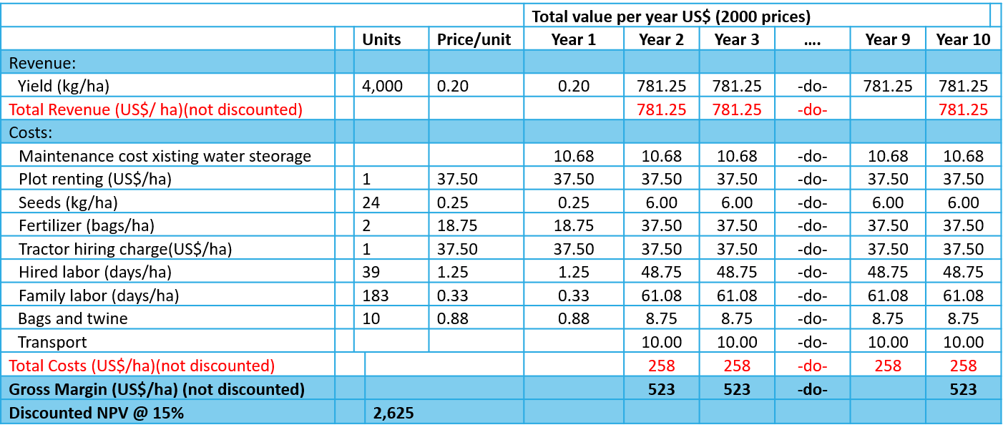
Information
CBA
Costs and Benefits
Cash Flows
Indicators
Examples
Sensitivity
Base Case - Happy Farmer
NDC ACTION PROJECT | Facilitating the implementation of climate-resilient and low-carbon development aligned with national and global goals
Notes:
Here we are looking at case where a farmer with a good yield in terms of Kg produced per hectare, over a project period of 10 years. So we compare the revenue from the yearly yield which starts from the first year itself, with costs. The cost includes maintenance, plot renting costs for seeds, fertilisers, hiring of equipment, labour and other costs. The year gross margin, that is, the profit is 523 US dollars, so if we consider the discount rate of 15% the NPV, that is the difference between the present value of cash inflows and the present value of cash outflows over a period of time after discounting for time value is 2625 USD, which makes the farmer happy.

Slide 13
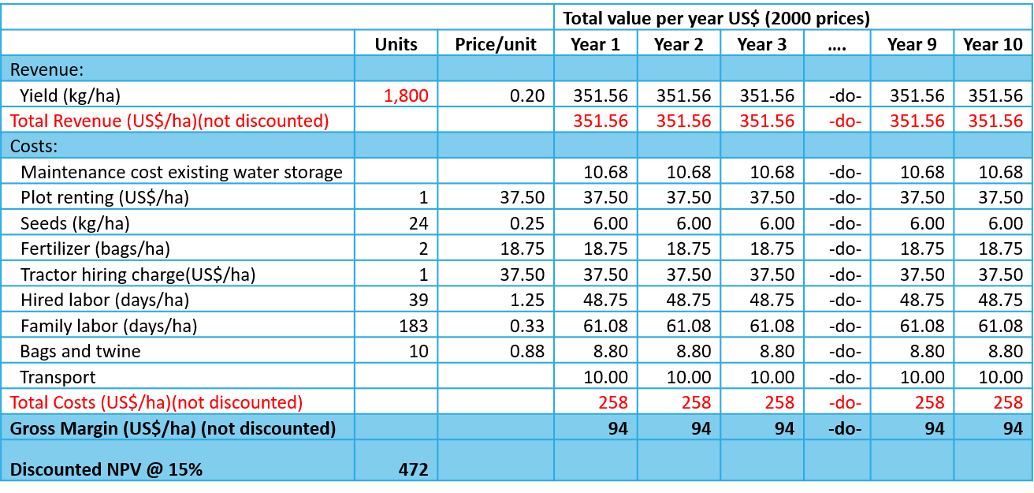
Information
CBA
Costs and Benefits
Cash Flows
Indicators
Examples
Sensitivity
Base Case - Unhappy Farmer
NDC ACTION PROJECT | Facilitating the implementation of climate-resilient and low-carbon development aligned with national and global goals
Notes:
In another case with the same cost structure, but the yield is lower per hectare. Therefore the revenues are les, this results in an NPV of 472 at discount rate of 15%, making the Farmer unhappy as the present value of cash flows is substantially less.

Slide 14
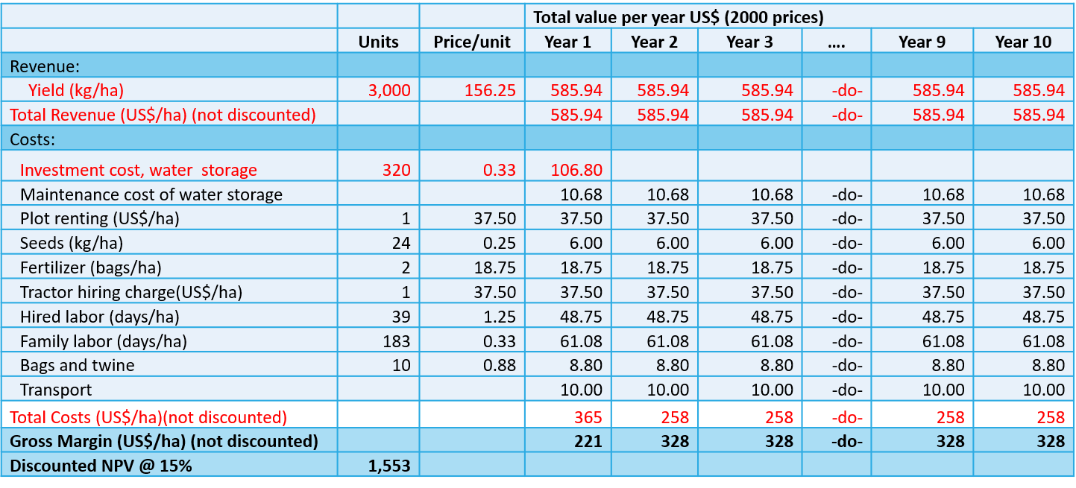
Information
CBA
Costs and Benefits
Cash Flows
Indicators
Examples
Sensitivity
Adaptation Case
NDC ACTION PROJECT | Facilitating the implementation of climate-resilient and low-carbon development aligned with national and global goals
Notes:
In the adaptation case, we find out that the unhappy Farmer has lower yeild as enough wáter is not available so in the adaptation case upfront investment is made in wáter storage so that yeild for the unhappy Farmer increases. So all paramters remaining same we find that by making an upfront investment of around 106 USD in wáter storage infrastructure, the yeild substantially increases and the new NPV is 1553, which should make the unhappy Farmer relatively happy.

Slide 15
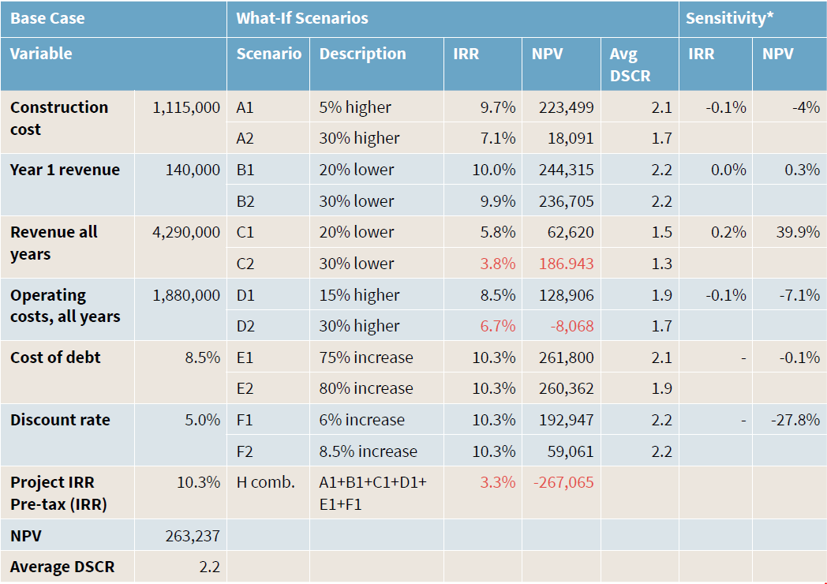
Information
CBA
Costs and Benefits
Cash Flows
Indicators
Examples
Sensitivity
Sensitivity Analysis
Consider financial risk and present different scenarios
  unforeseen higher costs
  Unforeseen lower revenues
Identify risk mitigation measures
  Currency exchange guarantees
  Government guarantees
NDC ACTION PROJECT | Facilitating the implementation of climate-resilient and low-carbon development aligned with national and global goals
Notes:
The base case provides a picture of the project and potentially an argument for why concessional finance is needed, and the alternative case provides a positive picture of the project, when the needed enabling financial environment is created, allowing for the investment to happen. Although both equity investors and funding institutions that provide grants and loans will always require an understanding of the risks to their investment. We will touch upon the topic of risk in more detail later, but in term of financial risk it important to understand how changes to financial structuring, such as grants from donors, loans from lenders and equity from owner–investors, will affect the project. So an analysis of what could happen under different circumstances, or if our assumptions change during implementation. The parameters that you want to test the alternatives on might depend on the specific situation. e.g. in countries with high currency fluctuations changes to the value of the dollar vs local currency might have a huge impact on the financial performance of the project if the investor provides a loan in dollars. This might also help you identify potential risk prevention measures like a currency exchange guarantee. Other parameters to check might be lower revenues than expected, higher construction or O&M costs. Another powerful instrument are government guarantees in case the project underperforms
The outcome of this analysis are alternative IRR and NPV to the different variables. Keep in mind that even if the project is robust under different kinds of stress, it might be relevant to also combine different scenarios in order to identify a worst case scenario, as even small variations in variables, when combined can make the project unviable (here illustrated by scenario H in the table).

Slide 16
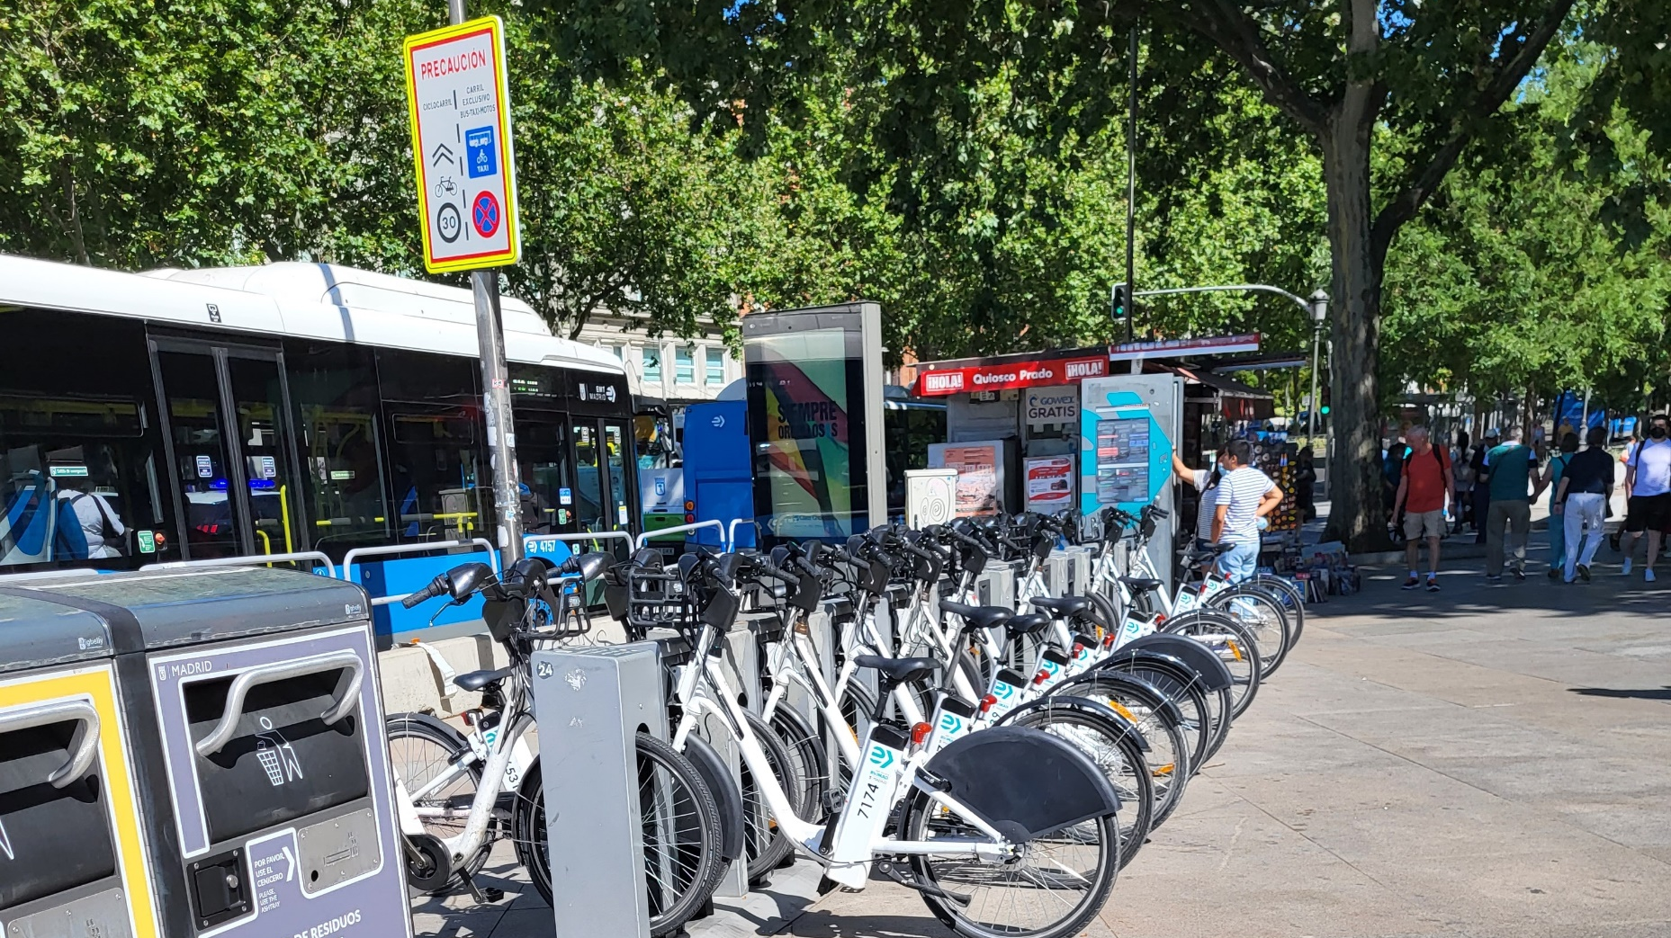
Thank you for contributing to a brighter future
Name: Talat Munshi
Position: Senior Advisor
UNEP Copenhagen Climate Centre
Supported by:
based on a decision of the German Bundestag

