Slide 1





The NDC Action Project
Climate Finance Training Kit
Identification of national sources of finance
- and financial structuring
Supported by:
based on a decision of the German Bundestag
Notes:
Scope,
mapping,
operational instruments
Financial engineering
examples

Slide 2
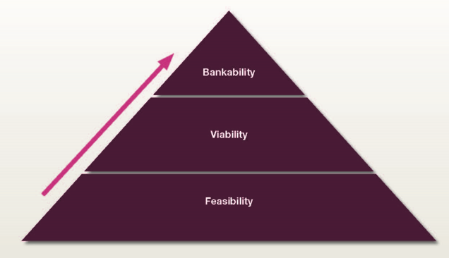

Scope
Mapping
Operational instruments
Financial ENgineering
From Feasibility to Bankability
Feasible - technically and politically
Viable - under realistic assumptions, produce acceptable yields
Financeable / bankable - Returns occur with a sufficient level of certainty (low risk)
The importance of banks
Source: S. E. Lütken 2014
NDC ACTION PROJECT | Facilitating the implementation of climate-resilient and low-carbon development aligned with national and global goals
Notes:
In a traditional private sector terminology, "feasible" refers to projects that are technically and politically feasible. "Viable" projects are feasible projects that, under realistic assumptions, produce acceptable returns on the investment as determined by the investor. But a project is 'bankable' or financeable, only if those returns are produced with a sufficient level of certainty as perceived by third-party funders, typically banks, and if they are convinced that the project can repay the debt. Therefore, the majority of financial engineering, also for climate change purposes, tries to accommodate the concerns of banks.
This is not necessarily as unfair as it seems. Traditionally, banks provide most of the total financing for projects, including investment related to climate, and do so at the beginning, when the risk is highest and all forecasts are to be put to the test. Banks depend on future cash flows to repay loans and, unless cash flows as expected, there is a risk of default. On the other hand, if the cash flow is higher than expected, banks do not have an additional advantage, that is, they only receive interest on the loan, not a part of the benefits.
Banks are the closest ally of the private sector. If the financial participation of the private sector in the mitigation action is crucial - which is in most policy interventions in one way or another, financial engineering is about providing such conditions that allow the private sector and its banking partners to participate and benefit together. Financial engineering is not about convincing banks against their investment principles to invest in sustainability, nor about replacing banks with other financiers. It is about designing financing to allow the private sector and its banking partners to invest profitably in commercial proposals with the benefits of reducing emissions.

Slide 3
Scope
Mapping
Operational instruments
Financial Engineering
The Order of Leveraging
National Public
International Public
National Private
International Private
National climate action and NDC implementation involves a financier in a leading role
  In NDC action development, the leading financier is typically a domestic, public institution
Freed-up cash flow or investment capital from the national budget may be used to leverage international public (donor) finance
Create investment conditions and options that are attractive for the local private sector
International private sector faces higher investment risks than local and usually comes last
Source: S. E. Lütken 2014
NDC ACTION PROJECT | Facilitating the implementation of climate-resilient and low-carbon development aligned with national and global goals
Notes:
Leveraging climate finance for national climate action and NDC implementation normally involves a financier in a leading role.
In NDC action development, the leading financier is typically a domestic, public institution. Demonstrating the ability to mobilize national resources, either through a revision of government budgets or by showing a willingness to regulate the private sector, is a good starting point.
With the NDC action initiative resting with the public sector, it is logical that the public sector should go first in order to inspire private-sector investment. Either by incentivising low carbon and climate resilient investments, and / or disincentivize carbon intensive and maladaptation practices.
Identifying the possible options for redirecting funds or sources of cross-subsidization is an exercise in itself. Any freed-up cash flow or investment capital from the national budget may be used to leverage international public (donor) finance. This does not mean that the two sources of public funding, national and donor, should be deployed in the same manner. The two should be deployed where their special characteristics are most valuable. For instance, international donor funding has distinct advantages for risk cover, particularly if foreign private investment is also being sought. Host country strength, on the other hand, lies in the government's regulatory power and the power to rearrange the national budget in support of specific purposes. Structuring the available finance from these two sources may create investment conditions and options that are attractive for the local private sector, possibly even sufficiently attractive for the foreign private investor, who generally faces higher investment risks than his local competitor. Thus there is a 'right order of leveraging' . As the national private sector has limited leveraging power over the foreign public donor, the national public sector should start its leveraging effort by presenting its policy ideas to international donors before it starts deploying its national financing capacity with the aim of securing private-sector initiative.

Slide 4

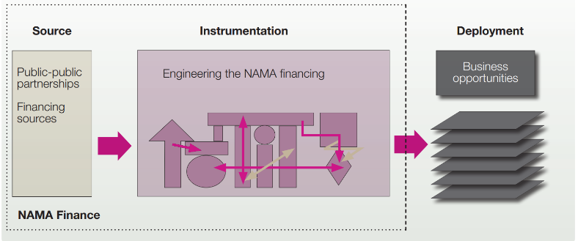

Scope
Mapping
Operational instruments
Financial Engineering
National sources of finance
Map all public stakeholders
Map what is already on-going in the sector
Identify instruments currently employed
Identify current financing sources
Consider the role for the private sector, if any
Source: S. E. Lütken 2014
NDC ACTION PROJECT | Facilitating the implementation of climate-resilient and low-carbon development aligned with national and global goals

Slide 5
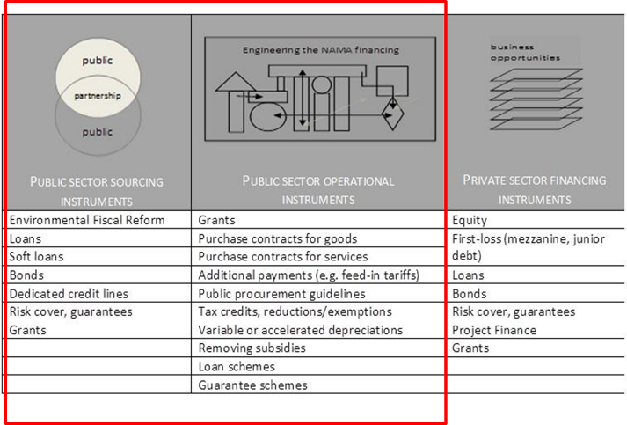
Scope
Mapping
Operational instruments
Financial Engineering
What’s in the toolbox?
NDC ACTION PROJECT | Facilitating the implementation of climate-resilient and low-carbon development aligned with national and global goals

Slide 6
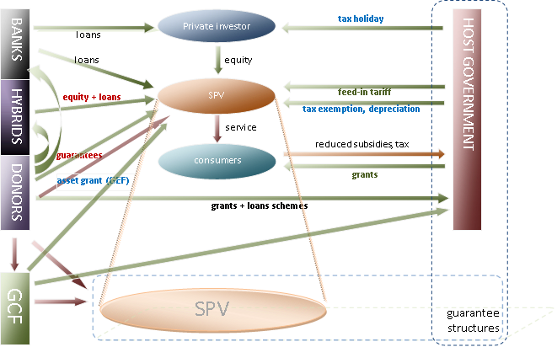
Scope
Mapping
Operational instruments
Financial Engineering
Financial Engineering
From Feasibility to bankability
Structuring the finance from a wide range of potential sources to make the project bankable
Source: S. E. Lütken 2014
NDC ACTION PROJECT | Facilitating the implementation of climate-resilient and low-carbon development aligned with national and global goals

Slide 7
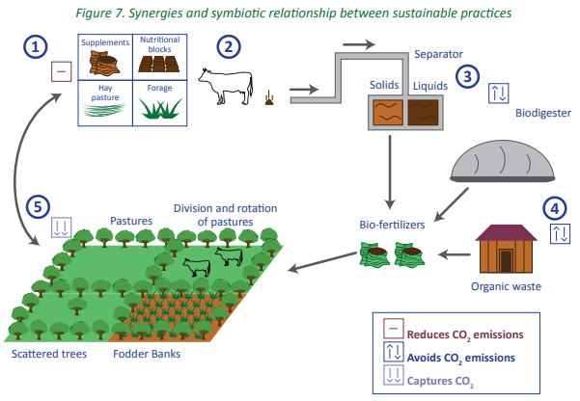
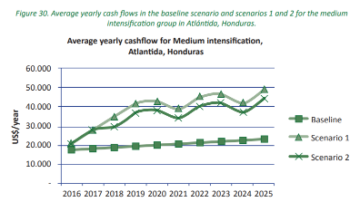
Scope
Mapping
Operational instruments
Financial Engineering
Examples: Honduras - Livestock NAMA
Practices
Implementation of silvopastoral systems
Introduction of biodigesters
Production and application of organic fertilizers
Barriers
Capacities:
Low level of knowledge and technical ability
Lack of administrative management of farms and financial knowledge
Financial:
Lack of access to credit
NDC ACTION PROJECT | Facilitating the implementation of climate-resilient and low-carbon development aligned with national and global goals
Notes:
The project for the development of a livestock NAMA in Honduras and a Low Carbon Development Strategy (LDS) in the livestock sector in Nicaragua was implemented through
a €282,650 grant from the Nordic Climate Facility (NEFCO), from 2015 to 2017.
The UNEP CCC and the Tropical Agricultural Research and Higher Education Center (CATIE) were the implementing agencies, also with in-kind contributions:
In the end, some practices were identified for the implementation of NAMAs:
Implementation of silvopastoral systems, including rotation and division of paddocks
The Introduction of Biodigesters
Production and application of organic fertilizers
At the same time, the grant provided through its activities a substantial portion of capacity building to livestock farmers with training on how to implement more climate-friendly technologies and systems.
Cost-benefit calculations showed that investments in the practices could be cost-effective and generate positive cash flows, through increased productivity, despite requiring high operating and maintenance costs. But why weren't these practices applied on a large scale?
Some critical barriers to the implementation of the practices were identified through an analysis of barriers in interactions with stakeholders.
Lack of Capacities:
Low level of knowledge and technical ability
Lack of administrative management of farms and financial knowledge
Financial:
Lack of access to credit for investment in biodigesters and materials for implementing other practices.

Slide 8
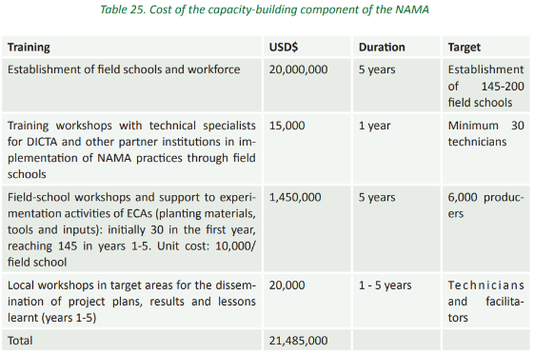
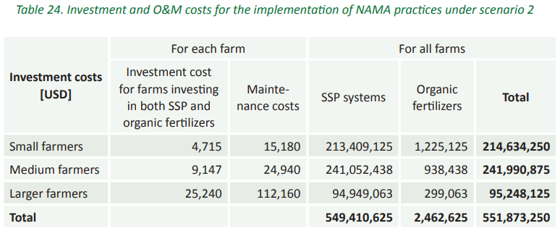
Scope
Mapping
Operational instruments
Financial Engineering
Examples: Honduras - Investment costs and capacity building
NDC ACTION PROJECT | Facilitating the implementation of climate-resilient and low-carbon development aligned with national and global goals
Notes:
The investment and training costs required for the implementation of the NAMA and Low Carbon Development Strategy at the national level were calculated.

Slide 9
Scope
Mapping
Operational instruments
Financial Engineering
Examples: Honduras - Proposal of a financial mechanism
National Sources
DICTA was able to cover 32% of technical assistance and training with existing programs
2.1 thousand USD contribution from other programs
Existing Investments in Field Schools
International Sources
30% on concessional loans or guarantees
$1.5K Training Grant
International Finance (GCF)
International Financial Resources
Central American Bank for Economic Integration (CABEI)
Ministry of Agriculture and Livestock (SAG)
Technical Assistance Resources, Nat & Int
Resource Canalization
Directorate of Science and Technology for Agriculture and Livestock (DICTA)
Technical Assistance
National Financial Institutions
(BANDESA – BANHPROVI)
Producers
Concessional Loans
NDC ACTION PROJECT | Facilitating the implementation of climate-resilient and low-carbon development aligned with national and global goals
Notes:
Through consultations with the parties, proposals for financial mechanisms were developed by NAMA. In this case, farmers represent the private sector that needs to make investments in new technology, but a financial mechanism is needed to overcome the identified barriers (training and access to low-cost credit). That is why it is necessary to involve other actors, public, private and international.
In the case of Honduras, the following mechanism was designed to overcome the identified capacity and financial barriers.
The Directorate of Agricultural Science and Technology (DICTA) in Honduras already had an Agricultural Technology Transfer Program, for the improvement of productive capacities and skills of producers, which could cover 32% of technical assistance and training. This national contribution equivalent to USD 1,302,300 is very important to show a national buy-in and prioritization in the NAMA.
NAMA was also connected to other existing initiatives, such as the National Rural Extension Program, supported by Zamorano University, Texas Technical University, the National Autonomous University of Honduras (UNAH), the National Program for the Reactivation of the Honduran Agri-Food Sector (FIRSA) and Dairy Consulting. The Program has a budget of USD 2.1 million. In addition, through the "Sustainable Management of Productive Landscapes" project, the Ministry of Environment has made investments in field schools, expecting the project to establish 145-200 schools, reaching 6,000 producers. The costs of establishing the field schools are estimated at USD 20 million and could be coordinated with NAMA. Including this funding as a national contribution to the NAMA has a good chance of leveraging further funding through international funding.
The NAMA will provide initial international funding to be able to offer preferential loans to farmers in the first five years, but it is anticipated that NAMA funding will become self-sustaining as confidence in NAMA grows. To this end, NAMA provides for support in the form of 30% in preferential loans or guarantees totalling USD58,755,000, enabling the provision of large-scale small loans to farmers. Of the USD 21,485,000 needed for capacity building activities, USD 20,000,000 will come from national sources through existing programs that invest in NAMA, but USD 1,485,000 will be sought in grant/grant through international climate finance, as additional capacity will be needed for the training of technicians and farmers and contributions to field schools, enabling capacity building in NAMA practices.
International financing is planned through the GCF, IDB, NAMA Facility and/or other sources. CABEI will channel international funds to SAG, while the National Bank for Agricultural Development (BANADESA) has the capacity and experience necessary to manage international funds for the implementation of projects and programs. The Honduran Bank for Production and Housing (BANHPROVI) has the experience and capacity to administer loans to producers.
A similar solution was sought in Nicaragua, but the actors and their way of interacting are a little different.
Also in this case, existing national fund flows are used in livestock activities,

Slide 10
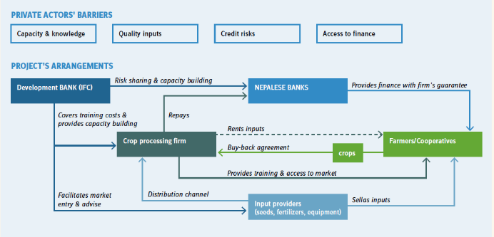
Scope
Mapping
Operational instruments
Financial Engineering
Examples: Nepal - Promoting climate-resilient agriculture through the participation of private sector companies
- International Finance Corporation Climate Resilience Pilot Project (IFC-PPCR)
Low supply of sugarcane -> The processing company only operates at 75-80% of its capacity
If 567 farmers implement improved practices, productivity can increase by 20% and net income by $12,000 a year
Cost USD 32,000 - 95,000
Interesting for the private sector if IFC can cover 70%
Increased productivity scenario | Repayment period with a 70% PPCR payment as a subsidy
 | High Cost Estimate | Low Cost Estimation
Low 10% | 15.7 years | 5.3 years
20% (baseline) | 7.9 years | 2.6 years
High 30% | 5.3 years | 1.8 years
NDC ACTION PROJECT | Facilitating the implementation of climate-resilient and low-carbon development aligned with national and global goals
Notes:
Climate change is threatening agricultural production in Nepal, which is already challenged by the limited use of stress-resistant and quality seeds, poor agricultural practices, and high reliance on rainfall patterns. The International Finance Corporation's Climate Resilience Pilot Project (IFC-PPCR) aims to improve crop productivity and agribusiness capacity utilization in five selected districts of the Terai region. The project has three components:
developing the technical skills of agribusiness, which in turn transfer them to farmers and improve farmers' access to improved seeds, irrigation technologies and fertilizers;
establishing risk-sharing mechanisms and assisting local banks in designing financial products tailored to the agricultural supply chain;
create SMS-based dissemination platforms to deliver weather forecasts and advice on agronomic practices, as well as market information to farmers.
In this case we can focus on the business case of sugarcane with the participation of 567 farmers. The sugar processing company is operating its plant at 75-80% capacity due to insufficient supplies of sugarcane, resulting in lost revenue. The case assumes that if 567 farmers are trained and adopt improved practices, they could increase their productivity by 20%. The sugarcane processing company could expect to increase its net revenue by at least $12,000 a year. The sugarcane business will invest between USD 32,000 and USD 95,000 in staff time, facilities and demonstration plots. The payback period for the company is 2.6 to 7.9 years, when IFC-PPCR will bear 70% of the cost. Therefore, there is a business case for the private sector to invest in the project if PPCR support is available. Sugarcane companies have an interest in participating in the project as it will reduce their vulnerability to climate-induced risks, which directly affect their profitability and performance.
Farmers will not be required to pay for training activities, but they will have to pay the costs of investing in improved, climate-resilient agricultural practices. A limiting factor is the high interest rates on loans available to farmers, ranging from about 20% for commercial banks to 33% for informal lenders, and the fact that farmers find it difficult to obtain loans from commercial banks. Therefore, commercial banks participated in the project and provided information on how to improve risk management and design financial products, enabling them to lend to farmers for innovative farming practices. In addition, a risk-sharing facility was designed together with the IFC that provides loan guarantees, reducing interest rates on loans to around 11.5%.

Slide 11
Scope
Mapping
Operational instruments
Financial Engineering
Examples: Mauritius - De-risking Facility for Energy Performance Contracting
Due to the limited capital, investment in the Private Sector are primarily for their core business at the expense of investments in Energy Efficiency, even though these have average payback times of 3-4 years.
No specific funds are allocated in the national budget for investments in Energy Efficiency.
Banks do not lend to Energy Service Companies that could invest on client’s behalf, because the assets to be procured with the loan capital are installed at the premises of the ESCOs’ clients and therefore not accepted by the banks as collateral.
The ESCOs’ financial reach is therefore constrained only to their own available equity.
Guarantee up to 80% will enable banks to provide loans to ESCOs.
Establishment of a Revolving Guarantee Fund
Guarantee fund seed capital |  | 15,600,000
Gearing | 50% | 7,800,000
Average EPC investment |  | 291,353
EPC duration (years) |  | 8
Loan % of investment | 75%
Interest rate | 6%
loan maturity, years | 6
Equity, % of investment | 25%
Guarantee coverage | 75%
Default rate | 3%
Default average at year | 3
Guarantee fee | 3%
shared saving, % to client | 10%
Mauritius ESCO Guarantee Admin costs | 1%
NDC ACTION PROJECT | Facilitating the implementation of climate-resilient and low-carbon development aligned with national and global goals

Slide 12
Scope
Mapping
Operational instruments
Financial ENgineering
Examples: Mauritius - De-risking Facility for Energy Performance Contracting
Implementation | Year 1 | Year 2 | Year 3 | Year 4 | Year 5 | Year 6 | Year 7 | Year 8 | Year 9 | Year 10 | Year 11 | Year 12 | Year 13 | Year 14 | Year 15 | Year 16 | Year 17 | Year 18 | Year 19 | Year 20
Projects implemented | 6 | 10 | 17 | 25 | 25 | 25 | 25 | 25 | 25 | 25 | 25 | 25 | 25 | 25 | 25 | 25
Average Energy savings per project kWh | 881,467 | 881,467 | 881,467 | 881,467 | 881,467 | 881,467 | 881,467 | 881,467 | 881,467 | 881,467 | 793,320 | 713,988 | 642,589 | 578,330 | 520,497 | 468,448 | 421,603 | 379,443 | 341,498 | 307,349
Average financial savings per project | 92,017 | 92,017 | 92,017 | 92,017 | 92,017 | 92,017 | 92,017 | 92,017 | 92,017 | 92,017 | 82,815 | 74,534 | 67,080 | 60,372 | 54,335 | 48,902 | 44,011 | 39,610 | 35,649 | 32,084
Loans by year 5.5 | 20,651,829
Equity by year 5.5 | 6,956,053
Total private investments by year 5.5 | 27,607,882
Loans by year 16 | 78,228,281
Equity by year 16 | 26,076,094
Total private investments by year 16 | 104,304,374
NDC ACTION PROJECT | Facilitating the implementation of climate-resilient and low-carbon development aligned with national and global goals

Slide 13
Scope
Mapping
Operational instruments
Financial ENgineering
Examples: Mauritius - De-risking Facility for Energy Performance Contracting
International Finance (Mitigation Action Facility)
Guarantee Fund capitalization
15,600,000 EUR
Technical Assistance 828,832 EUR
Capital Asset Management Ltd.
Applicant Support Partner (UNEP CCC)
National Commercial Banks
Loans to ESCOs (80%)
Fund Management
ESCO supportive regulation
Energy Service Companies
Capacity Building
Government and stakeholdders
Equity (20%) and implementation
Industrial Facilities and public buildings
NDC ACTION PROJECT | Facilitating the implementation of climate-resilient and low-carbon development aligned with national and global goals

Slide 14
Thank you for contributing to a brighter future
Federico Antonio Canu
Advisor - Finance
UNEP Copenhagen Climate Centre
federico.canu@un.org
Supported by:
based on a decision of the German Bundestag

