Slide 1
WELCOME!
Technical Workshop: Developing Best Practices for Loss and Damage Indicators & Reporting Tools
UNEP Copenhagen Climate Center (UNEP-CCC)
Notes:
"Good afternoon, everyone. I'm Fatemeh Bakhtiari, Senior Advisor at UNEP-Copenhagen Climate Centre, and I'm delighted to welcome you all to this Technical Workshop on Developing Best Practice Loss and Damage Indicators and Reporting Tools.

Slide 2
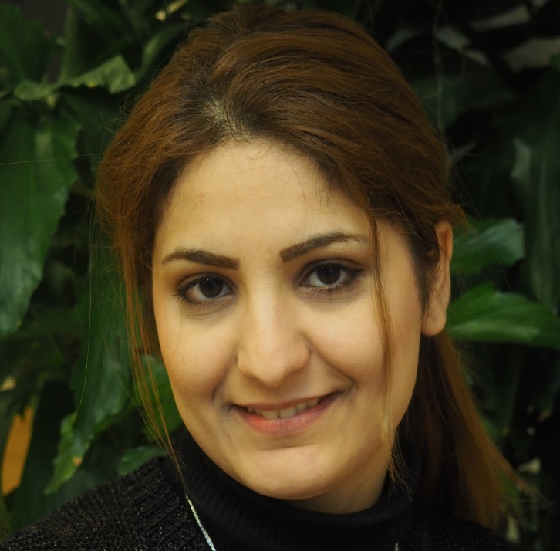
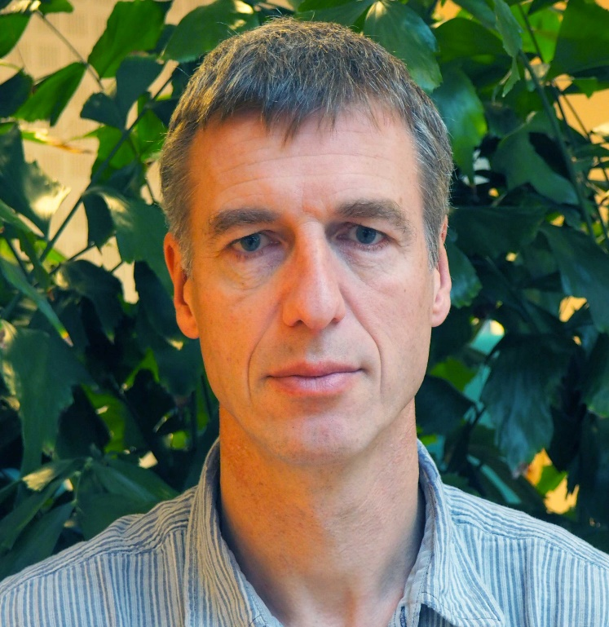
The UNEP Copenhagen Climate Centre Loss and Damage Team
Fatemeh Bakhtiari Senior advisor, Loss and Damage, UNEP CCC
Manages the L&D pipeline at UNEP-CCC
Works with policy and methodological development related to L&D reporting
Supports member states in establishing transparency frameworks to enhance data for L&D assessment and BRT reporting
Expert in Sustainable Development Assessments
Joshitha Sankam
Program Officer for Loss and Damage, UNEP CCC
Provides science-based advice on L&D and adaptation and assists in the development of knowledge and capacity-building products
Specializes in the domain of Climate Change and Health, with a focus on Planetary Health
Henry Neufeldt
Head of Section Impact Assessment and Adaptation Analysis,
UNEP CCC
Chief Editor of UNEP’s Adaptation Gap Report
Leads UNEP-CCC’s work on climate risks and transparency in adaptation
Lead author of the IPCC’s Sixth Assessment Report
Julia Rocha Romero
Program Officer for Climate Policy, UNEP CCC
Policy expert contributing to the Nature-based Solutions and L&D work being developed at UNEP-CCC
Specializes climate vulnerabilities in urban areas
Works across the climate Mitigation and Adaptation spectrum and provides support to member states on climate transparency projects related to NDC ambition

Slide 3
Developing Best Practice Loss and Damage Indicators and Reporting Tools
Workshop Objectives
To develop comprehensive L&D indicators: Identify and refine indicators that can accurately assess and report the impacts of climate change across various sectors, in line with UNFCCC guidelines.
To enhance countries' capacity for L&D measurement and reporting: Provide tools and methodologies that can help member states effectively measure, document, and report their losses and damages, thus supporting their engagement with the Santiago Network.
To coordinate L&D transparency with international processes: Align UNEP’s efforts with global frameworks, including the Paris Agreement and the Warsaw International Mechanism (WIM), to enhance the consistency and comparability of L&D reporting.
Expected Outcomes of Workshop
Participants will gain a deeper understanding of L&D indicators and reporting tools that are directly applicable to UNFCCC processes.
Facilitation of the production of a set of comprehensive indicators that member states and their sectoral expert teams can use to enhance their L&D transparency and reporting, facilitating their access to support through the Santiago Network.
Creation of a regionally diverse pool of experts per sector that contributes to ongoing UNFCCC discussions on L&D, providing practical tools for implementing global frameworks at the national level.
Notes:
As we gather here today, we find ourselves at a critical moment in our global efforts to address climate change. Loss and Damage has become an increasingly vital component of climate negotiations, and the need for accurate and comprehensive indicators has never been more pressing. This workshop builds upon the momentum generated during the 60th UN Climate Change Conference in Bonn, where we hosted a technical exchange on institutional arrangements for transparency in Loss and Damage reporting. That exchange highlighted the challenges faced by non-Annex 1 countries and the importance of international cooperation in institutionalizing Loss and Damage.

Slide 4
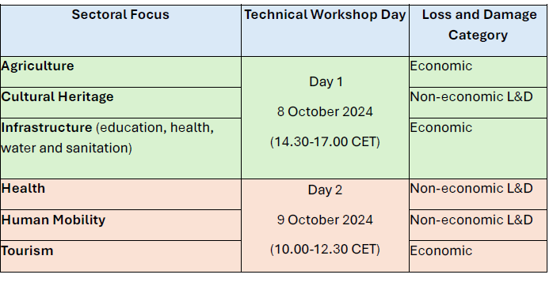
Sectoral Focus
Day 1 & Day 2

Slide 5
Agenda Day 1
14.30 – 14.45 Opening & Welcome
Introduction and Context Setting, Fatemeh Bakhtiari, Senior Advisor on Loss and Damage, UNEP-CCC
14.45 – 14.55 Updates from WIM on Loss and Damage specifically on the Development of Indicators,
Camila Minerva Rodriguez, Co-chair of the Warsaw International Mechanism
14.55 – 15.00 Break Out Rooms Allotment
15.00 – 16.00 Part I – Breakout Group Discussions
Breakout Group 1: Agriculture
Breakout Group 2: Cultural Heritage
Breakout Group 3: Infrastructure
Moderators: Present existing indicators and develop the ranking of indicators
Elizabeth Willetts - Independent Consultant/Strategic Advisor on Biodiversity and Health/Planetary Health/One Health
Lily Salloum Lindegaard - Senior Researcher, Danish Institute for International Studies (DIIS)
Karen Polson-Edwards - Regional Advisor, Climate Change and Health, Pan American Health Organization (PAHO/WHO)
16.00 – 16.15 Coffee Break
16.15 – 16:50 Part II – Group Presentations and General Discussion (10 min. per group)
Elizabeth Willetts - Independent Consultant/Strategic Advisor on Biodiversity and Health/Planetary Health/One Health
Lily Salloum Lindegaard - Senior Researcher, Danish Institute for International Studies
Karen Polson-Edwards - Regional Advisor, Climate Change and Health, Pan American Health Organization (PAHO/WHO)
16.50 – 17.00 Part III: Conclusion
Summary of Key Outcomes: Fatemeh Bakhtiari, Senior Advisor on Loss and Damage, UNEP-CCC

Slide 6
Meet the Speakers
Camilla Minerva Rodriguez
Climate Change Director at the Ministry of Environment of the Dominican Republic
Camilla holds a Political Science degree from Sciences with a Masters in Environmental Policy and Global Risks from the Paris School of International Affairs. She has worked with environmental risk reduction, climate change, and humanitarian action in the Caribbean.
She is currently co-chair of the Executive Committee of the Warsaw International Mechanism of Loss and Damage, a member of the Advisory Board of the Santiago Network, and Loss and Damage coordinator for the Alliance of Small Islands States (AOSIS)

Slide 7
Part I: Opening the Breakout Rooms Allotment

Slide 8
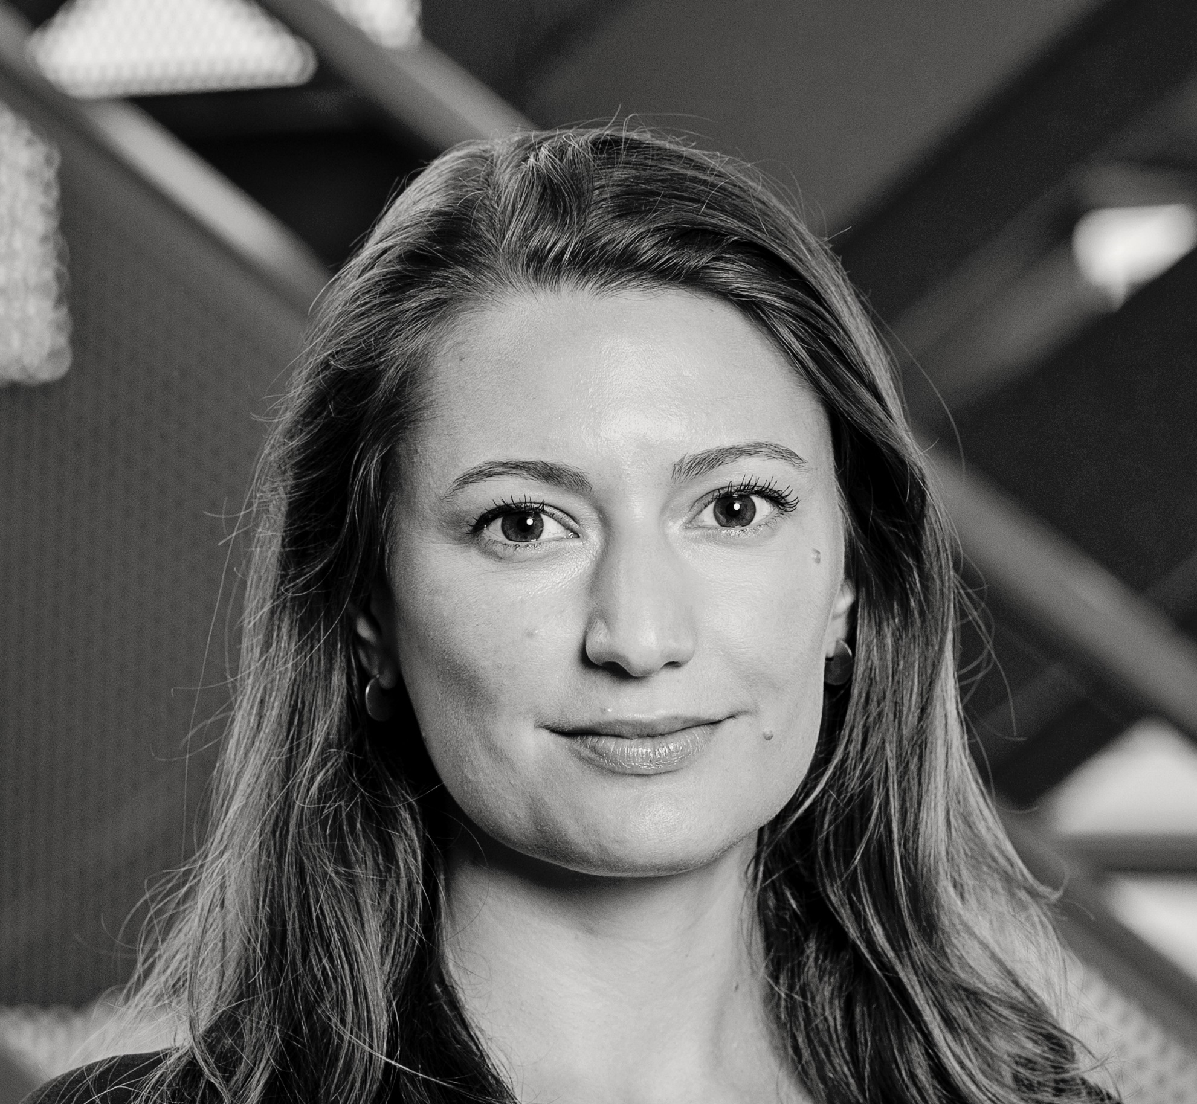
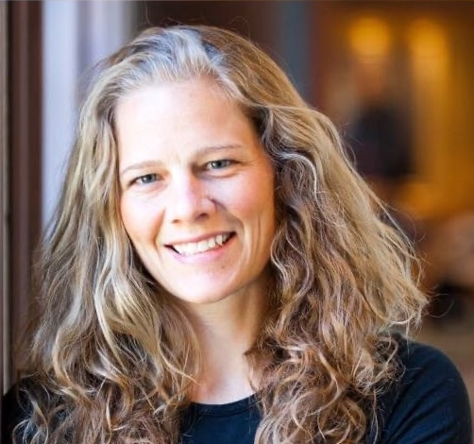
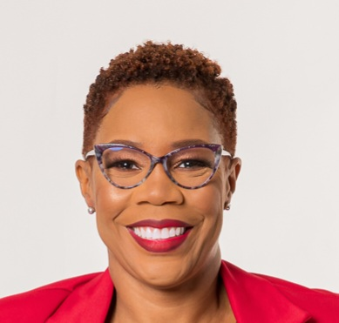
Lily Salloum Lindegaard – CULTURAL HERITAGE MODERATOR
Senior Researcher, Danish Institute for International Studies
Her work focuses on the politics and governance of climate change impacts and response from local to global scales.
Her current research includes the politics and governance of transformational responses to climate change, L&D, and climate-related mobility.
Geographically, she works mostly in Southeast Asia and West Africa, together with research partners from these areas.
Lilly holds a PhD in International Development from the University of Copenhagen, Denmark.
Sectoral Expert Moderators
Day 1
Elizabeth Willetts – AGRICULTURE MODERATOR
Independent Consultant/Strategic Advisor on Biodiversity and Health/Planetary Health/One Health
Liz served as Planetary Health Policy Director at Harvard TH Chan School of Public Health (2023-2024), as a science-policy advisor on biodiversity and health to the Convention on Biodiversity (2023-2024), and as science-policy advisor on climate change to the WHO (2022
She is a member of the IISD Earth Negotiations Bulletin where she tracked the UN Committee on World Food Security among other multilateral environmental agreements
Currently, she is also an Associate Scientist for the InterAmerican Institute for Global Change Research, Lead on Nature and Mental Health for the IUCN CEM Human Health Thematic Group
Liz graduated from Emory University School of Medicine and practiced family medicine full-time for 7 years.
Karen Polson-Edwards, PhD – INFRASTRUCTURE MODERATOR
Advisor, Climate Change and Health
Climate Change and Environmental - Determinants of Health Unit
Dr. Karen Polson has over 27 years of public health experience working at local, national, regional, and global levels and understands the issues faced by the health sector, especially in Caribbean SIDS, in implementing adaptation and mitigation measures to address the impacts of climate change on health.
In her current position, Dr Polson works with the health sector and other stakeholders in Latin America and the Caribbean to strengthen their capacities to prevent, prepare, and respond to the impacts of climate change on health with a focus on reducing health inequities.

Slide 9
Time for Break

Slide 10
Part II – Group Presentations and General Discussion

Slide 11
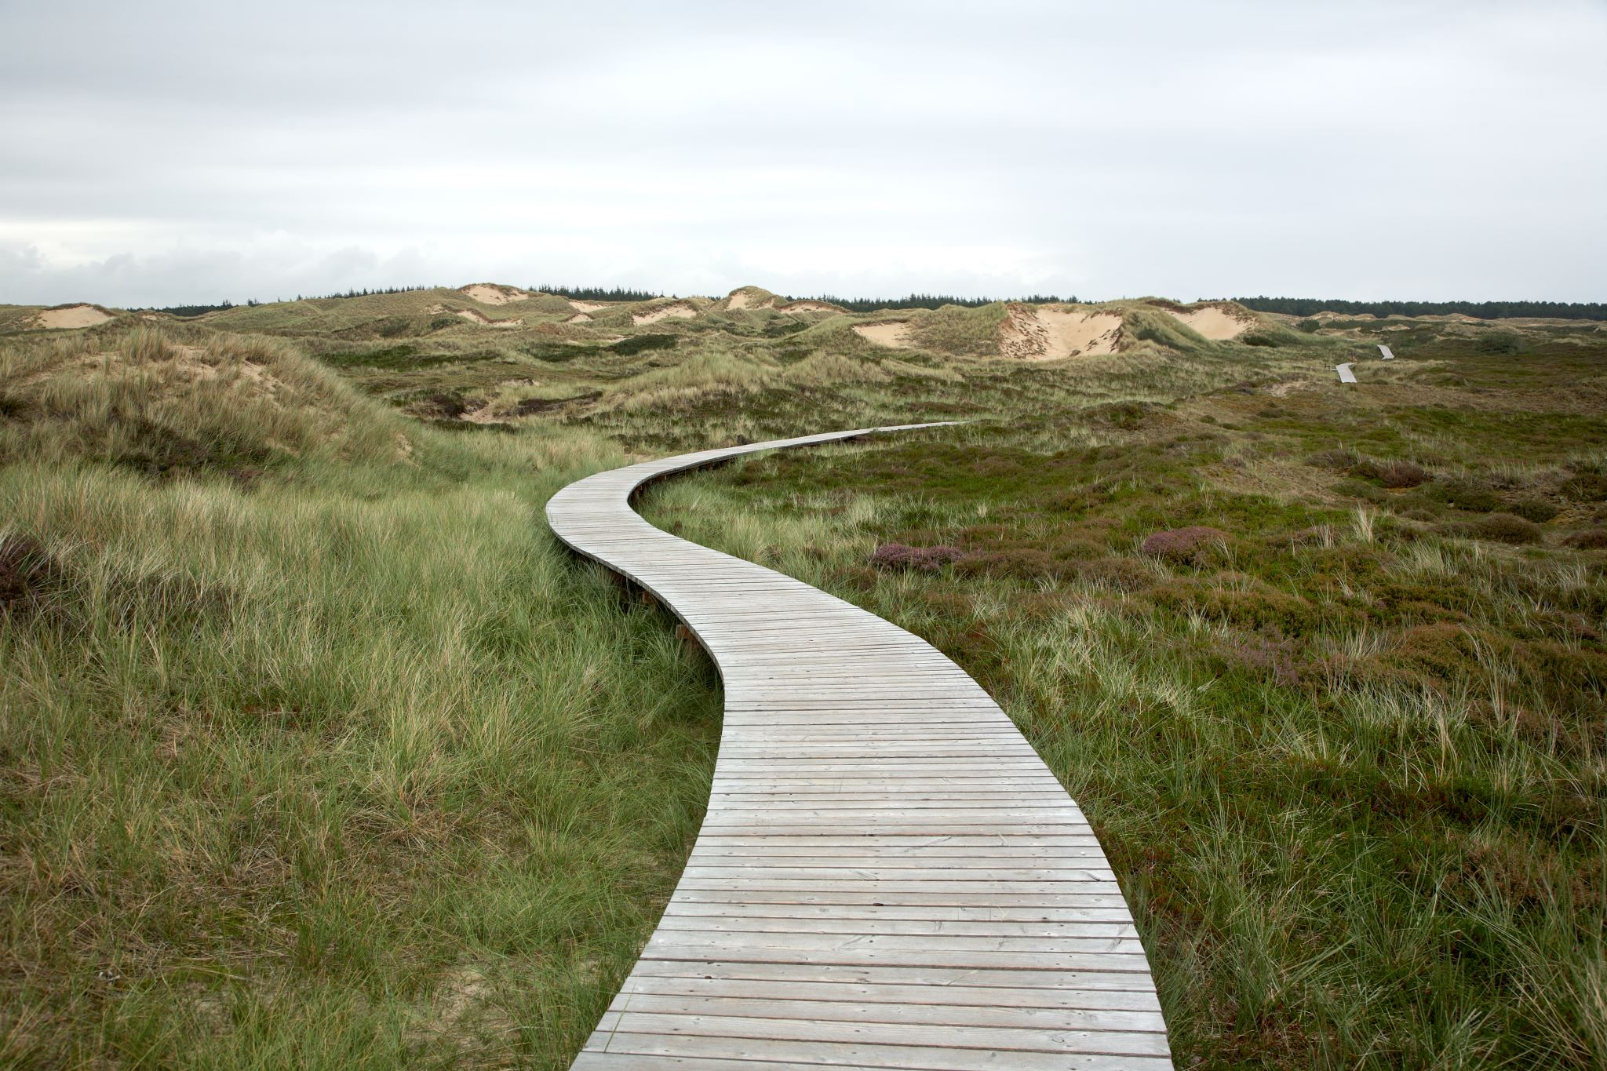
Conclusion
What did we achieve with the workshop and what lies ahead?

Slide 12
Key Outcomes & Insights
1. Comprehensive Indicator Development: The workshop successfully refined sector-specific indicators for each sector. Both economic and non-economic loss and damage metrics were prioritized. But this is not a one-off process!
2. Methodological Advancements: Innovative approaches for data collection and analysis were explored, including remote sensing, AI, digital archiving, and big data analytics. The need for standardized methodologies to ensure comparability across regions and sectors was emphasized.
3. Stakeholder Engagement: The importance of involving local communities, indigenous groups, and sector-specific stakeholders in indicator development and validation was recognized. Strategies for balancing local knowledge with standardized global metrics were discussed.
4. Alignment with Global Frameworks: It is important to ensure indicators are consistent with UNFCCC guidelines, the Paris Agreement, and the Warsaw International Mechanism (WIM). Lessons from the Sendai Framework, SDGs, and UNESCO conventions were highlighted.
5. Technological Integration: Sector-specific technological solutions were identified, such as remote sensing for agriculture, 3D mapping for cultural heritage, and big data analytics for tourism.

Slide 13
Recommendations & Next Steps
Enhance Data Collection and Management
Develop strategies to address data gaps, implement data privacy protocols, and leverage diverse data sources.
1
Improve Attribution Methodologies
Invest in research to enhance attribution of losses and damages to climate change, particularly for complex sectors like health and human mobility.
2
Strengthen Transparency and Reporting
Apply developed indicators to enhance reporting under the Enhanced Transparency Framework (ETF) and create sector-specific reporting templates.
3
Focus on Capacity Building Initiatives
Organize regional training workshops and develop online resources for continuous learning and support.
4
Deepen Collaboration and Knowledge Sharing
Establish an informal network for continued exchange on L&D among non-Annex 1 countries and create a digital platform for sharing best practices.
5
Strengthen a Future-ready Research Agenda
Identify priority areas for further research, including long-term impacts of slow-onset events and interconnections between sectoral losses and damages.
6
Strengthen Policy Integration
Provide guidance on integrating L&D indicators into national adaptation plans and NDCs and explore ways to use indicators to inform climate-resilient development strategies.
7

Slide 14
Did we leave anything out?
Do you have any immediate follow-up comments and considerations?
Please feel free to reach out – this is an exciting work in progress!

Slide 15
THANK YOU
From UNEP and UNEP-CCC’s
Loss and Damage Team
Fatemeh Bakhtiari
Senior advisor – Loss and Damage
fatemeh.bakhtiari@un.org

