Slide 1
WELCOME!
Technical Workshop: Developing Best Practices for Loss and Damage Indicators & Reporting Tools
UNEP Copenhagen Climate Center (UNEP-CCC)

Slide 2
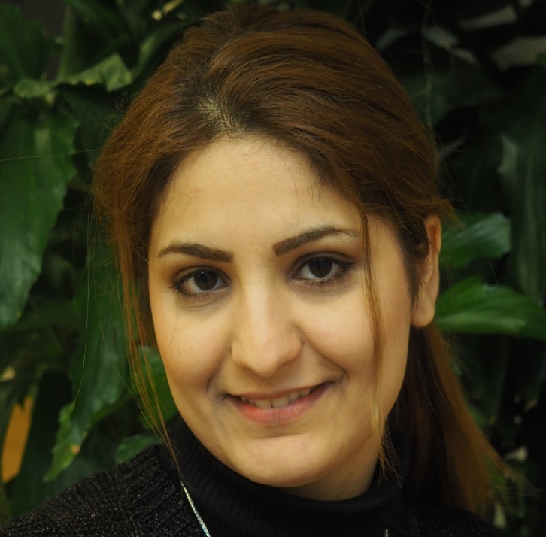
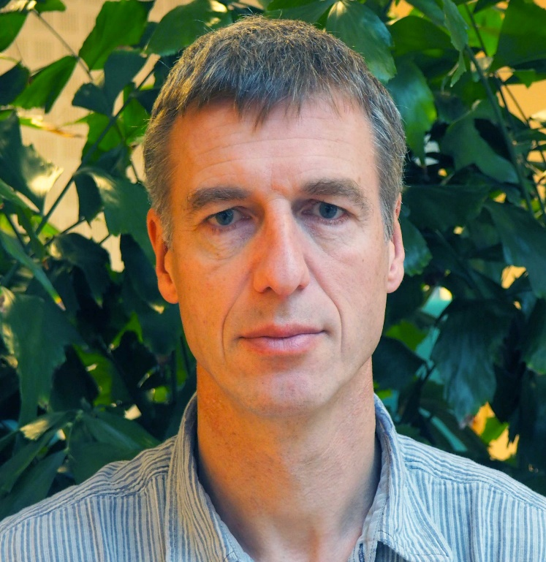
The UNEP Copenhagen Climate Centre Loss and Damage Team
Fatemeh Bakhtiari Senior advisor, Loss and Damage, UNEP CCC
Manages the L&D pipeline at UNEP-CCC
Works with policy and methodological development related to L&D reporting
Supports member states in establishing transparency frameworks to enhance data for L&D assessment and BRT reporting
Expert in Sustainable Development Assessments
Joshitha Sankam
Program Officer for Loss and Damage, UNEP CCC
Provides science-based advice on L&D and adaptation and assists in the development of knowledge and capacity-building products
Specializes in the domain of Climate Change and Health, with a focus on Planetary Health
Henry Neufeldt
Head of Section Impact Assessment and Adaptation Analysis,
UNEP CCC
Chief Editor of UNEP’s Adaptation Gap Report
Leads UNEP-CCC’s work on climate risks and transparency in adaptation
Lead author of the IPCC’s Sixth Assessment Report
Julia Rocha Romero
Program Officer for Climate Policy, UNEP CCC
Policy expert contributing to the Nature-based Solutions and L&D work being developed at UNEP-CCC
Specializes climate vulnerabilities in urban areas
Works across the climate Mitigation and Adaptation spectrum and provides support to member states on climate transparency projects related to NDC ambition

Slide 3
Developing Best Practice Loss and Damage Indicators and Reporting Tools
Workshop Objectives
To develop comprehensive L&D indicators: Identify and refine indicators that can accurately assess and report the impacts of climate change across various sectors, in line with UNFCCC guidelines.
To enhance countries' capacity for L&D measurement and reporting: Provide tools and methodologies that can help member states effectively measure, document, and report their losses and damages, thus supporting their engagement with the Santiago Network.
To coordinate L&D transparency with international processes: Align UNEP’s efforts with global frameworks, including the Paris Agreement and the Warsaw International Mechanism (WIM), to enhance the consistency and comparability of L&D reporting.
Expected Outcomes of Workshop
Participants will gain a deeper understanding of L&D indicators and reporting tools that are directly applicable to UNFCCC processes.
Facilitation of the production of a set of comprehensive indicators that member states and their sectoral expert teams can use to enhance their L&D transparency and reporting, facilitating their access to support through the Santiago Network.
Creation of a regionally diverse pool of experts per sector that contributes to ongoing UNFCCC discussions on L&D, providing practical tools for implementing global frameworks at the national level.

Slide 4
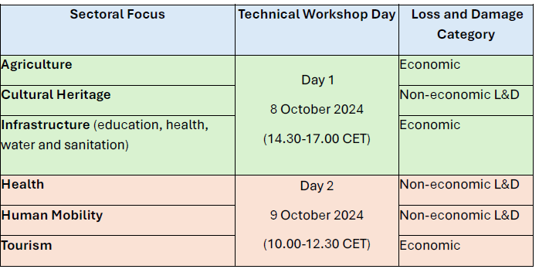
Sectoral Focus
Day 1 & Day 2

Slide 5
Agenda Day 2
10.00 – 10.15 Opening & Welcome
Introduction and Context Setting Fatemeh Bakhtiari, Senior Advisor on Loss and Damage, UNEP-CCC
10.15 – 10.25 The Importance of Loss and Damage Transparency and the Development of Indicators in Response to the UNFCCC Mandate
Mirey Attalah, Chief of the Adaptation and Resilience Branch, Climate Change Division, UNEP
10.25 – 10.30 Break Out Rooms Allotment
10.30 – 11.30 Part I – Breakout Group Discussions
Breakout Group 1: Health
Breakout Group 2: Human Mobility
Breakout Group 3: Tourism
Moderators: Present existing indicators and develop the ranking of indicators
Arthur Wyns - Research fellow, University of Melbourne
Chawanangwa Nyirenda - Climate-Induced Loss and Damage Specialist, UNEP
Christina Daszkiewicz - Programme Officer on Migration, Environment, Climate Change and Risk Reduction, International Organization for Migration (IOM)
11.30 – 11.45 Coffee Break
11.45 – 12:20 Part II – Group Presentations and General Discussion (10 min. per group)
Arthur Wyns - Research fellow, University of Melbourne
Chawanangwa Nyirenda - Climate-Induced Loss and Damage Specialist, UNEP
Christina Daszkiewicz - Programme Officer on Migration, Environment, Climate Change and Risk Reduction, International Organization for Migration (IOM)
12.20 – 12.30 Part III: Conclusion
Summary of Key Outcomes: Fatemeh Bakhtiari, Senior Advisor on Loss and Damage, UNEP-CCC

Slide 6
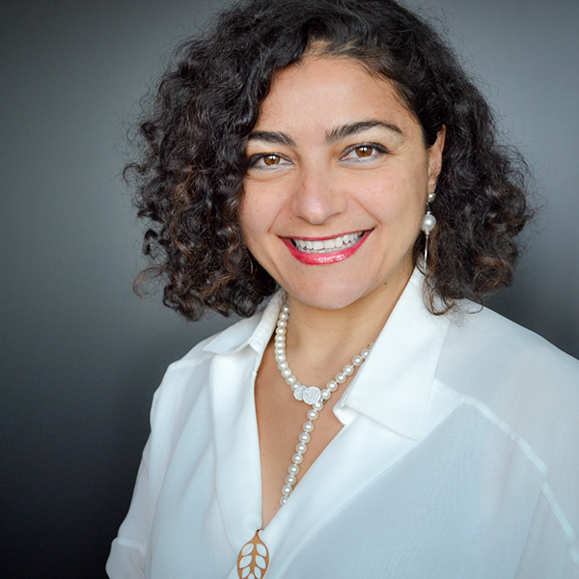
Meet the Speakers
Mirey Attalah
Head of the Nature for Climate Branch of UNEP
In the last 20 years, Mirey’s professional efforts have primarily been comprised of leveraging and mobilizing environmental funding and programming at the country level, as well as running multi-partner trust funds to support land use finance, climate, nature, and international waters. Mirey holds two post-graduate degrees in Land Use Planning and Environmental Management and Policies.

Slide 7
Part I: Opening the Breakout Rooms Allotment

Slide 8
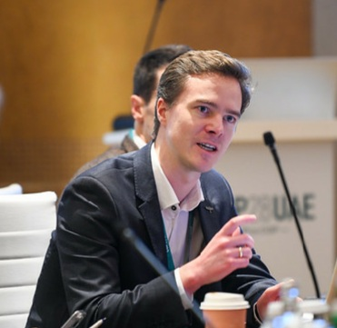
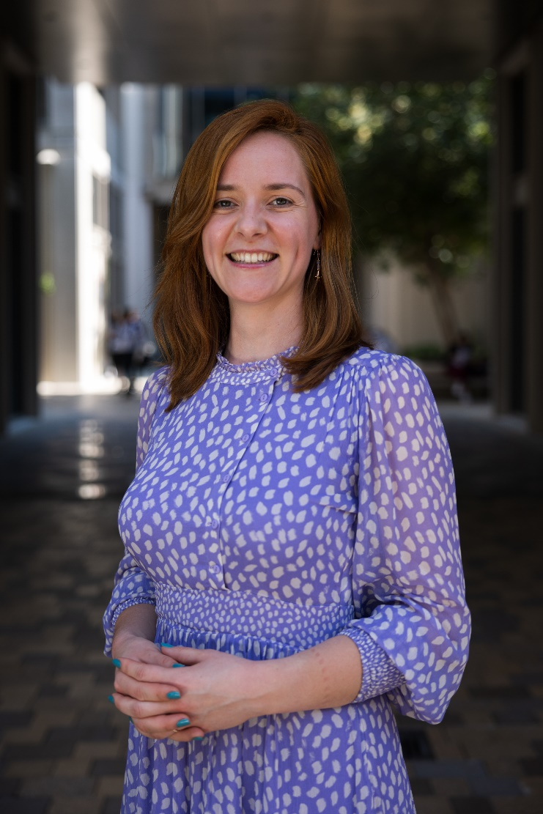
Sectoral Expert Moderators
Day 2
Chawanangwa Nyirenda – TOURISM MODERATOR
Climate-Induced Loss and Damage Specialist, UNEP
Engaged in shaping UNEP's position and strategic direction on climate-induced L&D tracking
Supports negotiations process under UNFCCC
Arthur Wyns – HEALTH MODERATOR
Research fellow, University of Melbourne
Arthur Wyns is the former health advisor to the COP28 Presidency, and the former climate change advisor to the World Health Organization.
He is a research fellow at the University of Melbourne and an editor of the Journal of Climate Change and Health.
Ileana Sînziana PUȘCAȘ
– HUMAN MOBILITY MODERATOR
Climate Migration Senior Expert- Climate Action Division, International Organization for Migration Geneva, Switzerland
Ileana has worked on migration, climate change, and risk reduction since 2016, including roles with IOM and the Platform on Disaster Displacement (PDD).
She leads IOM’s engagement with UNFCCC and climate commitments under the Global Compact for Migration, including COP28 and Loss and Damage Fund deliberations.
Her work spans policy, research, and operations in areas such as the UNFCCC Task Force on Displacement and regional migration processes, and she served on the Technical Support Unit for loss and damage finance.

Slide 9
Time for Break

Slide 10
Part II – Group Presentations and General Discussion

Slide 11
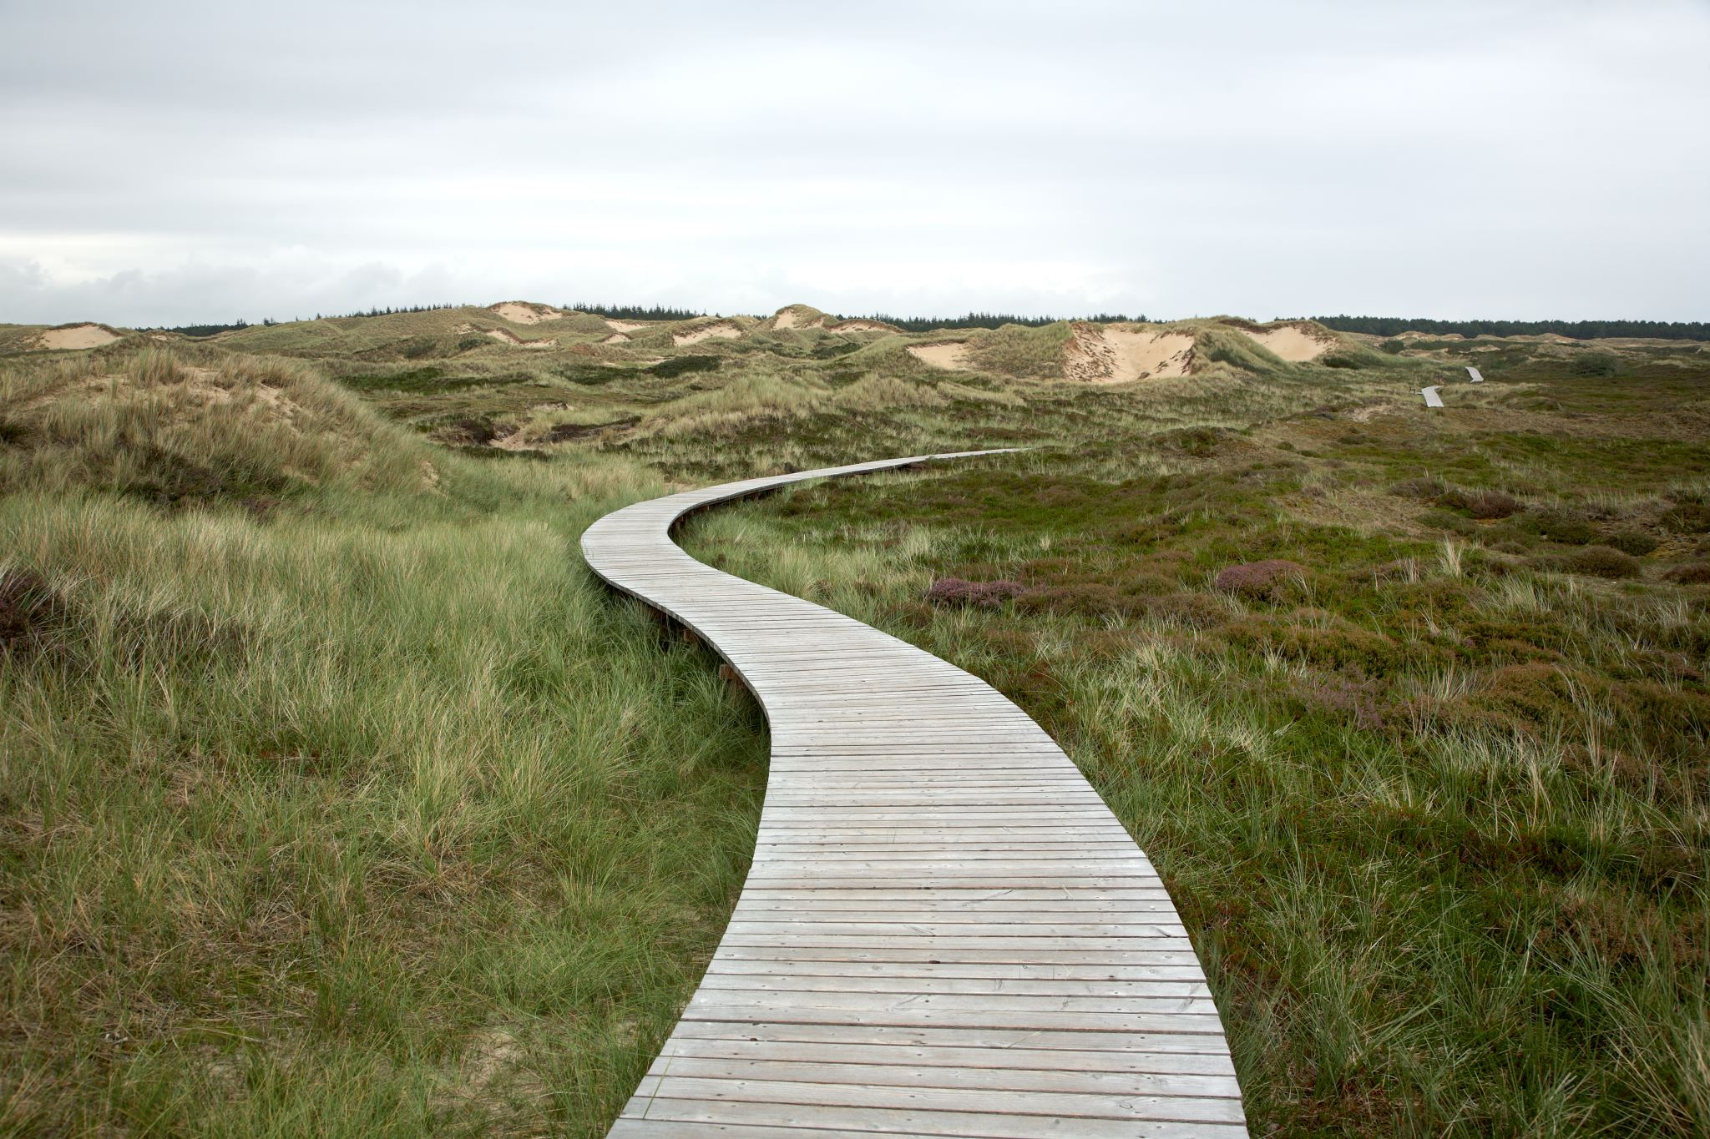
Conclusion
What did we achieve with the workshop and what lies ahead?

Slide 12
Key Outcomes & Insights
1. Comprehensive Indicator Development: The workshop successfully refined sector-specific indicators for each sector. Both economic and non-economic loss and damage metrics were prioritized. But this is not a one-off process!
2. Methodological Advancements: Innovative approaches for data collection and analysis were explored, including remote sensing, AI, digital archiving, and big data analytics. The need for standardized methodologies to ensure comparability across regions and sectors was emphasized.
3. Stakeholder Engagement: The importance of involving local communities, indigenous groups, and sector-specific stakeholders in indicator development and validation was recognized. Strategies for balancing local knowledge with standardized global metrics were discussed.
4. Alignment with Global Frameworks: It is important to ensure indicators are consistent with UNFCCC guidelines, the Paris Agreement, and the Warsaw International Mechanism (WIM). Lessons from the Sendai Framework, SDGs, and UNESCO conventions were highlighted.
5. Technological Integration: Sector-specific technological solutions were identified, such as remote sensing for agriculture, 3D mapping for cultural heritage, and big data analytics for tourism.

Slide 13
Recommendations & Next Steps
Enhance Data Collection and Management
Develop strategies to address data gaps, implement data privacy protocols, and leverage diverse data sources.
1
Improve Attribution Methodologies
Invest in research to enhance attribution of losses and damages to climate change, particularly for complex sectors like health and human mobility.
2
Strengthen Transparency and Reporting
Apply developed indicators to enhance reporting under the Enhanced Transparency Framework (ETF) and create sector-specific reporting templates.
3
Focus on Capacity Building Initiatives
Organize regional training workshops and develop online resources for continuous learning and support.
4
Deepen Collaboration and Knowledge Sharing
Establish an informal network for continued exchange on L&D among non-Annex 1 countries and create a digital platform for sharing best practices.
5
Strengthen a Future-ready Research Agenda
Identify priority areas for further research, including long-term impacts of slow-onset events and interconnections between sectoral losses and damages.
6
Strengthen Policy Integration
Provide guidance on integrating L&D indicators into national adaptation plans and NDCs and explore ways to use indicators to inform climate-resilient development strategies.
7

Slide 14
Did we leave anything out?
Do you have any immediate follow-up comments and considerations?
Please feel free to reach out – this is an exciting work in progress!

Slide 15
THANK YOU
From UNEP and UNEP-CCC’s
Loss and Damage Team
Fatemeh Bakhtiari
Senior advisor – Loss and Damage
fatemeh.bakhtiari@un.org

