Slide 1


Low Carbon Cement: Making it happen
Webinar Series: Capacity Building for Industrial Partners in Pakistan
Dr Anders McCarthy
Sustainability Consultant
22.10.2025

Slide 2

Mitigation Technologies

Slide 3
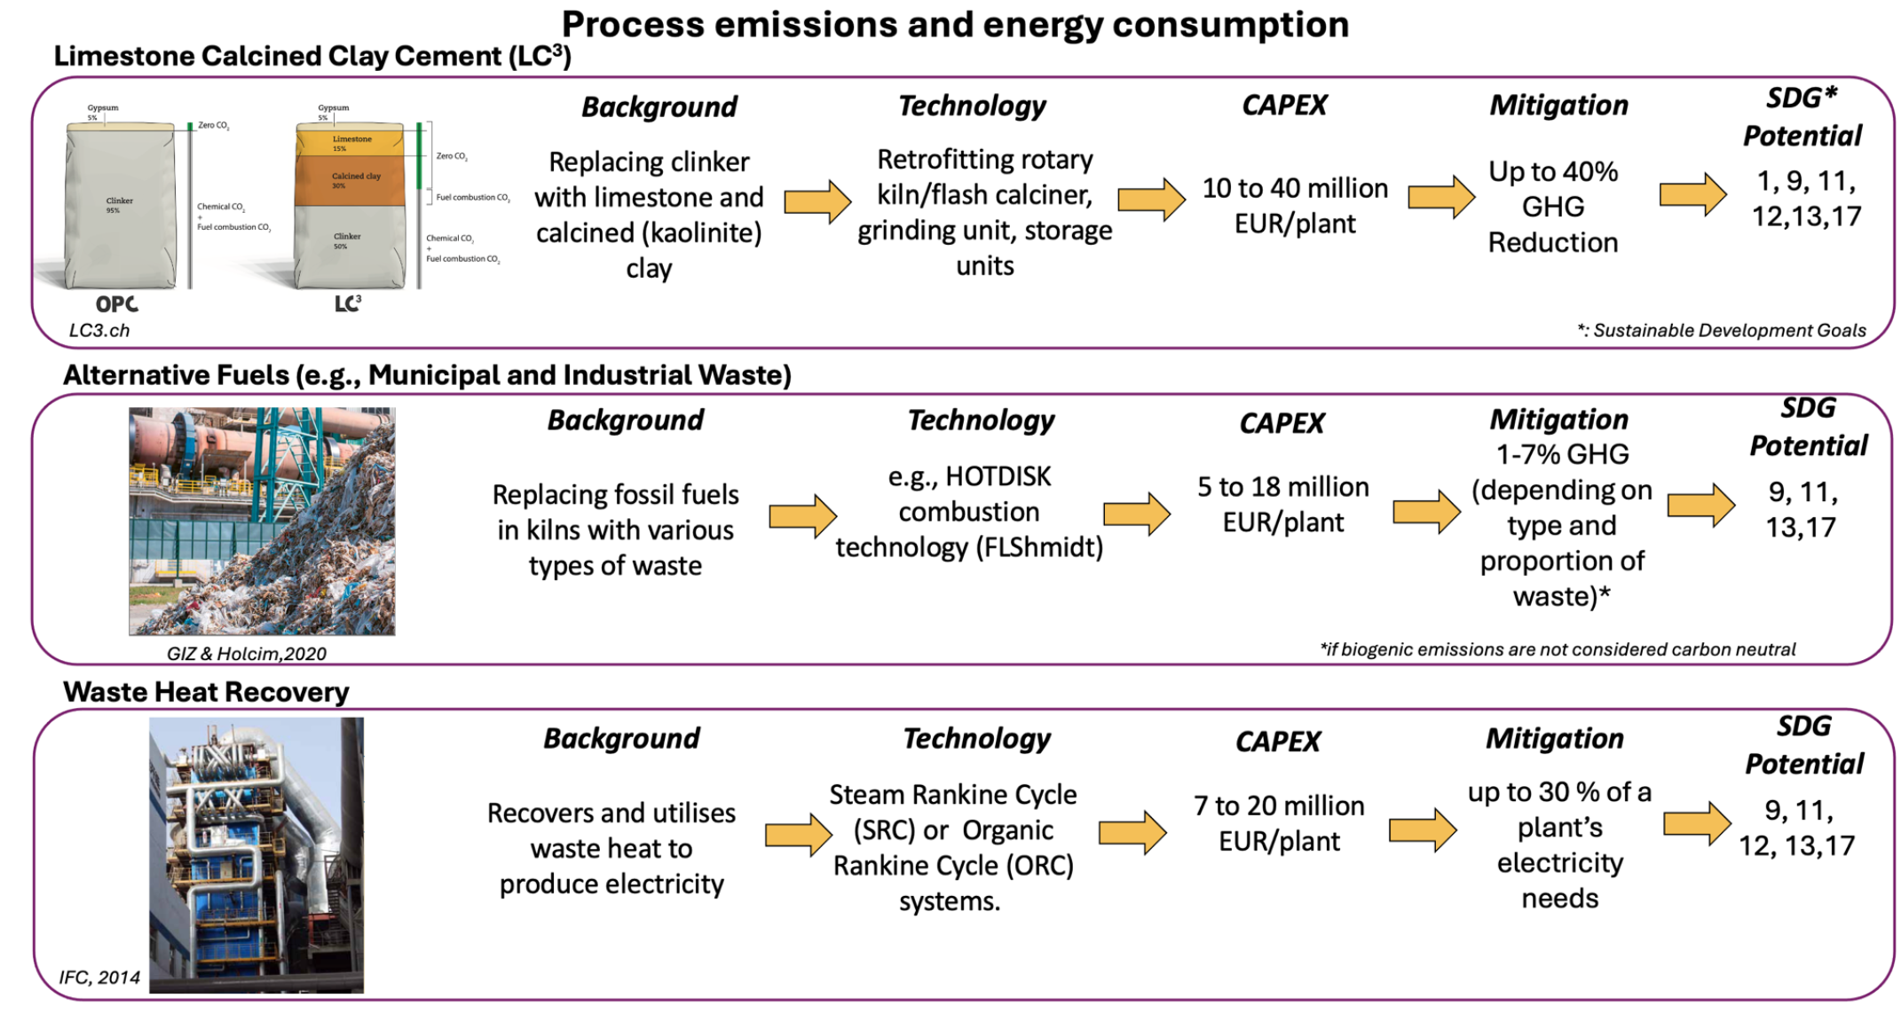

Effective pathways to Decarbonise Cement NOW
The most effective way to decarbonise the cement sector TODAY is through Limestone Calcined Clay Cement (LC3)

Slide 4
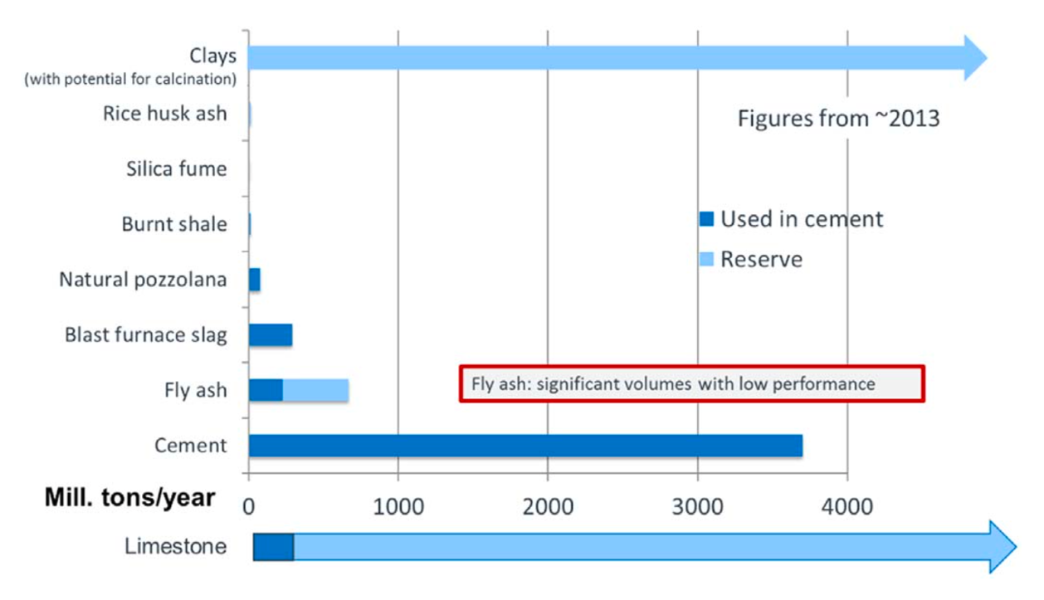
Supplementary Cementitious Materials
SCMs: Reducing the clinker factor to decrease CO2 emissions by adding SCMs.
Types of SCMs: Fly ash, blast furnace slag, natural pozzolan, silica fume, rice husk ash.
Challenge: lack of sufficient high quality SCMs to reduce the clinker factor.
Alternative: Kaolinite-bearing clays which are calcined at 700-850°C + an addition of a small percentage of limestone.
LC3: Limestone Calcined Clay Cement
Scrivener et al., 2018 Cement and Concrete Research

Slide 5
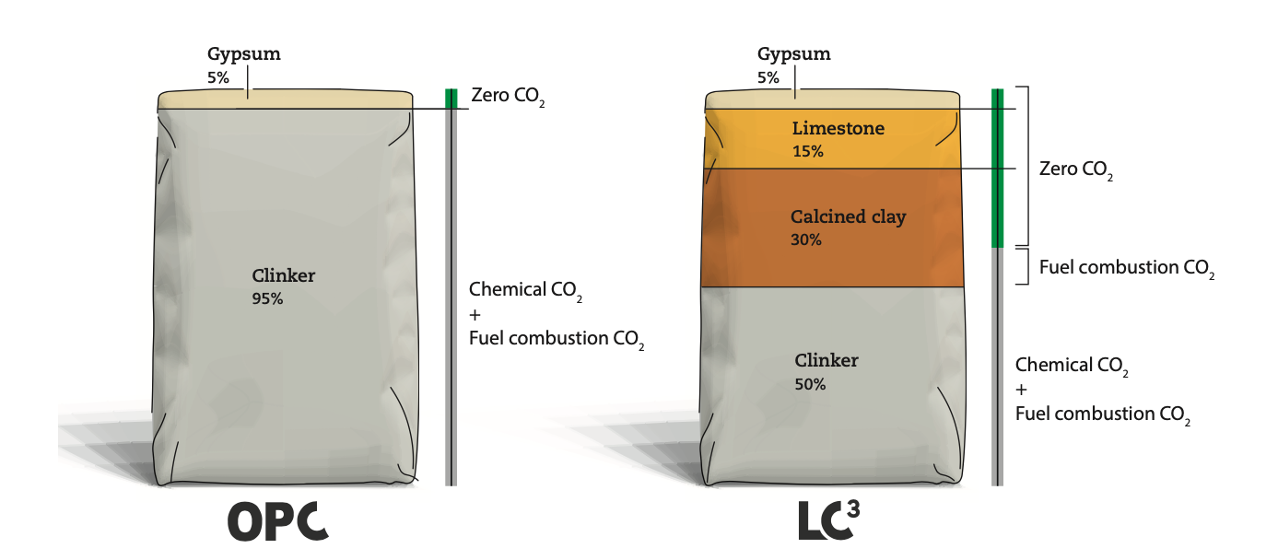
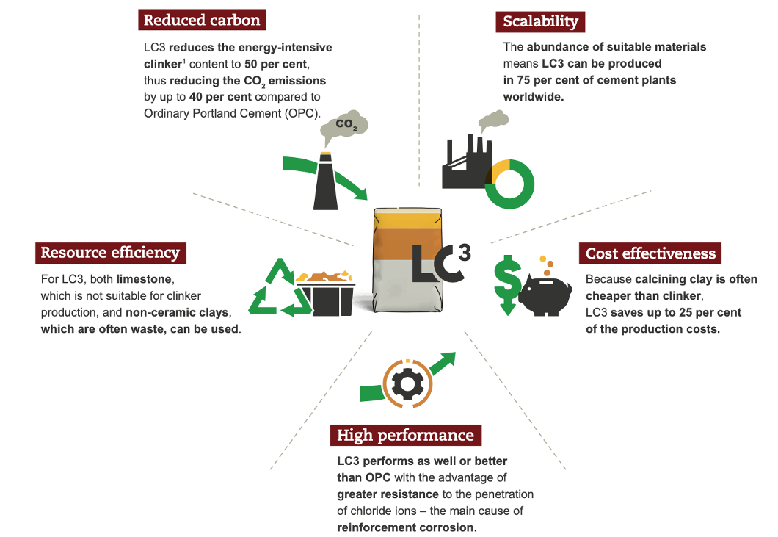
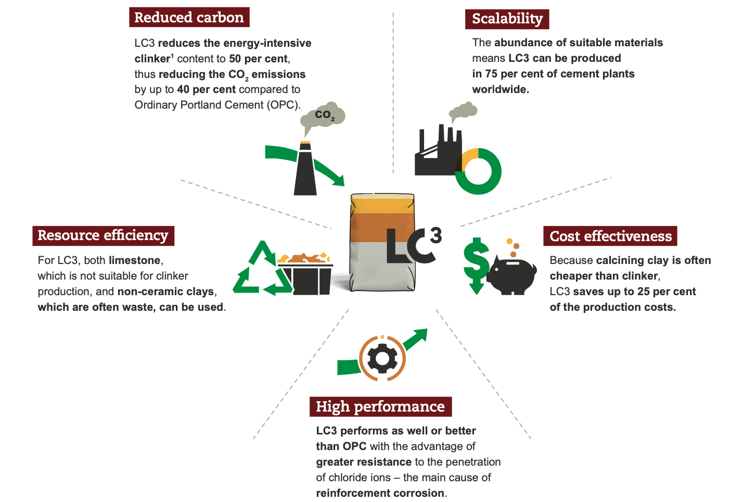
LC3 versus OPC
Up to 40% decrease in GHG emissions (LC3-50)
Up to 25% cheaper to produce
LC3 can decrease infrastructure costs substantially
LC3.ch, 2022, LC3: A sustainable alternative for the cement industry, 2022
High upfront costs requires Concessional and Carbon Finance
Zunino & Scrivener October 2025 CBM: LC3 with 25-35% clinker shows potential for high strength and general use cement.

Slide 6
An Enabling Environment for Low-Clinker Cement and Concrete
Target:
Address demand-side barriers to unlock private & public sector investments.
Barrier 1
Development and Adoption of Standards
Barrier 2
Green Building Code Amendments
Barrier 3
Green Public Procurement Reform
Update cement and concrete standards to allow for the use of low-clinker cements. E.g., EN 197-5, PS 5586:2023, ASTM C595, IS 18189:2023.
Updating Building Codes to prevent the overuse of OPC and stimulate the use of low-clinker cements/concrete.
Green Public Procurement criteria to prioritize the use of low-clinker cements and concrete.
For transformational change that attracts financing opportunities, commitment from relevant authorities who develop and implement standards, building codes and procurement policies is essential. This would strengthen the case of cement companies to access financing.

Slide 7

Financing: Getting Started

Slide 8
Cement Sector Experience under CDM
406 projects developed worldwide:
Clinker Substitution
Energy Efficiency
Waste Heat Recovery
Waste Heat Recovery at Attock Cement Plant (Baluchistan)
GHG methodologies well developed over the years:
e.g., ACM0003, AMSIII.Q,
Waste co-processing remains a key methodological challenge!
Cement is a key sector through which Carbon Finance can be efficiently implemented as every part of the value chain can be easily monitored (MRV), ensuring transparency and high integrity of internationally transferred mitigation outcomes (ITMOS) delivered.
CDM Pipeline Database, filtered for Projects which have been validated, registered. (as of December 2024)

Slide 9
Financing pathways for the cement sector
In 2024, MOCC&EC published the Carbon Market Guidelines. A Carbon Market Watch Group (CMWG) and a digital National Carbon Registry will be developed to facilitate the implementation of Article 6 projects.
Cement Decarbonisation Project
SPAR6C ToolBox : Screening and developing Article 6 activities
Not Viable under current market conditions
MDBs, DFIs wishing to catalyse private sector investments
Concessional Finance
Bilateral partners willing to purchase ITMOs
Article 6 – Carbon Finance
Grant (Technical Assistance)

Slide 10
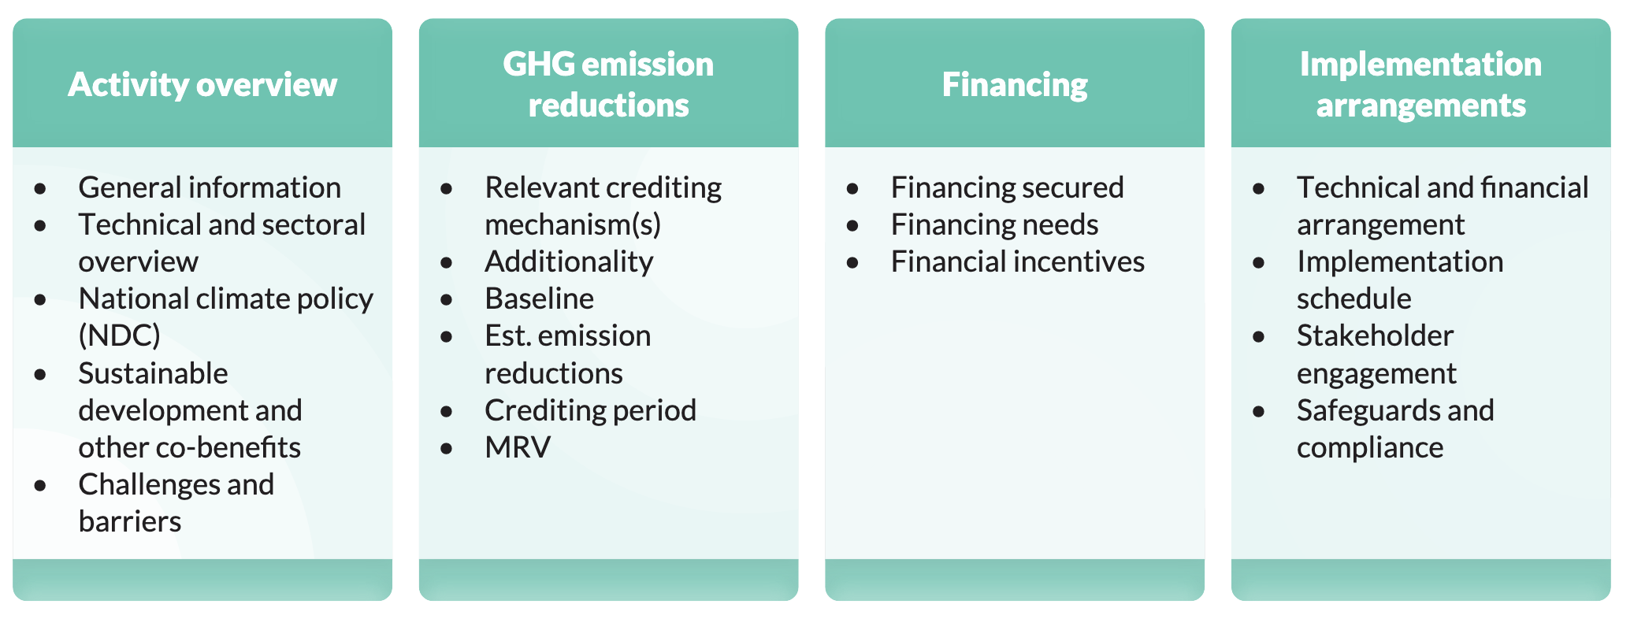
Step 1: Project Idea Note (PIN)*
* Also called Mitigation Activity Idea Note (MAIN)
Identify all costs and revenue streams: Capex, Opex, Revenue, Energy/Tax Savings
Assessment of Financial viability and demonstration of Additionality.
PIN can then be shared with potential ITMO-acquiring parties as well as MoCC&EC (NDA - National Designated Authority) for approval and issuance of a Letter of Intent.
See Annex 1 & 2 of the Carbon Market Guidelines & Chapter 3 of the Screening and Developing Article 6 Activities

Slide 11
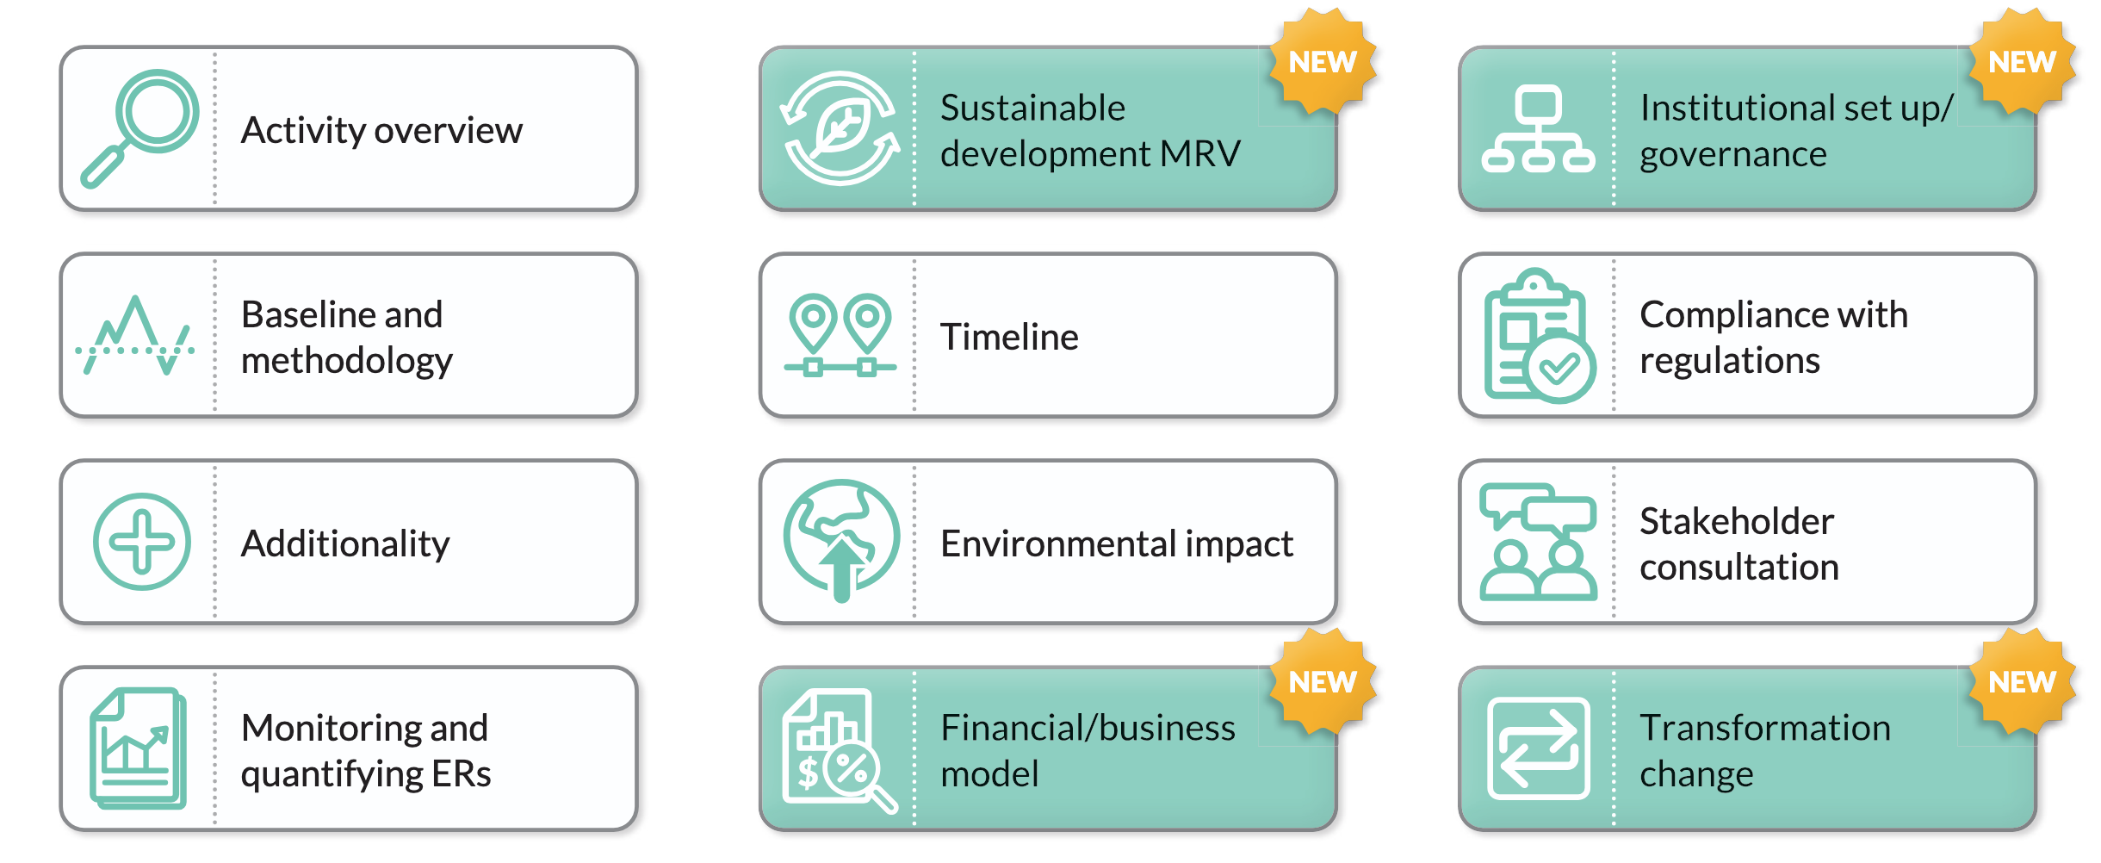
Step 2: Project Design Document**
** Also called Mitigation Activity Design Document (MADD)
This is a fully developed PIN. This updated PDD has additional (NEW) requirements compared to CDM.
Important: Needs to be in line with NDC, align with Government Sustainable Development Policies and needs to show a transformational change.
ITMO-buying entities (donor countries) and private foundations can provide upfront financing for the development of a full PDD with the help of external consultants.
Chapter 4 of the Screening and Developing Article 6 Activities

Slide 12
Step 3 & 4: Validation and Implementation
Step 3: Validation & Approval
The project will be validated by qualified, independent third-party auditors – Designated operational entities (DOE). This step, where costs vary substantially based on the project, assess the validity of the assumptions and calculations + sustainable development co-benefits.
Only once the PDD is validated can the project be approved and then implemented.
Typical challenges for validation include : lack of engagement with all stakeholders, insufficient evidence for additionality, MRV is unclear, and unclear baseline.
Step 4: Implementation and MRV
Ensuring transparency and high integrity of internationally transferred mitigation outcomes (ITMOS) requires a well-designed Monitoring activity for GHG emissions and good QA/QC.
Chapter 5 & 8 of the Screening and Developing Article 6 Activities

Slide 13

Long-term Vision: Sectoral Approach
Certain ITMO-buying entities are interested in transformative sector-wide projects.
II) Based on pilot-projects implemented, expanding to a Cement Sectoral Approach could be possible.
Concessional Finance
(MDBs, IFDs)
Sectoral Financing Instrument for Green Cements
WHR
Waste
PDD, letter of no objection
Carbon Finance from ITMO-buying entities
LC3
Solar PV/BESS
Request upfront grant financing (TA) to address demand-side levers/barriers.
Carbon Payment
(X USD/Ton)
Emission Reduction Units, Standardized GHG Monitoring System
iii) A Sectoral Financing Instrument would simplify submission process per individual project.
IV) Establishing a mandatory, standardized GHG monitoring system, along with developing a sector-wide Marginal Abatement Cost Curve (MACC) would ensure data consistency & investment prioritization.

Slide 14
Thank you
Contact information
Dr. Anders McCarthy
Heat International
mccarthyanders@gmail.com

