Slide 1


Intro to SPAR6C and Article 6 Carbon Markets
Webinar Series: Article 6 Capacity Building for Industrial Partners in Pakistan
Denis Machnik
Senior Advisor Carbon Markets
UNEP Copenhagen Climate Centre

Slide 2













Program Structure and Results
Leading Partner:
Supporting Partners:
Colombia
Pakistan
Thailand
Zambia
Country Partners:
Ministry of Environment and Sustainable Development
Ministry of Climate Change and Environmental Coordination
Ministry of Natural Resources and Environment
Ministry of Green Economy and Environment
Funding Partners:

Slide 3
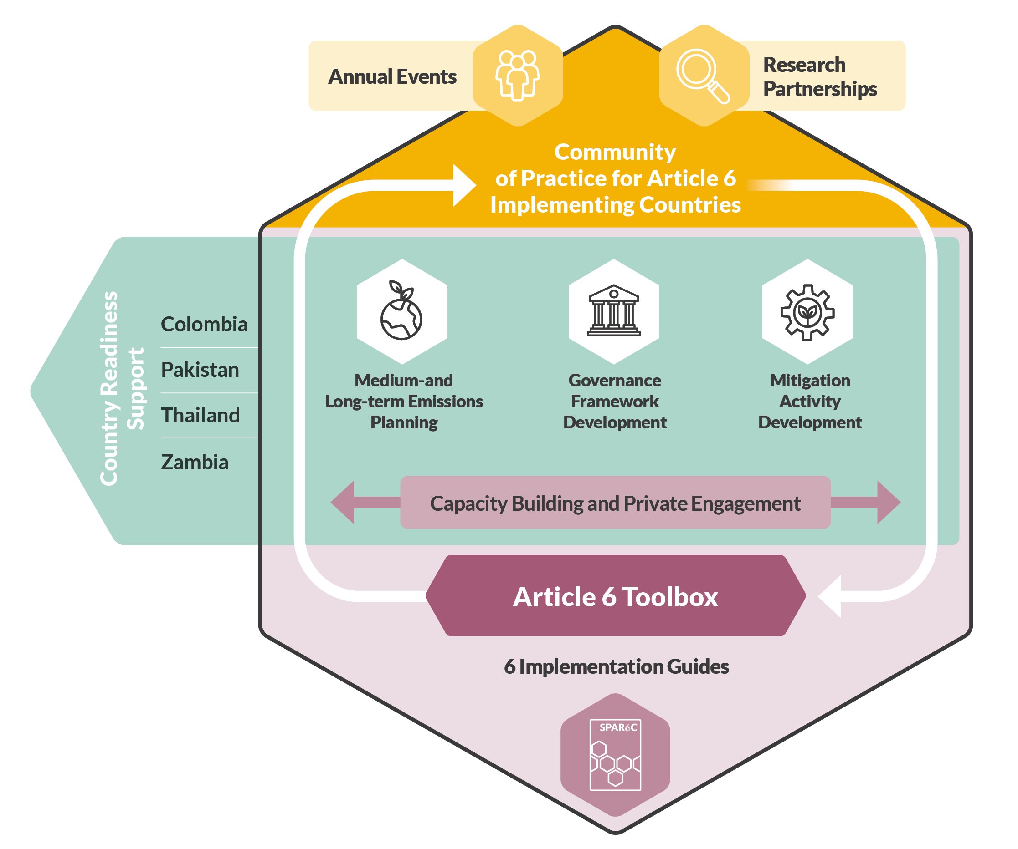

SPAR6C Program Activities
6
interlinked work packages
4 in-country
2 global
Emphasizes capacity building and knowledge exchange
Download the ToolboxA6 | SPAR6C

Slide 4
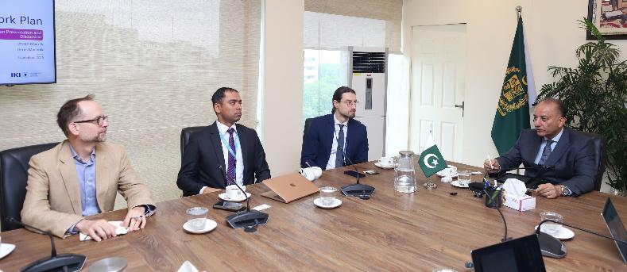
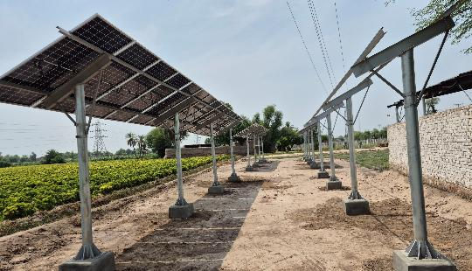
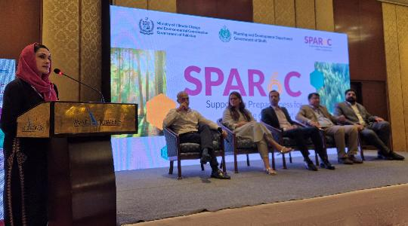
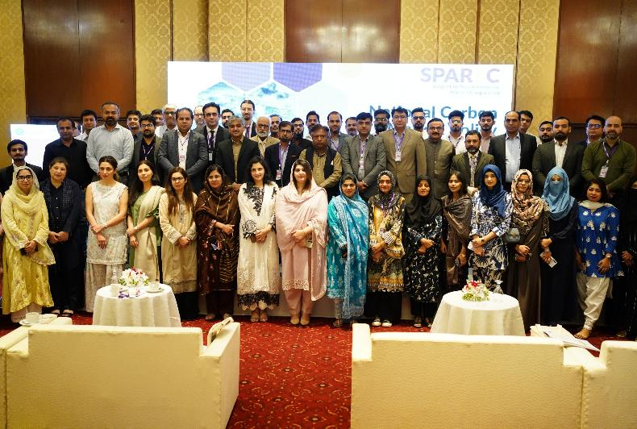
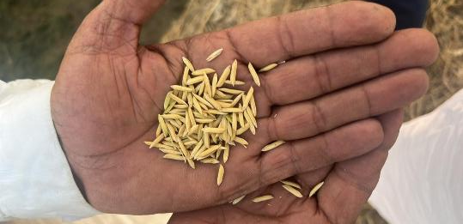

Our work in Pakistan
  Opening of the Carbon Market office at MoCC
  Development of 3 Sectoral studies
  Development of 16 Project ideas note (MAINs) for consideration as Article 6 activity
  Support to the MoCC on operationalizing Carbon Market Guidelines and Rules
  Capacity Building for the public and private sector in Pakistan
  Development of 3 projects into Article 6 activities: Lakhodair Landfill, E-Rickshaws and Rice Cultivation

Slide 5
Carbon Market Landscape
Corporate carbon offsets
Article 6 Carbon Markets: 6.2 bilateral cooperation and 6.4 market mechanism
International
CORSIA
Independent Crediting Mechanisms (Gold Standard, VCS, etc.)
Offsetting compliance
Domestic or governmental mechanisms
Regional Certification mechanisms (e.g. EU CRCF)
Domestic
ETS-Linkages
Voluntary
Compliance
Supply
Demand

Slide 6

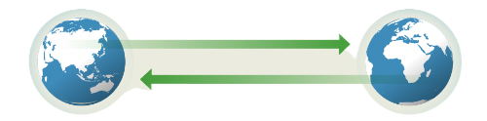


Article 6.2 – Bilateral Cooperation
Host country transfers Article 6.2 units (ITMOs) to buyer country through a bilateral agreement
Article 6.2 Units (ITMOS)
Financial Support
Host Country/Project Developer
Buyer Country/Entity
Decentralized approach, allowing G2G cooperation in climate change mitigation
All Emission reductions must be accounted for
High-priority to avoid double counting in two national GHG inventories

Slide 7

Article 6.4 – Market Mechanism
The Paris Agreement Crediting Mechanism (PACM)
Host country generates units through a UNFCCC centralized mechanism and transfers them to buyer country
Host Country/Project Developer
Buyer Country/Entity
Centralized approach, infrastructure provided by the UNFCCC
Project developers can participate equally to the Clean Development Mechanism
PACM may use accounting rules from Art 6.2 cooperative approaches

Slide 8
Additionality as a core concept of Carbon Markets
Additionality Tests
Regulatory
surplus
Financial / investment analysis
Barrier analysis
Common practice analysis
Activity is required by law, mandate, court order, or regulation?​
Is the activity economically and financially viable without incentives from carbon credits?
Is the activity free of obstacles to implementation? Do Barriers prevent the implementation of similar projects in the region?
Is the technology or practice an established common practice and might occur even without the credits?

Slide 9
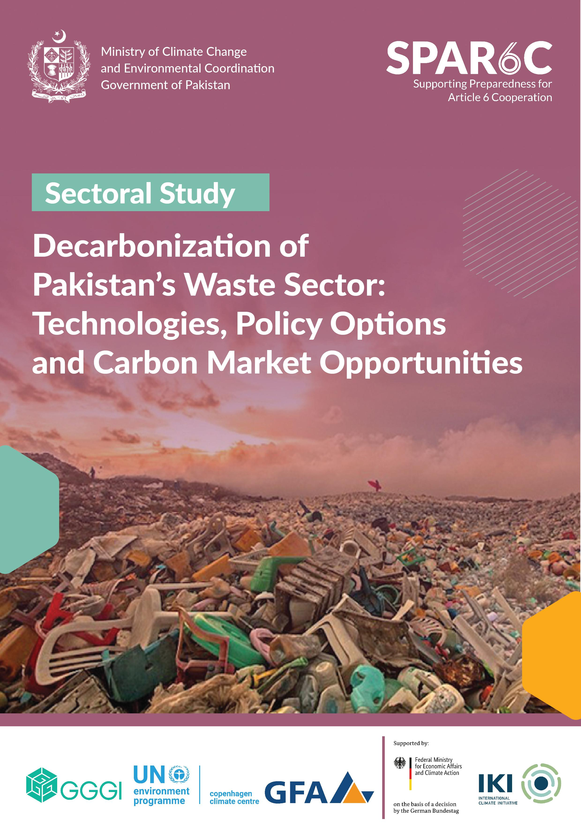
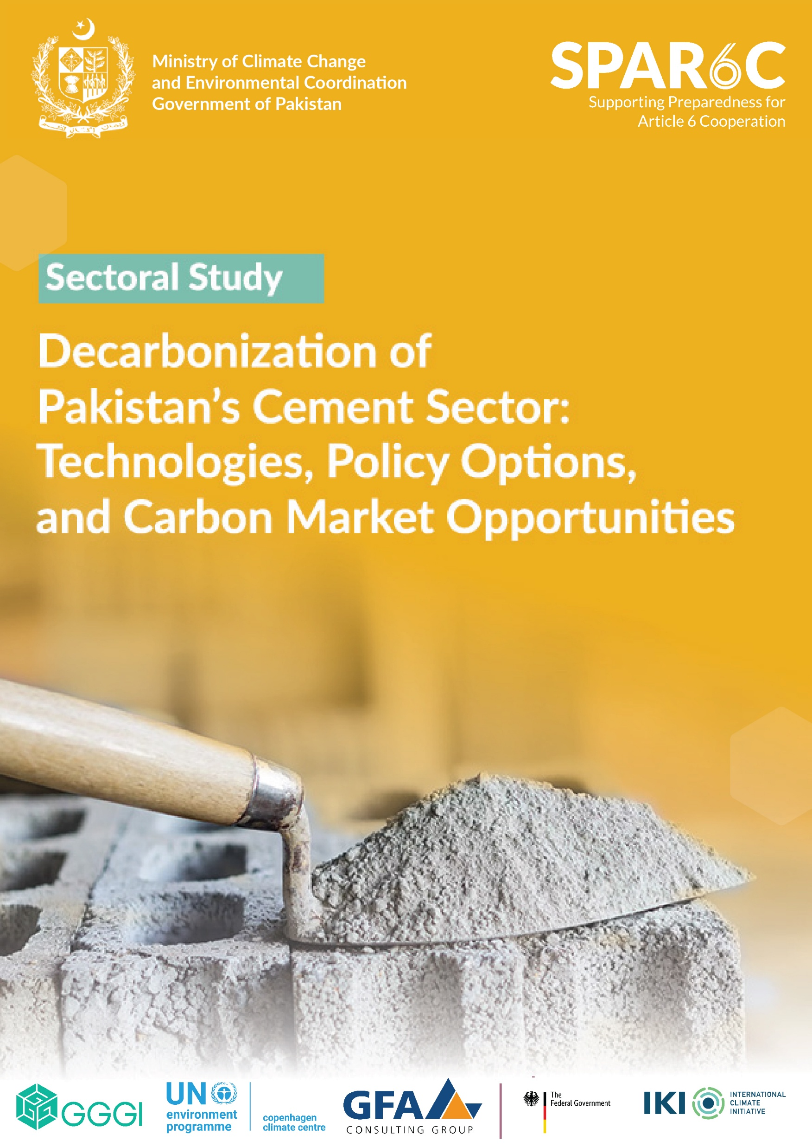
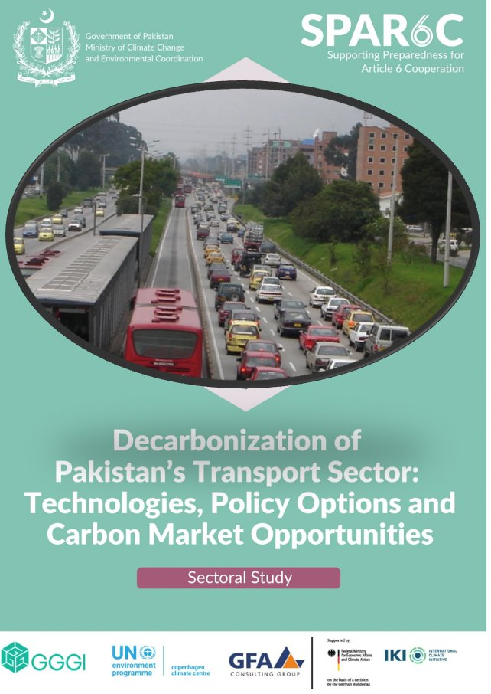


Sectoral Studies Pakistan
Decarbonisation of Pakistan’s Waste Sector: Technologies, Policy Options and Carbon Market Opportunities | SPAR6C
Decarbonisation of Pakistan’s Cement Sector: Technologies, Policy Options and Carbon Market Opportunities | SPAR6C
Publication planned for December 2025

Slide 10



Contact information
Denis Machnik
Senior Advisor Carbon Markets
Denis.Machnik@un.org
Maham Shahzadi
SPAR6C Pakistan, National Communications Consultant
mahamshahzadi73@gmail.com

